Slide 1
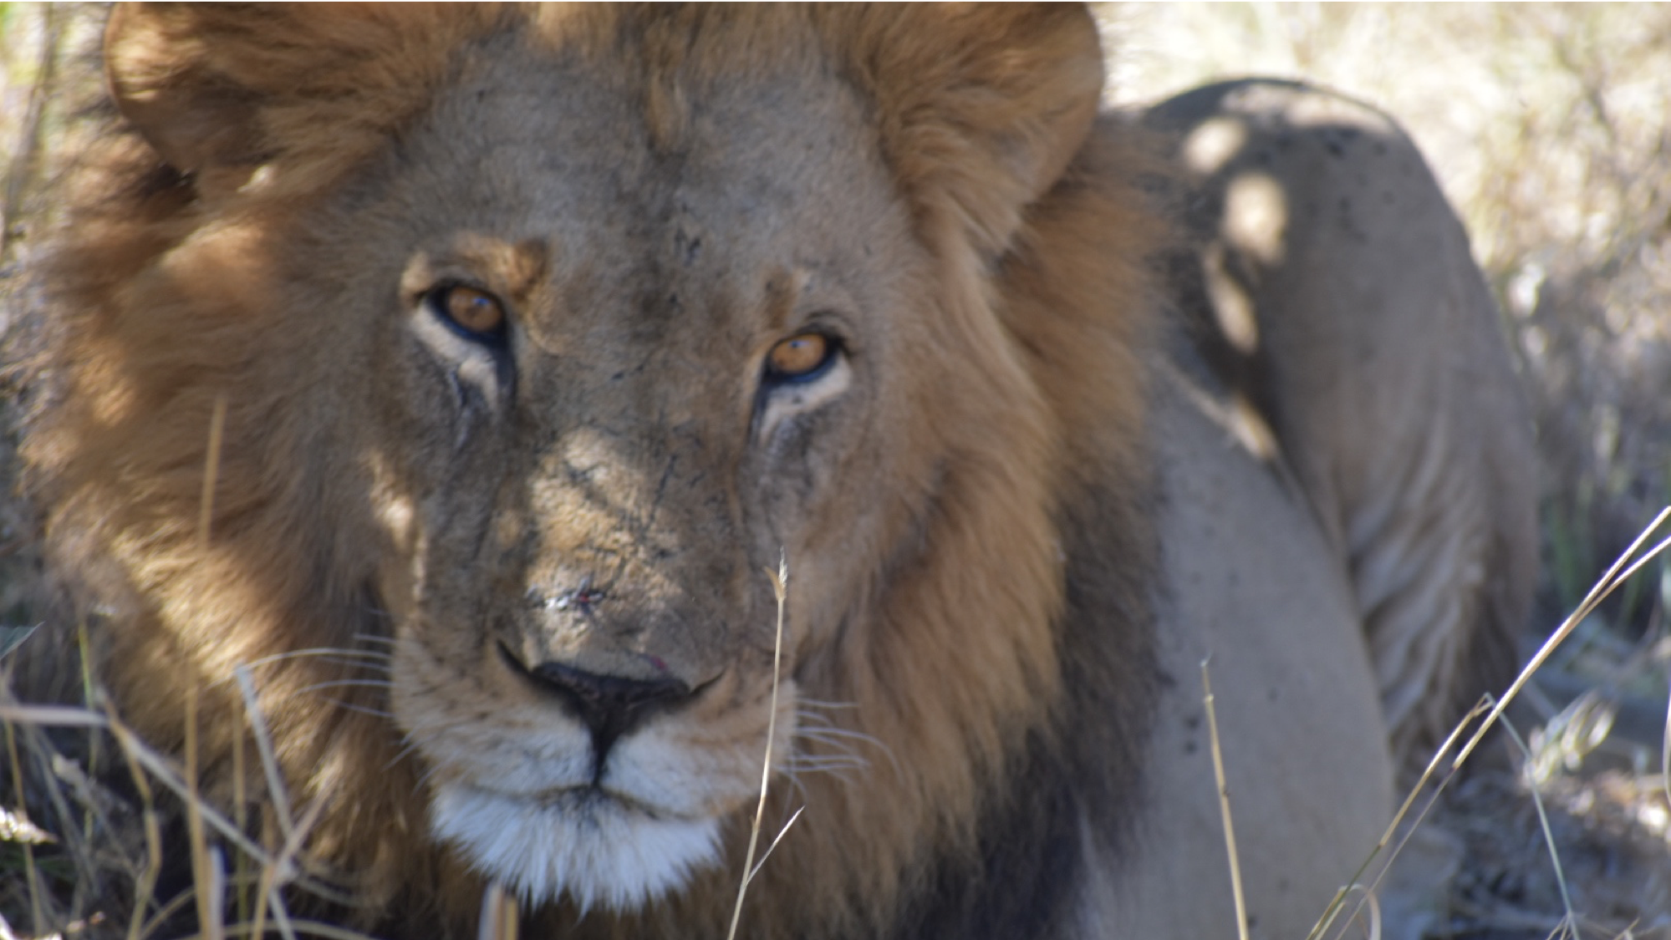
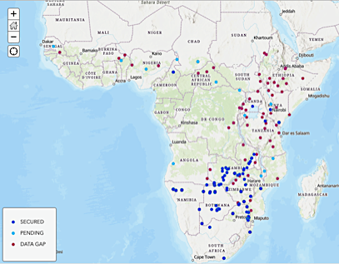
Ellie Armstrong
Stanford University
Petrov & Hadly Labs

Slide 2
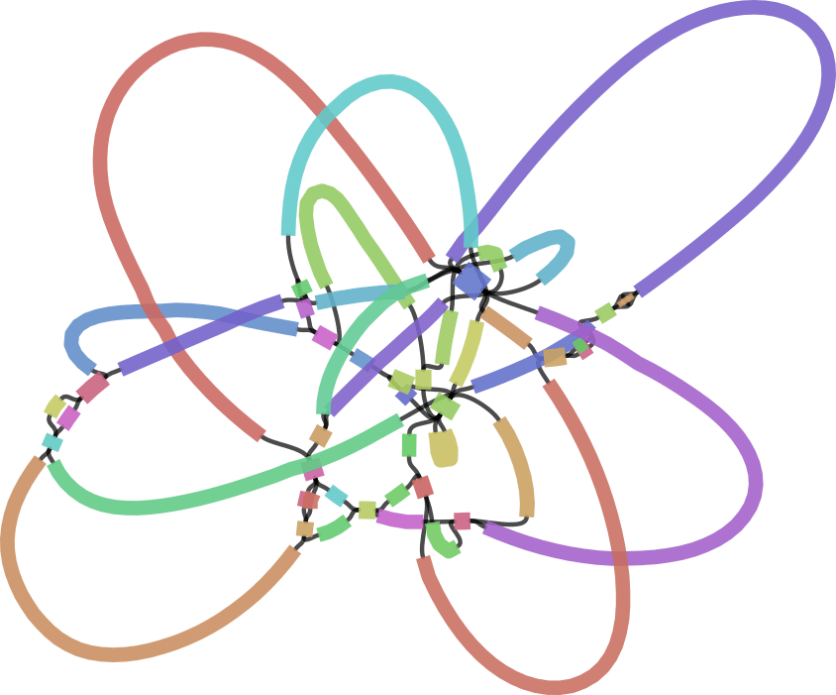

Genome Assembly
Gregg Thomas
Harvard University
@greggwcthomas
Ellie Armstrong
Stanford University
@_ellie_cat
Source: Kolmogorov et al. 2019, Nature Biotech

Slide 3
What is a genome assembly?

Slide 4

A genome assembly is a copy of the information encoded in DNA
…CGGTACAACTGGCA…
Original
Copy

Slide 5
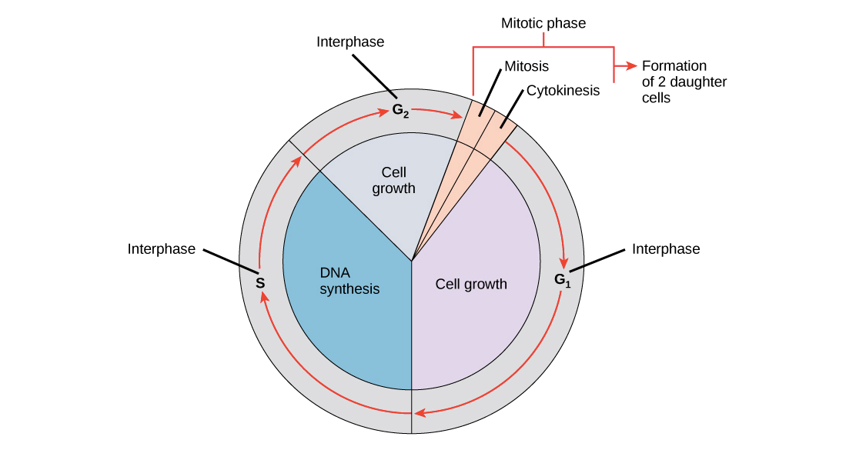
Cells are very good at making copies of their DNA
Original
Copy
Source: https://cnx.org/contents/GFy_h8cu@9.87:1tJ55Ot6@7/The-Cell-Cycle

Slide 6
Cells are very good at making copies of their DNA
Original
Copy
Humans: ~0.46 errors per cell division
Source: https://cnx.org/contents/GFy_h8cu@9.87:1tJ55Ot6@7/The-Cell-Cycle

Slide 7
It is more difficult for us to manipulate chemicals at the nano scale than it is for our cells
Difficult!
Original
Copy
Source: https://cnx.org/contents/GFy_h8cu@9.87:1tJ55Ot6@7/The-Cell-Cycle

Slide 8
Additional steps are needed for us to read the information in DNA
ATCATGTA
ATCATGTA
ATCATGTA
ATCATGTA
ATCATGTA
…CGGTACAACTGGCA…
ATCATGTA
ATCATGTA
ATCATGTA
ATCATGTA
ATCATGTA
Original
Copy

Slide 9
These steps result in high error rates
ATCATGTA
ATCATGTA
ATCATGTA
ATCATGTA
ATCATGTA
…CGGTACAACTGGCA…
ATCATGTA
ATCATGTA
ATCATGTA
ATCATGTA
ATCATGTA
Original
Copy
Sequencing error rate up to 20%!

Slide 10
A genome assembly is a hypothesis regarding the information encoded in the original DNA
ATCATGTA
ATCATGTA
ATCATGTA
ATCATGTA
ATCATGTA
…CGGTACAACTGGCA…
ATCATGTA
ATCATGTA
ATCATGTA
ATCATGTA
ATCATGTA
Original
Hypothesis
Sequencing error rate up to 20%!

Slide 11
A genome assembly is a hypothesis regarding the information encoded in the original DNA
Goal of Genome Assembly:
Accurate chromosome level representations of the original strand of DNA
ATCATGTA
ATCATGTA
ATCATGTA
ATCATGTA
ATCATGTA
…CGGTACAACTGGCA…
ATCATGTA
ATCATGTA
ATCATGTA
ATCATGTA
ATCATGTA
Original
Hypothesis
Sequencing error rate up to 20%!

Slide 12
A genome assembly is a hypothesis regarding the information encoded in the original DNA
Goal of Genome Assembly:
Accurate chromosome level representations of the original strand of DNA
ATCATGTA
ATCATGTA
ATCATGTA
ATCATGTA
ATCATGTA
…CGGTACAACTGGCA…
ATCATGTA
ATCATGTA
ATCATGTA
ATCATGTA
ATCATGTA
Original
Hypothesis
Sequencing error rate up to 20%!

Slide 13
A genome assembly is a hypothesis regarding the information encoded in the original DNA
Goal of Genome Assembly:
Accurate chromosome level representations of the original strand of DNA
ATCATGTA
ATCATGTA
ATCATGTA
ATCATGTA
ATCATGTA
…CGGTACAACTGGCA…
ATCATGTA
ATCATGTA
ATCATGTA
ATCATGTA
ATCATGTA
Original
Hypothesis
Sequencing error rate up to 20%!

Slide 14
1. | A brief history of sequencing technology
2. | de novo Assembly: reads, contigs, and scaffolds
3. | Reference-guided assembly
4. | Practical considerations for genome assembly

Slide 15
1. | A brief history of sequencing technology
2. | de novo Assembly: reads, contigs, and scaffolds
3. | Reference-guided assembly
4. | Practical considerations for genome assembly

Slide 16
Synthesizing and reading long fragments of DNA is hard
…TAGAAAACGCGATCTTACGGCGGTACATTAGGGTTCTACCCCAACCTCTTCGAGCAGTTAATGCGCGGGACGTCCGGAGTTCTCTCGCAATCTGAACATT…

Slide 17

Synthesizing and reading long fragments of DNA is hard
The Human Genome
…TAGAAAACGCGATCTTACGGCGGTACATTAGGGTTCTACCCCAACCTCTTCGAGCAGTTAATGCGCGGGACGTCCGGAGTTCTCTCGCAATCTGAACATT…

Slide 18
Synthesizing and reading long fragments of DNA is hard
x
The Human Genome
…TAGAAAACGCGATCTTACGGCGGTACATTAGGGTTCTACCCCAACCTCTTCGAGCAGTTAATGCGCGGGACGTCCGGAGTTCTCTCGCAATCTGAACATT…

Slide 19
Synthesizing and reading long fragments of DNA is hard
x
The Human Genome
…TAGAAAACGCGATCTTACGGCGGTACATTAGGGTTCTACCCCAACCTCTTCGAGCAGTTAATGCGCGGGACGTCCGGAGTTCTCTCGCAATCTGAACATT…
GGACGTCCGGA
CGGTACAT
CGGTAACTCAG
TAGAAAACGC
CTACCC

Slide 20
Synthesizing and reading long fragments of DNA is hard
x
The Human Genome
…TAGAAAACGCGATCTTACGGCGGTACATTAGGGTTCTACCCCAACCTCTTCGAGCAGTTAATGCGCGGGACGTCCGGAGTTCTCTCGCAATCTGAACATT…
GGACGTCCGGA
CGGTACAT
Sequence reads
CGGTAACTCAG
TAGAAAACGC
CTACCC

Slide 21
Reads are short fragments of sequenced DNA
Read length depends on sequencing platform
Platform | Typical read length | # of reads to cover human genome once
Sanger | 800 bp | 3.75 million
Illumina paired-end | 150 bp | 20 million
Long read technologies | 10,000 bp | 300,000

Slide 22
Reads are short fragments of sequenced DNA
Read length depends on sequencing platform
Platform | Typical read length | # of reads to cover human genome once
Sanger | 800 bp | 3.75 million
Illumina paired-end | 150 bp | 20 million
Long read technologies | 10,000 bp | 300,000
Instead of a single linear representation of DNA, we end up with many short, overlapping pieces of the original DNA

Slide 23
How do we sequence reads?
1970
1980
1990
2000
2010
2020

Slide 24
Sanger sequencing (Chain termination method)
DNA
CTGACTTCGACAA
Normal nucleotides
A
T
C
G
Modified nucleotides
A*
T*
C*
G*
DNA polymerase
Sanger
1970
1980
1990
2000
2010
2020

Slide 25

Sanger sequencing (Chain termination method)
DNA
CTGACTTCGACAA
Normal nucleotides
A
T
C
G
Modified nucleotides
A*
T*
C*
G*
DNA polymerase
Sanger
1970
1980
1990
2000
2010
2020

Slide 26
Sanger sequencing (Chain termination method)
GACTGAAGCTGTT*
DNA
CTGACTTCGACAA
GACTGAAGCTGT*
GACTGAAGCTG*
Normal nucleotides
A
T
GACTGAAGCT*
C
G
GACTGAAGC*
GACTGAAG*
Modified nucleotides
A*
T*
GACTGAA*
C*
G*
GACTGA*
GACTG*
DNA polymerase
GACT*
GAC*
GA*
G*
Sanger
1970
1980
1990
2000
2010
2020

Slide 27
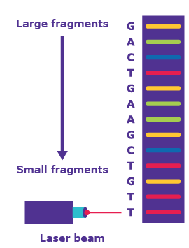
Sanger sequencing (Chain termination method)
GACTGAAGCTGTT*
GACTGAAGCTGT*
GACTGAAGCTG*
GACTGAAGCT*
GACTGAAGC*
GACTGAAG*
GACTGAA*
GACTGA*
GACTG*
GACT*
GAC*
GA*
G*
Source: https://www.sigmaaldrich.com/technical-documents/articles/biology/sanger-sequencing.html
Sanger
1970
1980
1990
2000
2010
2020

Slide 28
Sanger sequencing (Chain termination method)
GACTGAAGCTGTT*
GACTGAAGCTGT*
GACTGAAGCTG*
GACTGAAGCT*
GACTGAAGC*
GACTGAAG*
GACTGAA*
GACTGA*
GACTG*
GACT*
GAC*
GA*
G*
Source: https://www.sigmaaldrich.com/technical-documents/articles/biology/sanger-sequencing.html
Sanger
1970
1980
1990
2000
2010
2020

Slide 29
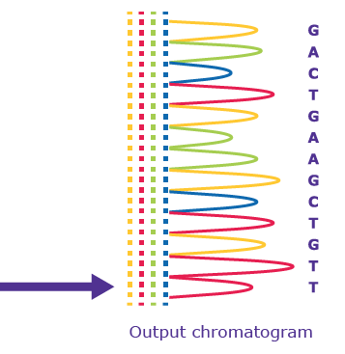
Sanger sequencing (Chain termination method)
GACTGAAGCTGTT*
GACTGAAGCTGT*
GACTGAAGCTG*
GACTGAAGCT*
GACTGAAGC*
GACTGAAG*
GACTGAA*
GACTGA*
GACTG*
GACT*
GAC*
GA*
G*
Sanger
Source: https://www.sigmaaldrich.com/technical-documents/articles/biology/sanger-sequencing.html
1970
1980
1990
2000
2010
2020

Slide 30
Sanger sequencing (Chain termination method)
GACTGAAGCTGTT*
GACTGAAGCTGT*
GACTGAAGCTG*
Sequencing by synthesis
Methods that use DNA polymerase to create a complementary DNA strand based on a template and measure some signal as bases are added
GACTGAAGCT*
GACTGAAGC*
GACTGAAG*
GACTGAA*
GACTGA*
GACTG*
GACT*
GAC*
GA*
G*
Sanger
Source: https://www.sigmaaldrich.com/technical-documents/articles/biology/sanger-sequencing.html
1970
1980
1990
2000
2010
2020

Slide 31
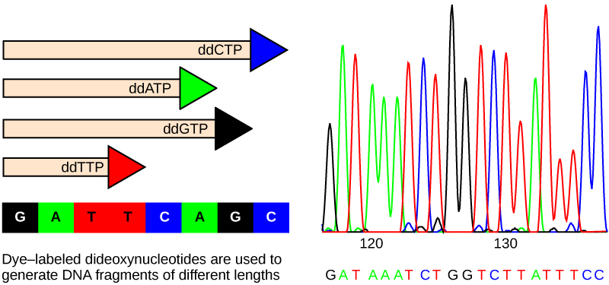
Sanger sequencing (Chain termination method)
Read length ~800bp
Very low error rate (as low as 0.001%)
Very slow (low throughput)
Sanger
1970
1980
1990
2000
2010
2020

Slide 32
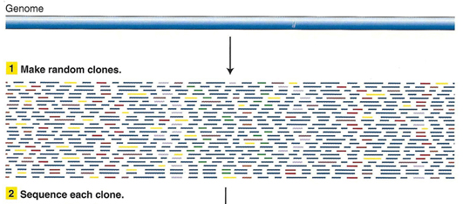
The “shotgun” method improves throughput of Sanger sequencing
Source: http://www.discoveryandinnovation.com/BIOL202/notes/lecture24.html
Sanger
1970
1980
1990
2000
2010
2020

Slide 33
The “shotgun” method improves throughput of Sanger sequencing
This introduces a problem: how do we put the small overlapping sequences back together – Genome Assembly
Source: http://www.discoveryandinnovation.com/BIOL202/notes/lecture24.html
Sanger
1970
1980
1990
2000
2010
2020

Slide 34

Sanger sequencing was the driver behind the first generation of sequenced genomes
The human genome (completed in 2003) used whole-genome “shotgun” Sanger sequencing and sequencing of bacterial artificial chromosomes (BACs).
D. melanogaster
Source: https://en.wikipedia.org/wiki/Human_Genome_Project
Yeast
C. elegans
First bacterial genomes sequenced
Human Genome Sequenced
Sanger
1970
1980
1990
2000
2010
2020

Slide 35
Second generation sequencing increased throughput
Detect signal as nucleotides are added to template DNA
Affix template DNA to physical media (beads, flowcells) with adapters to facilitate localized amplification
Human Genome Sequenced
Sanger
1970
1980
1990
2000
2010
2020

Slide 36
454 Pyrosequencing
Affix DNA to beads and synthesize with DNA polymerase
Detect sequence by light that is emitted as DNA is synthesized (no need to terminate the chain)
Source: Heather and Chain 2016, Genomics
454
Human Genome Sequenced
Sanger
1970
1980
1990
2000
2010
2020

Slide 37
454 Pyrosequencing
Affix DNA to beads and synthesize with DNA polymerase
Detect sequence by light that is emitted as DNA is synthesized (no need to terminate the chain)
454
Human Genome Sequenced
Source: Heather and Chain 2016, Genomics
Sanger
1970
1980
1990
2000
2010
2020

Slide 38
Illumina sequencing
Affix DNA to flowcells and synthesize with DNA polymerase
Source: Heather and Chain 2016, Genomics
Solexa (now Illumina)
454
Human Genome Sequenced
Sanger
1970
1980
1990
2000
2010
2020

Slide 39
Illumina sequencing
Affix DNA to flowcells and synthesize with DNA polymerase
Detect sequence by light that is emitted as DNA is synthesized (no need to terminate the chain)
Solexa (now Illumina)
454
Source: Heather and Chain 2016, Genomics
Human Genome Sequenced
Sanger
1970
1980
1990
2000
2010
2020

Slide 40
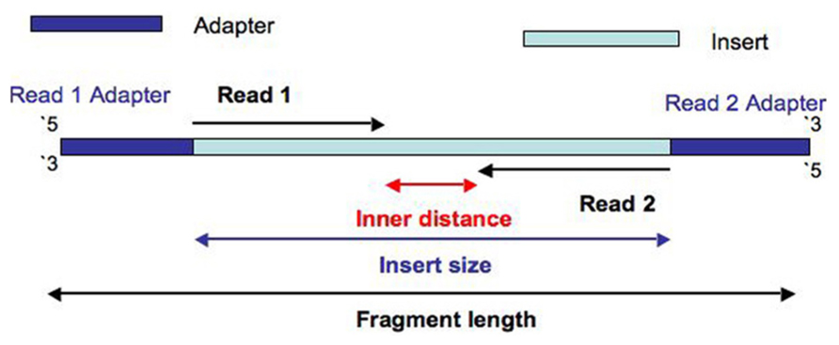
Illumina paired-end sequencing
Affix DNA to flowcells and synthesize with DNA polymerase
Detect sequence by light that is emitted as DNA is synthesized (no need to terminate the chain)
Source: https://thesequencingcenter.com/knowledge-base/what-are-paired-end-reads/
Solexa (now Illumina)
454
Human Genome Sequenced
Sanger
1970
1980
1990
2000
2010
2020

Slide 41
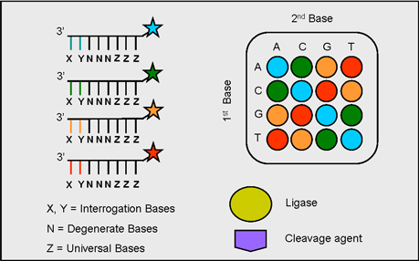
SOLiD sequencing
Affix DNA to beads and ligate di-nucleotide pairs
Detect sequence with 2-base encoding by light that is emitted as DNA is ligated
Solexa (now Illumina)
454
Human Genome Sequenced
SOLiD
Sanger
1970
1980
1990
2000
2010
2020

Slide 42
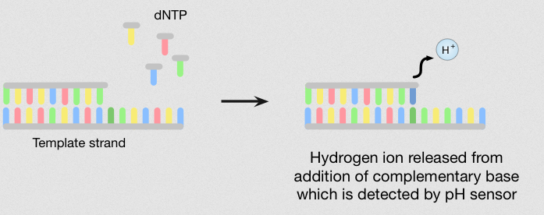
Ion Torrent
Source: https://www.atdbio.com/content/58/Next-generation-sequencing
Affix DNA to beads and synthesize with DNA polymerase
Detect sequence by changes in pH that result from H⁺ ions being released during polymerization
Solexa (now Illumina)
454
Human Genome Sequenced
Ion Torrent
SOLiD
Sanger
1970
1980
1990
2000
2010
2020

Slide 43
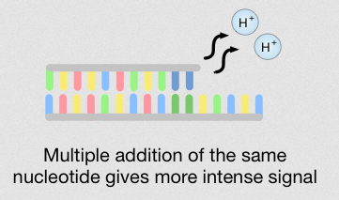
Ion Torrent
Source: https://www.atdbio.com/content/58/Next-generation-sequencing
Affix DNA to beads and synthesize with DNA polymerase
Detect sequence by changes in pH that result from H⁺ ions being released during polymerization
Solexa (now Illumina)
454
Human Genome Sequenced
Ion Torrent
SOLiD
Sanger
1970
1980
1990
2000
2010
2020

Slide 44
Third generation sequencing promises longer, higher quality assemblies
Solexa (now Illumina)
454
Human Genome Sequenced
Sanger
1970
1980
1990
2000
2010
2020

Slide 45
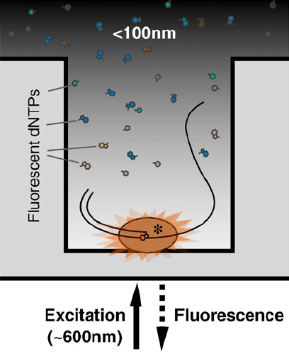
PacBio single molecule real-time sequencing (SMRT)
Affix the polymerase to the bottom of a well, the diameter of which is smaller than the wavelength of light emitted by the fluorescent dNTPs
Solexa (now Illumina)
Source: Heather and Chain 2016, Genomics
454
Human Genome Sequenced
PacBio SMRT
Sanger
1970
1980
1990
2000
2010
2020

Slide 46
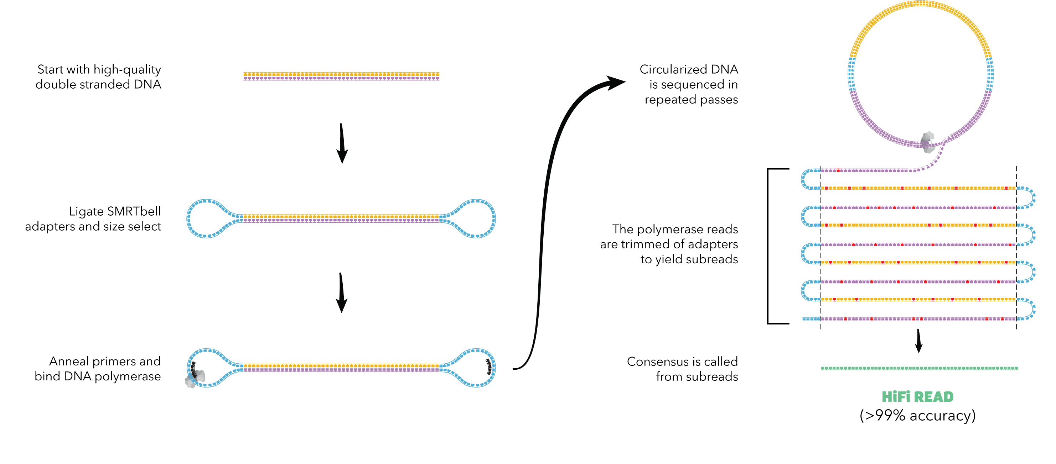
PacBio single molecule real-time sequencing (SMRT)
https://www.pacb.com/smrt-science/smrt-sequencing/hifi-reads-for-highly-accurate-long-read-sequencing/
Solexa (now Illumina)
Source: Heather and Chain 2016, Genomics
454
Human Genome Sequenced
PacBio SMRT
Sanger
PacBio HiFi
1970
1980
1990
2000
2010
2020

Slide 47
Oxford nanopore
No amplification or modification of DNA required
Electric current is monitored as DNA is fed through a pore in a membrane
Solexa (now Illumina)
Oxford Nanopore
454
Source: Heather and Chain 2016, Genomics
Human Genome Sequenced
PacBio SMRT
Sanger
PacBio HiFi
1970
1980
1990
2000
2010
2020

Slide 48
Sequencing technology overview
Technology | Read length | Error rate | Sources of error | Active?
Sanger | ~800bp | 0.001% |  | Y
454 | 700bp | 1% | No temporary chain termination makes homopolymers difficult to resolve Incomplete cleaning of wells between cycles can generate noise | N
Illumina | 150bp | 1-2.5% | Errors increase towards end of reads due to dephasing | Y
SOLiD | 75bp | 0.06% |  | N
Ion Torrent | 200bp | 1.5-4.5% | Signal degradation occurs during sequencing of homopolymers | Y
PacBio SMRT | 10-300kbp | 13-15% | random | Y
PacBio HiFi | 10-300kbp | <1% | random | Y
Oxford Nanopore R9.4.1 |  | 1-5% | homopolymers
Oxford Nanopore R10.4.1 | 10-20kbp, up to 100kbp | <=1% | homopolymers, but less in new flow cells | Y

Slide 49

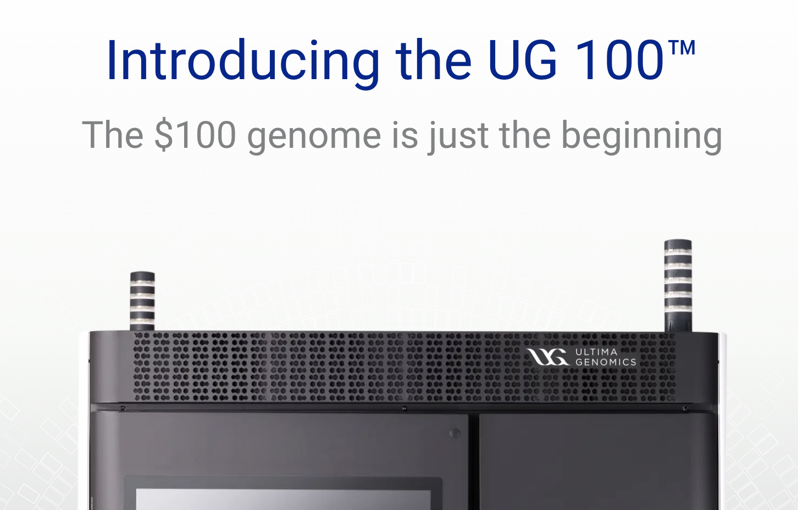

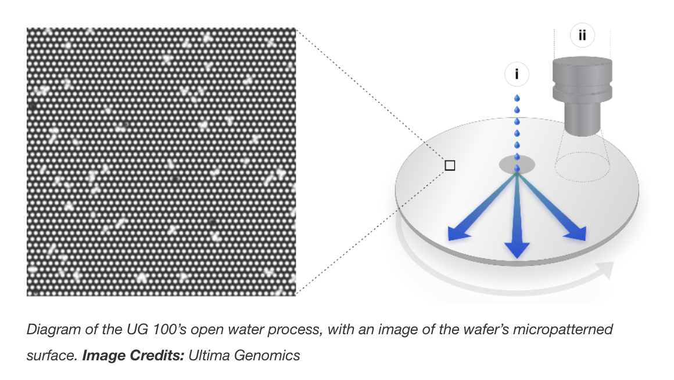
The New Kids on the Block

Slide 50
1. | A brief history of sequencing technology
2. | de novo Assembly: reads, contigs, and scaffolds
3. | Reference-guided assembly
4. | Practical considerations for genome assembly

Slide 51
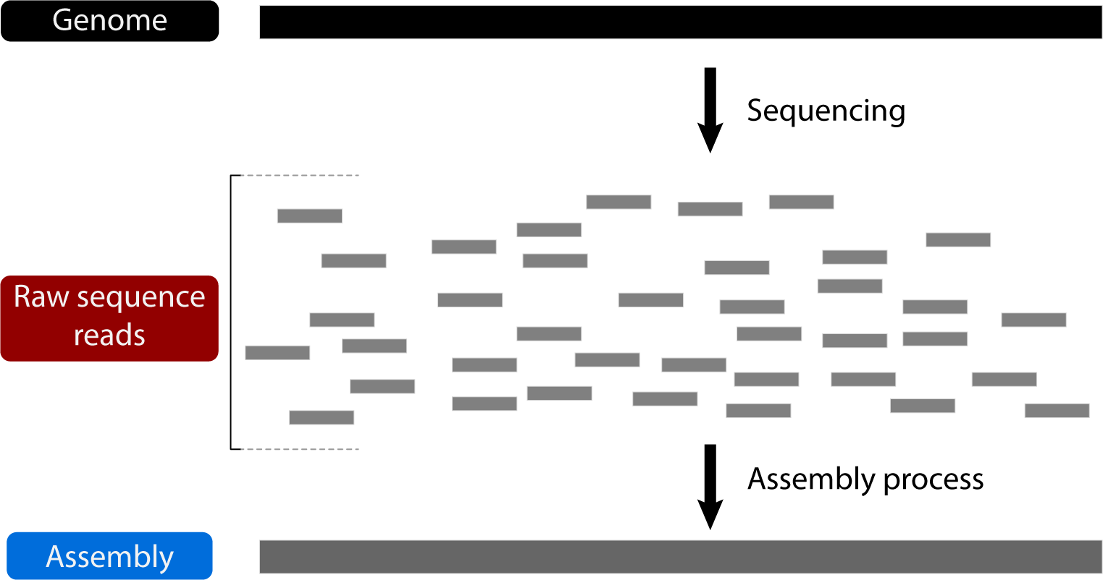
How do we reconstruct the genome from reads?

Slide 52
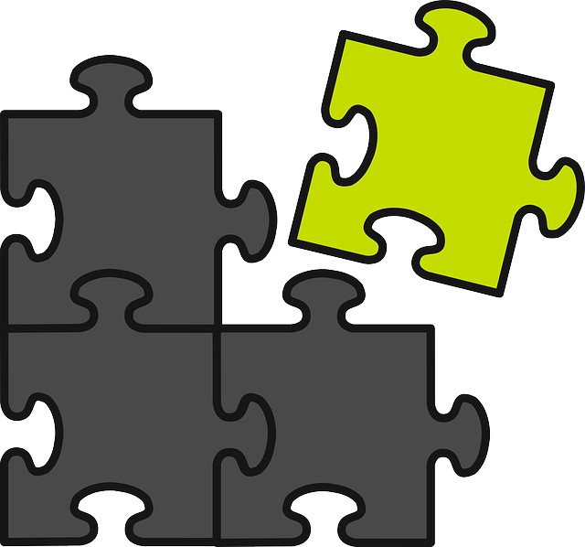
How do we reconstruct the genome from reads?

Slide 53
How do we reconstruct the genome from reads?
x
Overlapping pieces

Slide 54
How do we reconstruct the genome from reads?
x
Overlapping pieces
We don’t know the original sequence

Slide 55
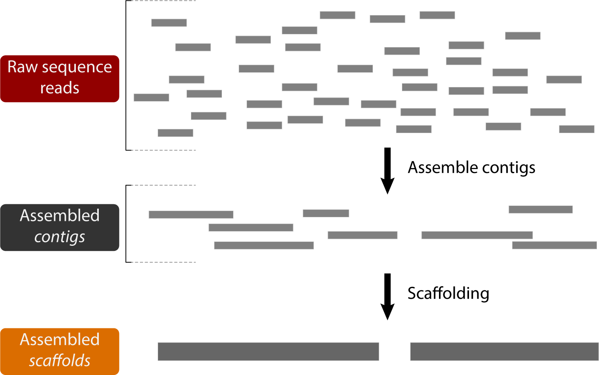
How do we reconstruct the genome from reads?

Slide 56
How do we reconstruct the genome from reads?
A contig (short for contiguous) is a sequence that has been generated by assembling reads

Slide 57
How do we reconstruct the genome from reads?
A contig (short for contiguous) is a sequence that has been generated by assembling reads
A scaffold is made up of adjacent contigs separated by gaps (stretches of Ns)

Slide 58
How do we assembly contigs from reads?
?

Slide 59
Two main classes of contig assembly algorithms
Source: http://www.cs.jhu.edu/~langmea/resources/lecture_notes/20_assembly_scaffolding_v2.pdf

Slide 60
Two main classes of contig assembly algorithms
Graph based algorithms
Source: http://www.cs.jhu.edu/~langmea/resources/lecture_notes/20_assembly_scaffolding_v2.pdf

Slide 61
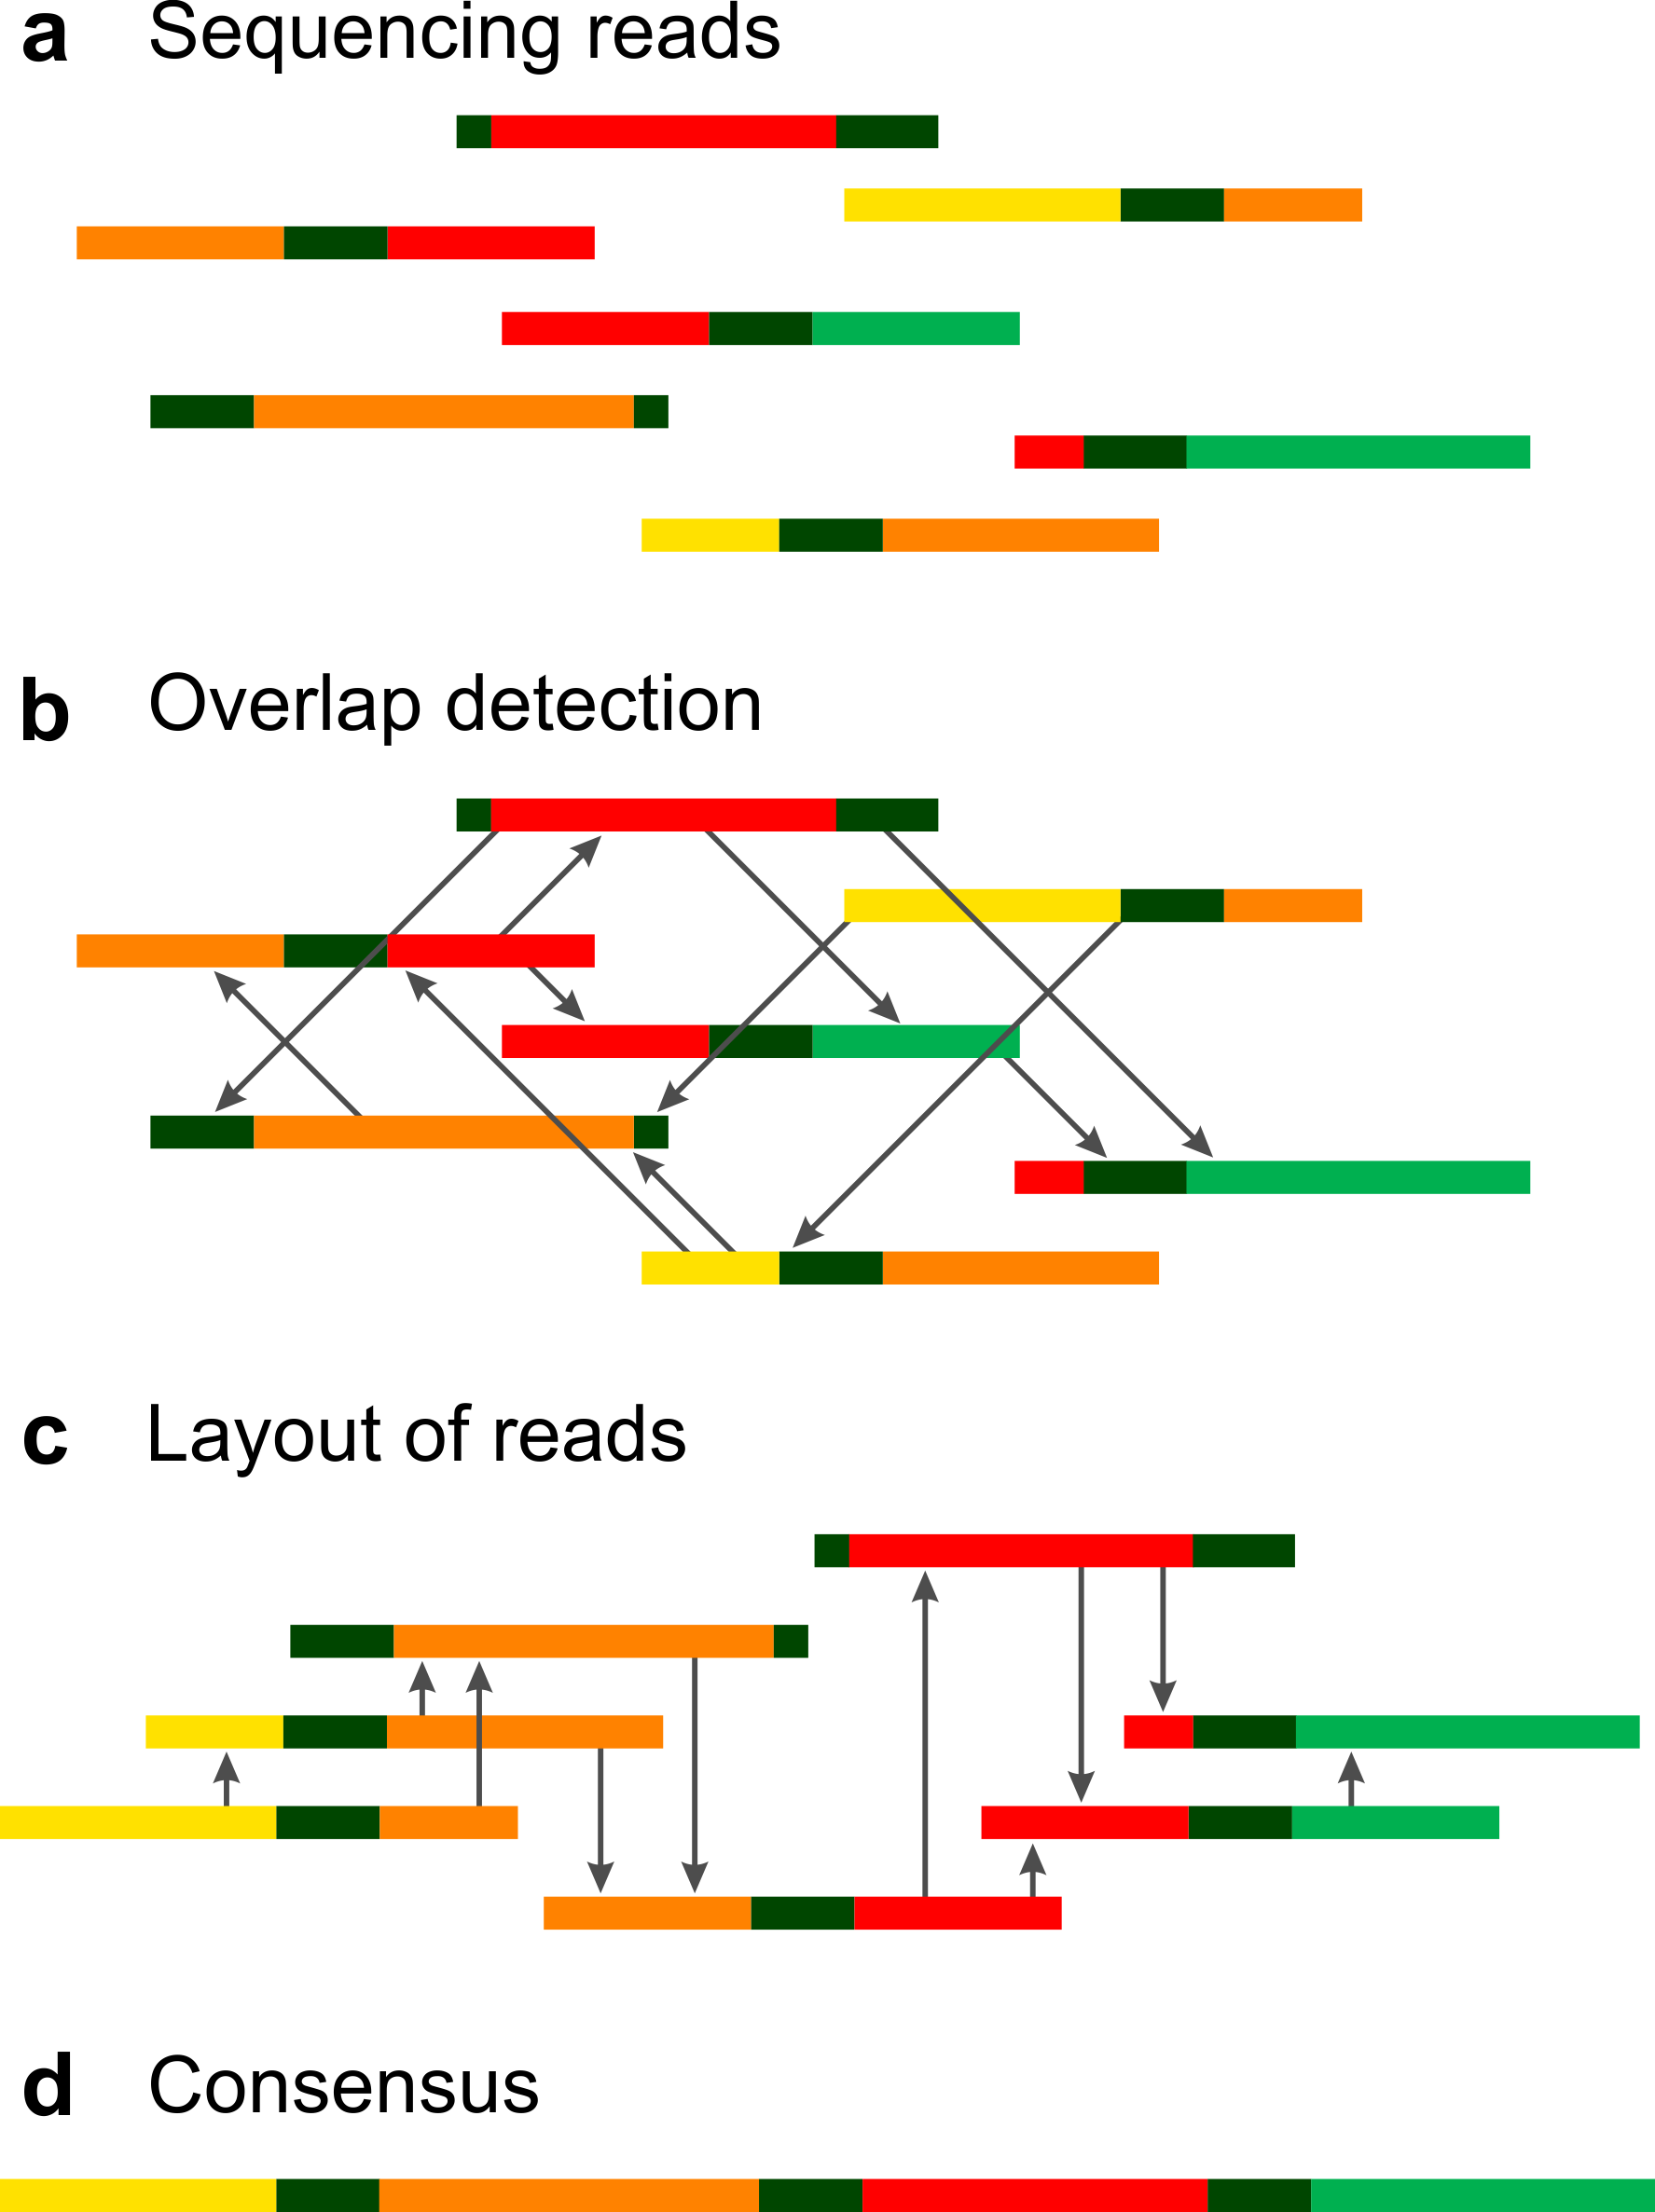
Overlap-layout-consensus
Straightforward search for all overlaps between all pairs of reads
Retains read information
Slow and computationally intensive
Better for longer reads
Source: Vollmers et al. 2017, PLoS One

Slide 62
de Bruijn graphs chop up the reads even further into segments of length k called k-mers
k-mers
Substrings of length k
Source: Pevzner et al. 2001, PNAS

Slide 63
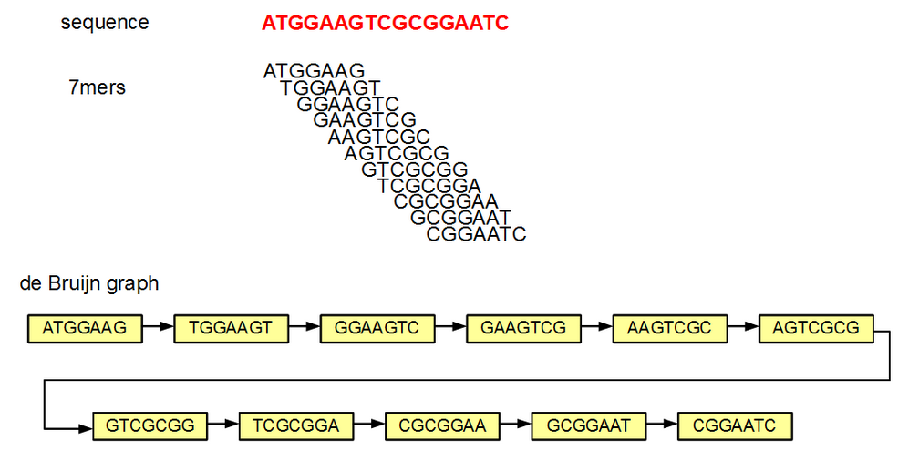
Overlaps of k-1 are used to construct the de Bruijn graph
Source: https://naturalis.github.io/mebioda/doc/week1/w1d2/lecture1.html

Slide 64
Overlaps of k-1 are used to construct the de Bruijn graph
k-mer selection depends on read length
Smaller k means more repeats joined and shorter contigs
Higher k can lead to a fragmented graph
Source: https://naturalis.github.io/mebioda/doc/week1/w1d2/lecture1.html

Slide 65
Overlaps of k-1 are used to construct the de Bruijn graph
k-mer selection depends on read length
Smaller k means more repeats joined and shorter contigs
Higher k can lead to a fragmented graph
https://github.com/rrwick/Bandage/wiki/Effect-of-kmer-size
Source: https://naturalis.github.io/mebioda/doc/week1/w1d2/lecture1.html

Slide 66
de Bruijn graphs join repeats
Source: Pevzner et al. 2001, PNAS

Slide 67
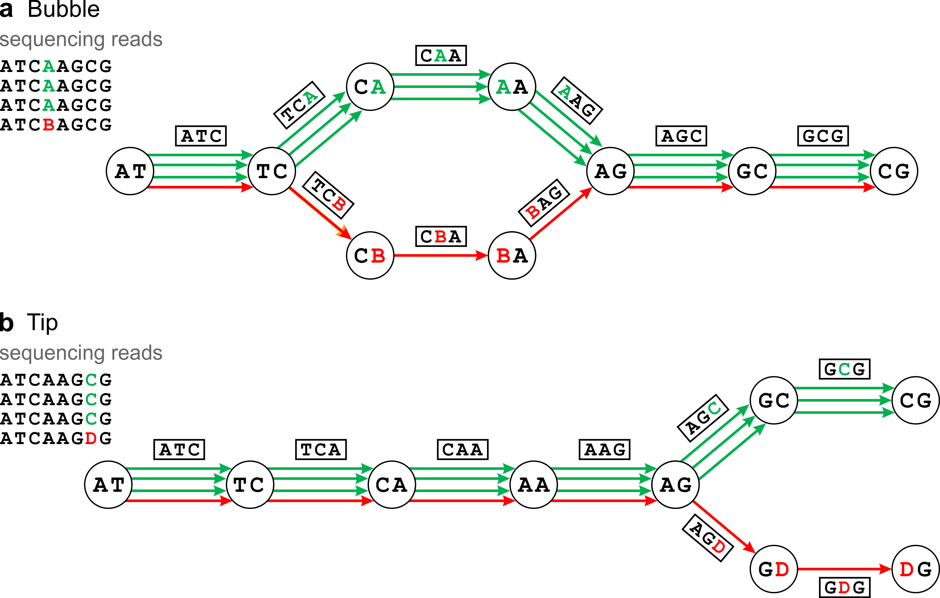
Error correction based on graph structure
Source: Vollmers et al. 2017, PLoS One

Slide 68
Two main classes of assembly algorithms
Much faster for short reads
Efficient algorithms to find paths through the graph
Overlap-Layout-Consensus
de Bruijn graph
Source: Compeau et al. 2011

Slide 69
Two main classes of assembly algorithms
Much faster for short reads
Efficient algorithms to find paths through the graph
Overlap-Layout-Consensus
(vertices are READS, not k-mers)
de Bruijn graph
Source: Compeau et al. 2011

Slide 70
Two main classes of assembly algorithms
Time consuming for short reads
One million reads -> one trillion pairwise alignments
Much faster for short reads
Efficient algorithms to find paths through the graph
Overlap-Layout-Consensus
(vertices are READS, not k-mers)
de Bruijn graph
Source: Compeau et al. 2011

Slide 71
Two main classes of assembly algorithms
Time consuming for short reads
One million reads -> one trillion pairwise alignments
Hamiltonian path problems are NP-Complete
Much faster for short reads
Efficient algorithms to find paths through the graph
Overlap-Layout-Consensus
(vertices are READS, not k-mers)
de Bruijn graph
Source: Compeau et al. 2011

Slide 72
Two main classes of assembly algorithms
Time consuming for short reads
One million reads -> one trillion pairwise alignments
Hamiltonian path problems are NP-Complete
Much faster for short reads
Efficient algorithms to find paths through the graph
Overlap-Layout-Consensus
(vertices are READS, not k-mers)
de Bruijn graph
Source: Compeau et al. 2011

Slide 73
Two main classes of assembly algorithms
Time consuming for short reads
One million reads -> one trillion pairwise alignments
Hamiltonian path problems are NP-Complete
Much faster for short reads
Efficient algorithms to find paths through the graph
x
contig
Overlap-Layout-Consensus
(vertices are READS, not k-mers)
de Bruijn graph
Source: Compeau et al. 2011

Slide 74
Two main classes of assembly algorithms
Time consuming for short reads
One million reads -> one trillion pairwise alignments
Hamiltonian path problems are NP-Complete
Much faster for short reads
Efficient algorithms to find paths through the graph
https://gwct.github.io/congen/programs.html
x
contig
Overlap-Layout-Consensus
(vertices are READS, not k-mers)
de Bruijn graph
Source: Compeau et al. 2011

Slide 75
How do we join contigs into longer scaffolds?
?

Slide 76
Post-sequencing scaffolding
Using read pairs that span contigs
Source: https://thesequencingcenter.com/knowledge-base/what-are-paired-end-reads/

Slide 77
Post-sequencing scaffolding
Using read pairs that span contigs
Source: https://thesequencingcenter.com/knowledge-base/what-are-paired-end-reads/

Slide 78
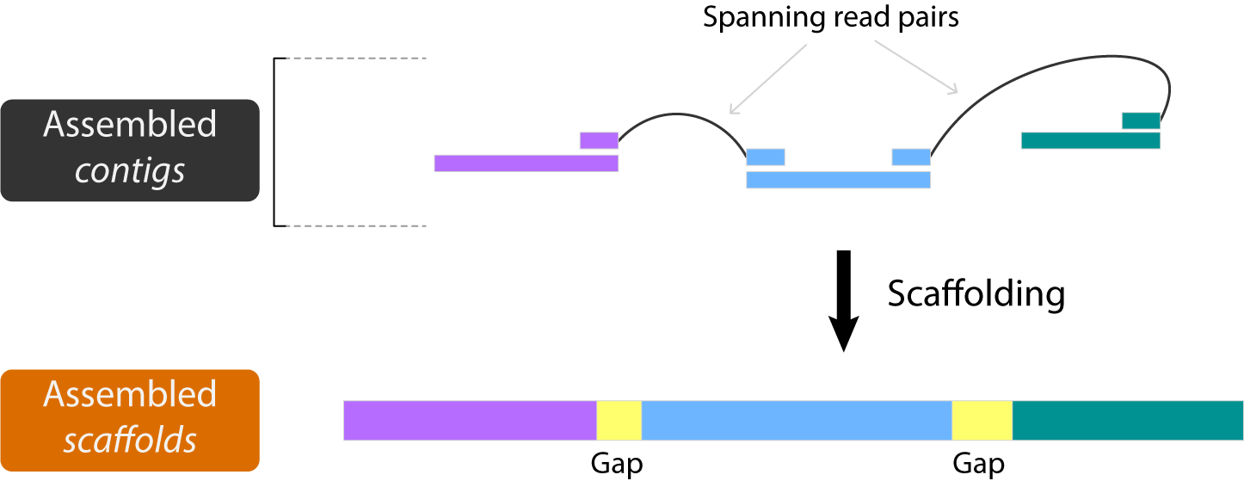
Post-sequencing scaffolding
Using read pairs that span contigs

Slide 79
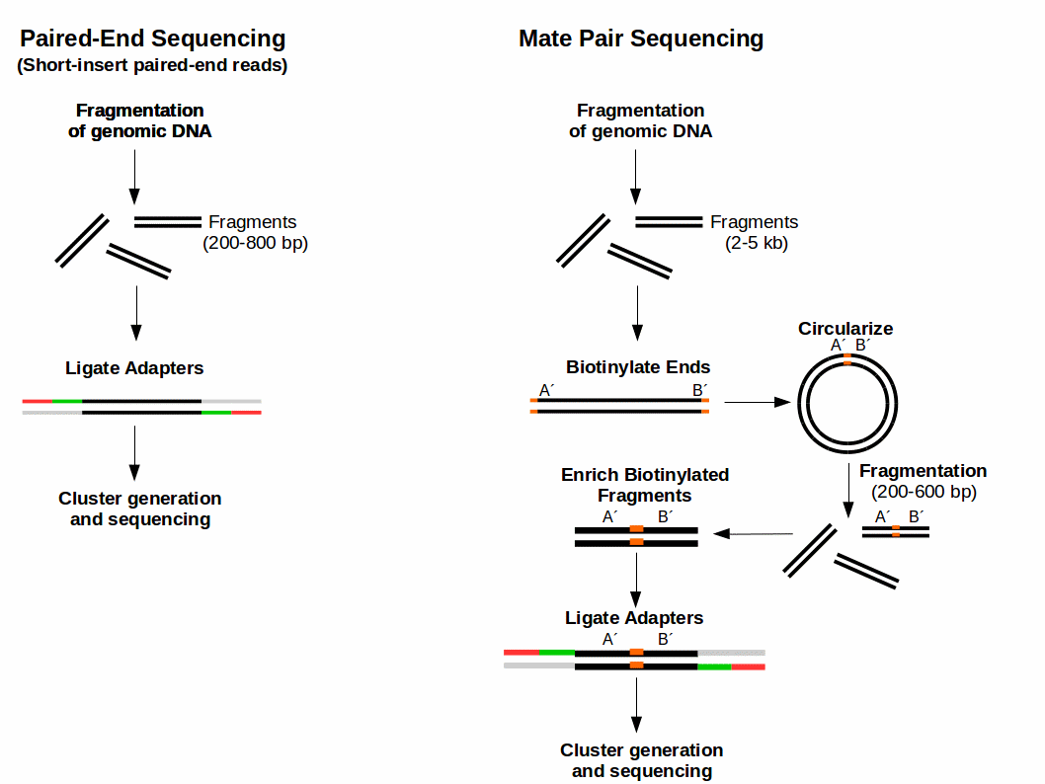
Post-sequencing scaffolding
Using read pairs that span contigs
Using long insert-size mate-pair libraries (“jumping libraries”)
Source: https://www.ecseq.com/support/ngs/what-is-mate-pair-sequencing-useful-for

Slide 80
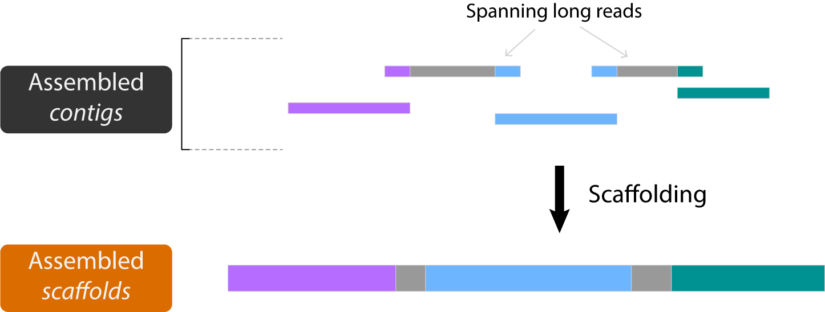
Post-sequencing scaffolding
Using read pairs that span contigs
Using long insert-size mate-pair libraries (“jumping libraries”)
Using long reads

Slide 81
Pre-sequencing preps that aid in scaffolding
Hi-C chromosome conformation capture
Crosslink DNA that is close together in physical space when packed into chromatin with the assumption that DNA on the same chromosome will often be packed closely together
Source: Liebereman-Aiden et al. 2009, Science

Slide 82
Pre-sequencing preps that aid in scaffolding
Hi-C chromosome conformation capture
Source: Burton et al. 2013, Nat Biotech

Slide 83
Pre-sequencing preps that aid in scaffolding
Linked reads also group reads by chromosome
10x Genomics approaches this during the library phase using “linked read” strategy
Each GEM bead allows you to first assemble by DNA molecule
This then makes it computationally easier to overlay long haplotypes and place them
Source: 10X Genomics

Slide 84
Pre-sequencing preps that aid in scaffolding
Group by barcode instead of crosslinks
Hi-C chromosome conformation capture
Linked reads/haplotagging
Source: Burton et al. 2013, Nat Biotech

Slide 85
Assemblies are haploid representations of genomes

Slide 86
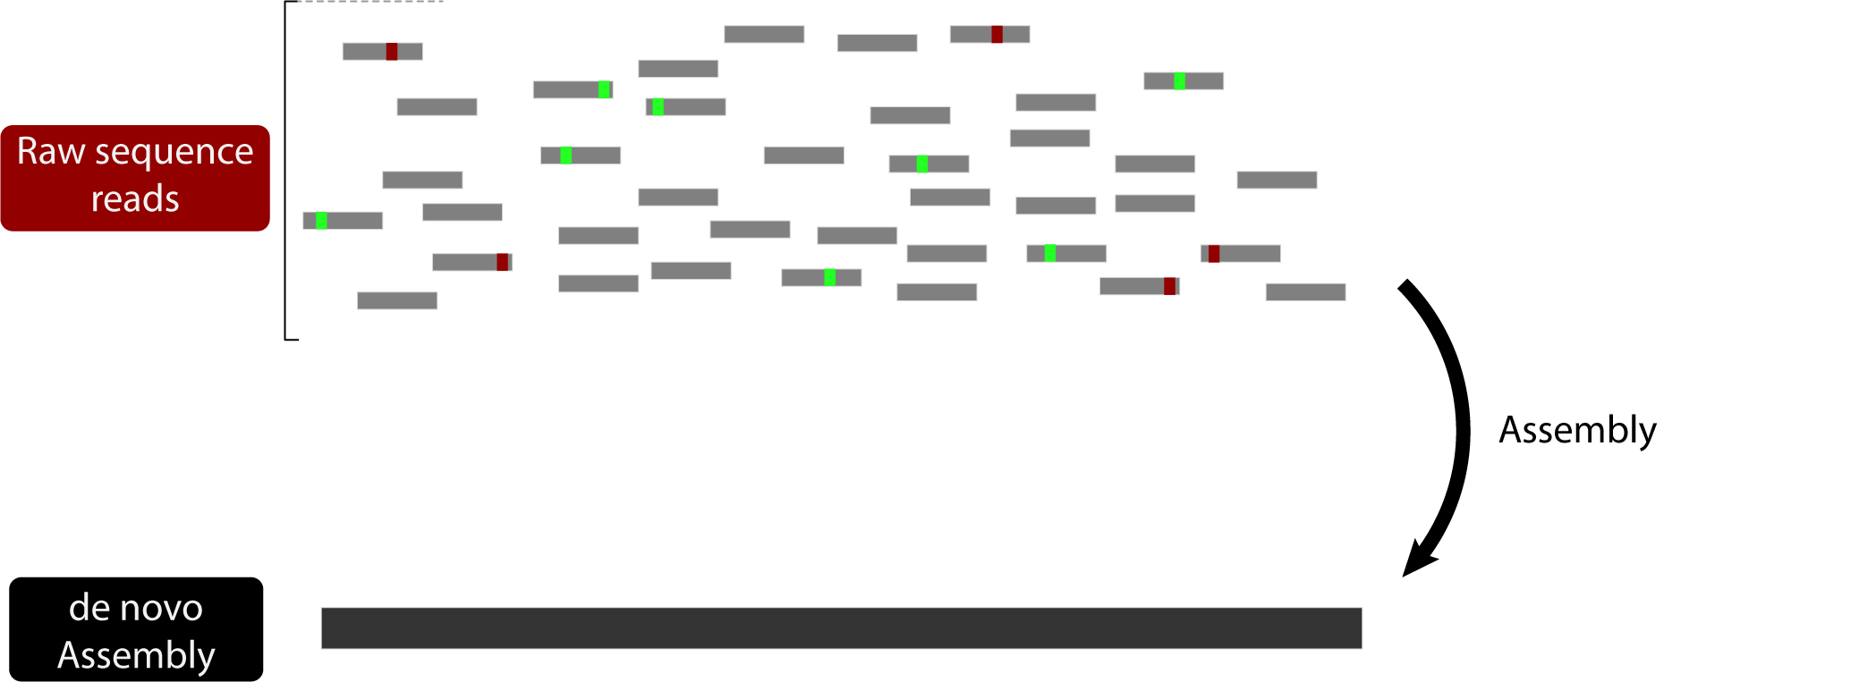
Determine heterozygous sites by mapping reads to assembly

Slide 87
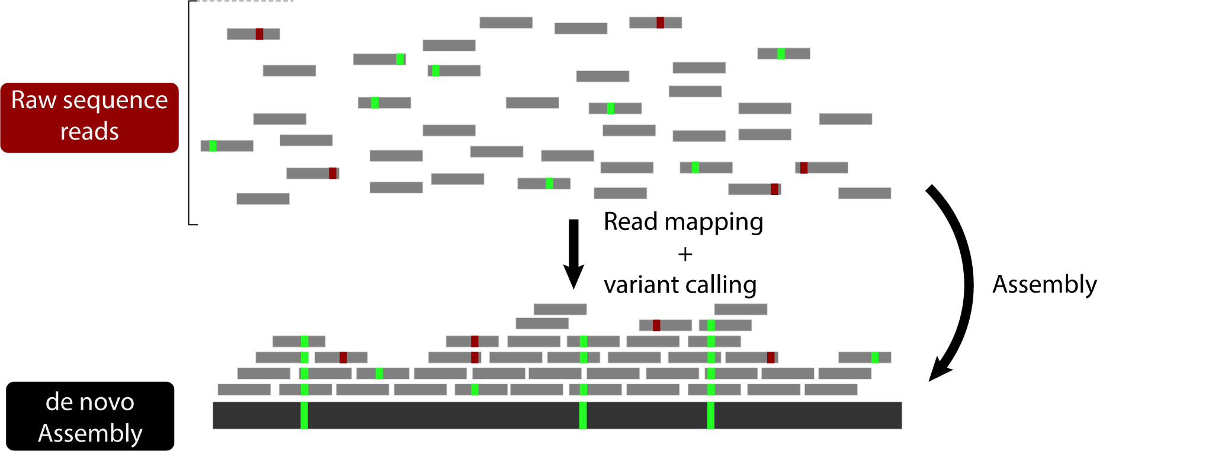
Determine heterozygous sites by mapping reads to assembly
Can identify heterozygous sites

Slide 88
Determine heterozygous sites by mapping reads to assembly
Can identify heterozygous sites
Can also assign quality scores to assembly (Referee)

Slide 89
Determine heterozygous sites by mapping reads to assembly
Can identify heterozygous sites
Can also assign quality scores to assembly (Referee)
Does not phase any of the variants

Slide 90
Genome Phasing
What is phasing?
Phasing an assembly means to separate the maternal and paternal chromosomes. This has been relatively difficult until recently when long read sequencing could more easily resolve haplotypes.
Source: 10X Genomics

Slide 91
Genome Phasing
What is phasing?
Phasing an assembly means to separate the maternal and paternal chromosomes. This has been relatively difficult until recently when long read sequencing could more easily resolve haplotypes.
Source: 10X Genomics

Slide 92
Genome Phasing
What is phasing?
Phasing an assembly means to separate the maternal and paternal chromosomes. This has been relatively difficult until recently when long read sequencing could more easily resolve haplotypes.
Source: 10X Genomics

Slide 93
Genome Phasing
How can we accomplish phasing?
Pacbio (and Nanopore) and linked reads addresses this by using long reads and identifying alternative haplotigs
Create an assembly graph that contains “bubbles” which represent structural variation and alternative haplotypes (with different SNPs)
Break these apart by identifying which reads go with each haplotype
Source: Chin et al. 2016, Nat Methods

Slide 94
Genome Phasing
How can we accomplish phasing?
Trio binning describes the process of using the maternal and paternal haplotypes to resolve offspring assembly
Assign reads from child to each paternal haplotype

Slide 95
How do we capture population level variation in genome assemblies?
Genome assemblies are from single individuals
Loops in graph represent repeat regions
Pan-genomes are assemblies from multiple individuals
Loops in graph represent population level variation
Source: Eizenga et al. 2020, Annual Review of Genomics and Human Genetics

Slide 96
How do we capture population level variation in genome assemblies?
Genome assemblies are from single individuals
Loops in graph represent repeat regions
Pan-genomes are assemblies from multiple individuals
Loops in graph represent population level variation
Source: Eizenga et al. 2020, Annual Review of Genomics and Human Genetics

Slide 97
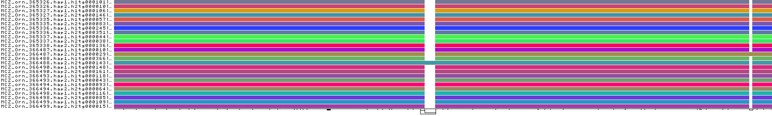
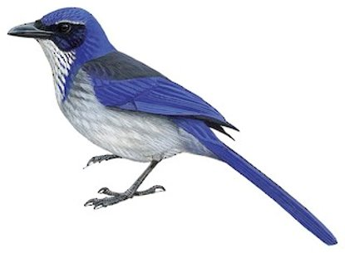
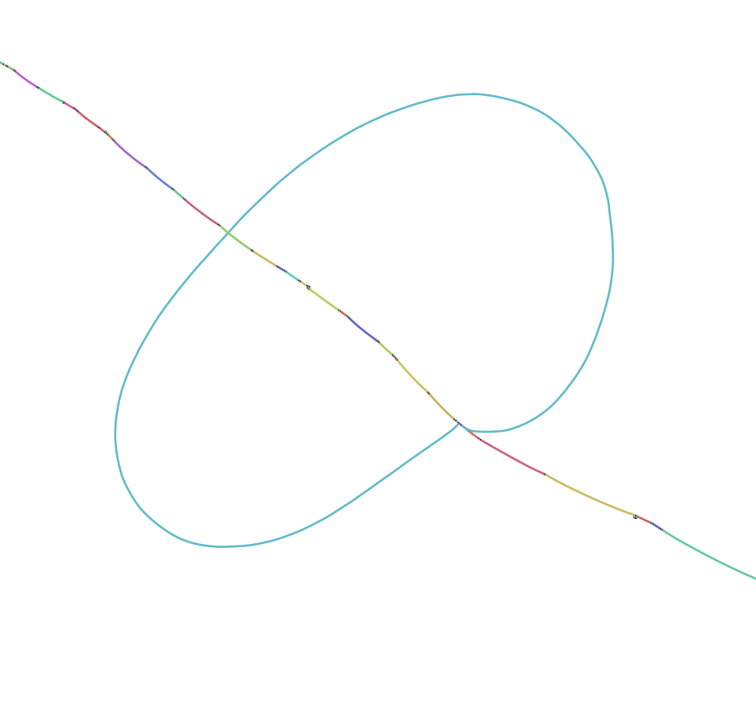
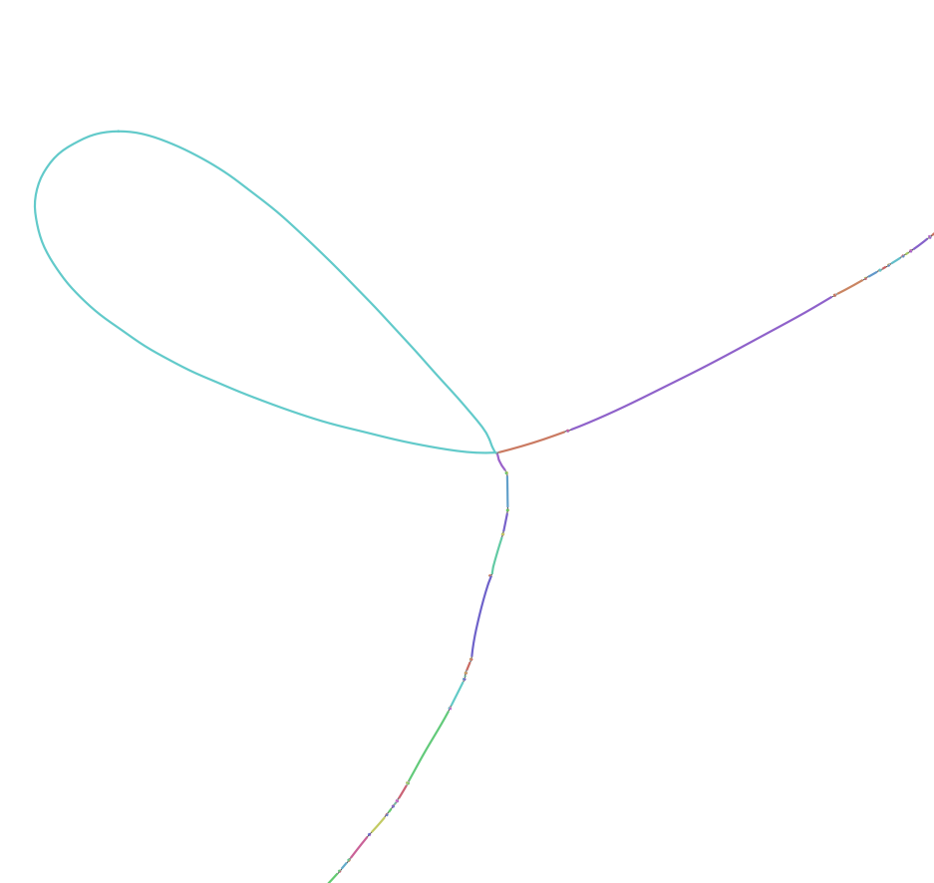
Genomic stability of 400-kb hox1a region in Western Scrub Jays
Pangenome graphs
generated with odgi
and visualized with Bandage
Slide from Scott Edwards
Guarracino et al. 2021. Bioinformatics, in press.
Wick et al. 2015. Bioinformatics 31:3350.
7.5 kb polymorphic indel
2.5 kb polymorphic indel

Slide 98
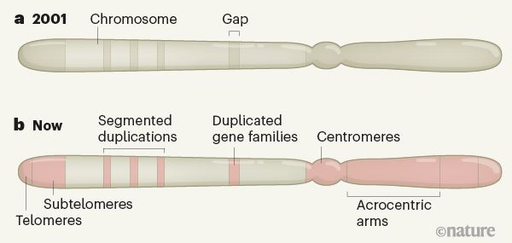
Telomere-to-telomere assemblies
Initial genome assemblies are full of gaps (repeat regions)
Improved scaffolding and long reads allow these gaps to be resolved
Allows for study of whole genome, but requires much more sequencing
Source: Miga 2021, Nature

Slide 99
1. | A brief history of sequencing technology
2. | de novo Assembly: reads, contigs, and scaffolds
3. | Reference-guided assembly
4. | Practical considerations for genome assembly

Slide 100
How do we reconstruct the genome from reads?
x
Overlapping pieces
We don’t know the original sequence

Slide 101
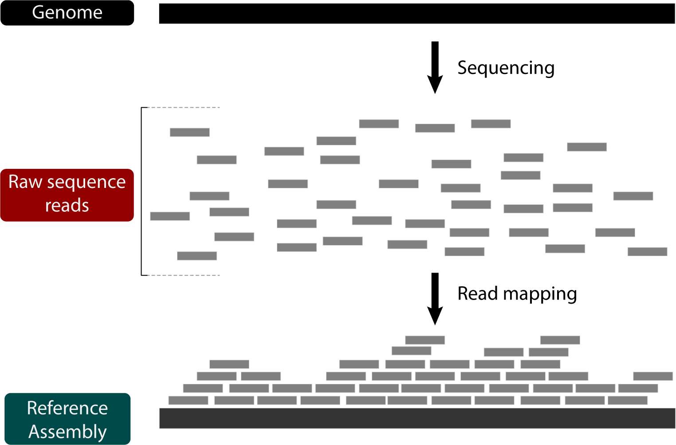
What if we know a sequence similar to the original?
x
Overlapping pieces
We have an assembly from a closely related species

Slide 102
We can map the reads to this assembly
x
Overlapping pieces
We have an assembly from a closely related species

Slide 103
We can map the reads to this assembly
BWA, Bowtie, bbmap, minimap

Slide 104
We can map the reads to this assembly
BWA, Bowtie, bbmap, minimap
Use Burrows-Wheeler transform to facilitate many string searches

Slide 105
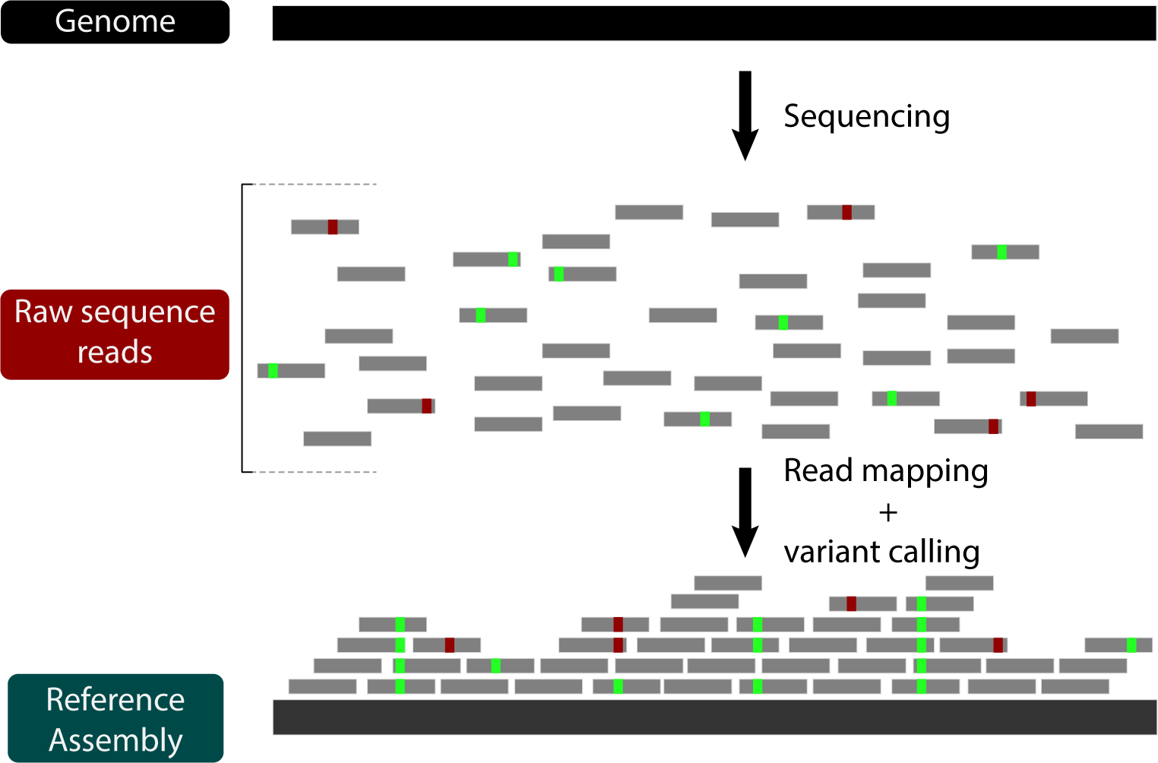
Variants can be called based on the quality of aligned sequences

Slide 106
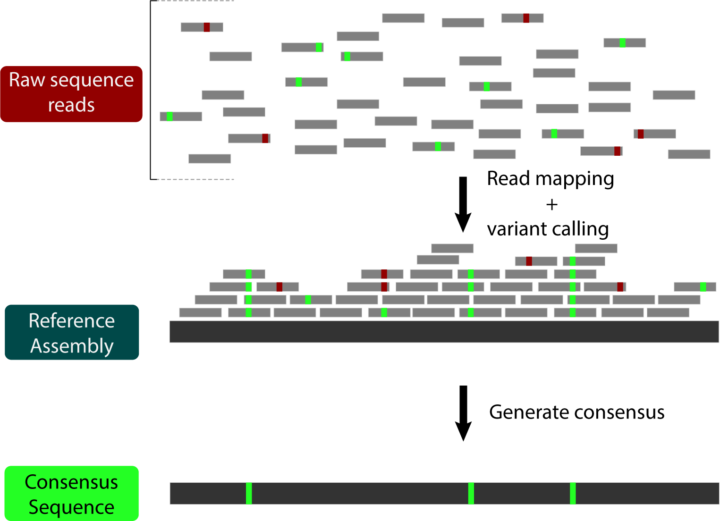
Consensus sequences incorporate called variants

Slide 107
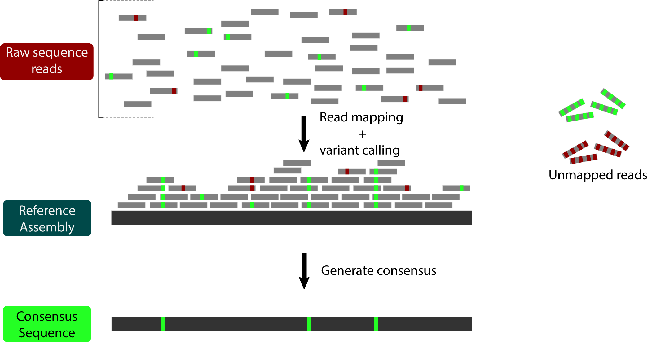
Reads with too much variation may not be mapped

Slide 108
Reads with too much variation may not be mapped
This leads to
Reference Bias
The consensus sequence looks more similar to the reference than it actually is.

Slide 109
Mapping to a single reference decreases estimated heterozygosity
Source: Armstrong et al. 2020, BMC Biology

Slide 110
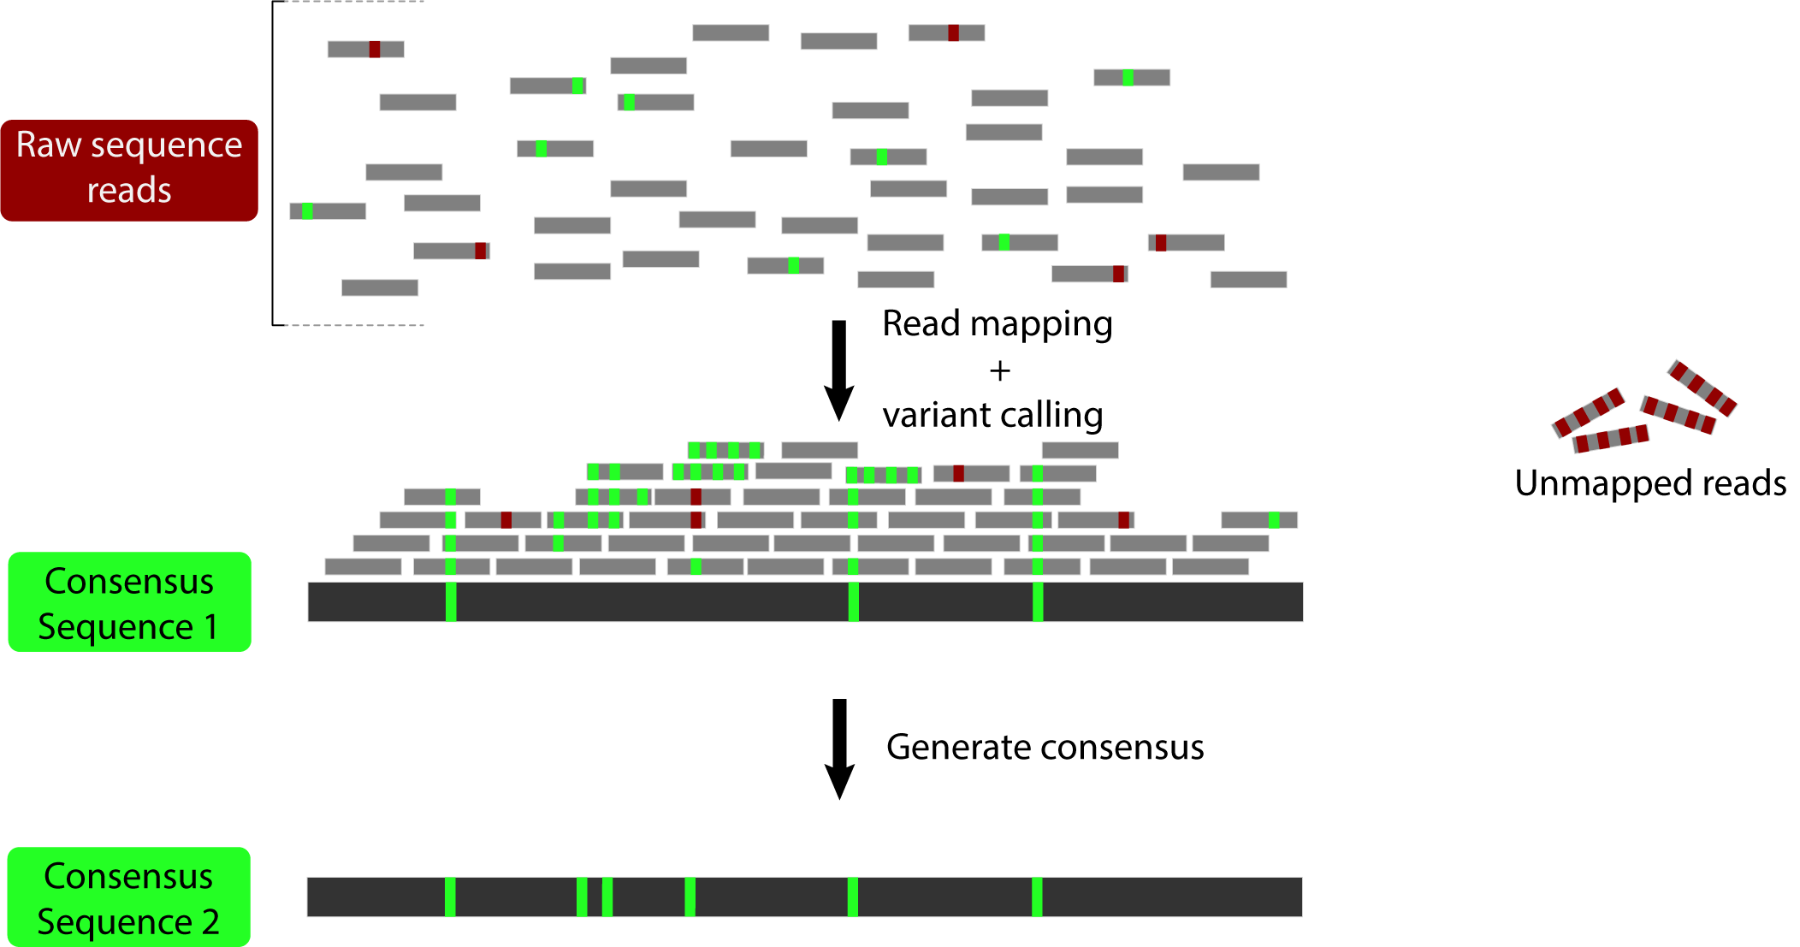
Iterative mapping back to the consensus sequence can reduce reference bias

Slide 111
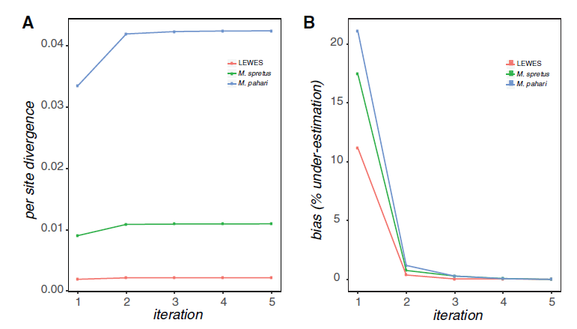
Iterative mapping reduces reference bias
Source: Sarver et al. 2017, GBE

Slide 112
1. | A brief history of sequencing technology
2. | de novo Assembly: reads, contigs, and scaffolds
3. | Reference-guided assembly
4. | Practical considerations for genome assembly

Slide 113
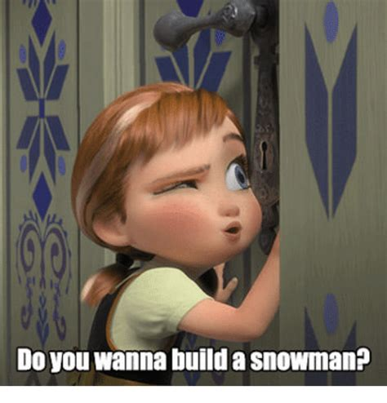
So you want to build a genome?
Some factors to consider:
-Organism ploidy
-Genome size (http://www.genomesize.com)
-Repeat content
-How much/what quality of DNA will you have available?
-If ref mapping, what is the divergence?
-What are you using it for?
genome

Slide 114
So you want to build a genome?
Ploidy: the number of sets of chromosomes in a cell
How is this relevant to assembly?
-when there are many copies of chromosomes, the assemblers can have a difficult time telling what goes where
-genome size tends to be large, and can contain many complex repeat regions from the duplications
-phasing also more complex/difficult
-common in plants, but also seen in amphibians, reptiles, arthropods

Slide 115
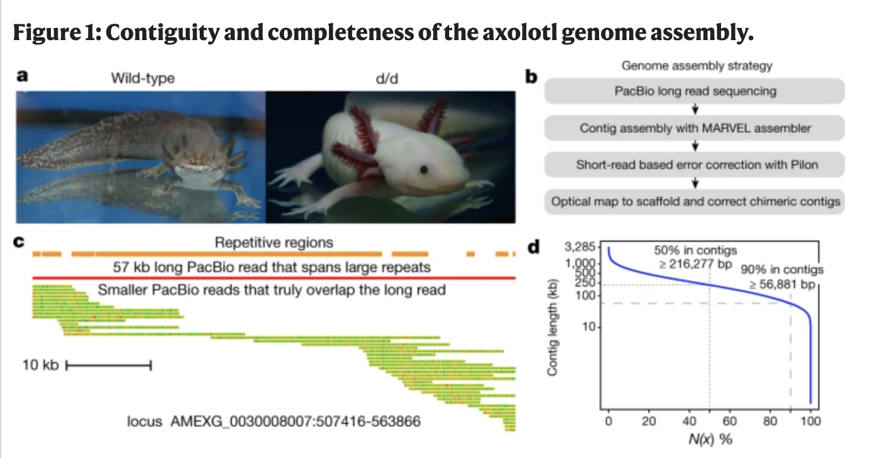
So you want to build a genome?
-In general, repeat content scales with genome size
-Repeats (depending on their class) can be hard to assemble and resolve
-If you have a lot of repetitive content, longer reads will be better at resolving this
Repeat Content!
Probably not junk, but we don’t really know
Elliot and Gregory 2015
Nowoshilow et al. 2018

Slide 116
So you want to build a genome?
C value: Estimate of genome size based on flow cytometry
-Some groups of organisms have conserved genome sizes (birds, mammals)
-Others have high variability (arthropods, frogs, plants)
-Can be difficult to predict assembly size (which affects how much and what you would sequence) in some groups, so tread carefully

Slide 117
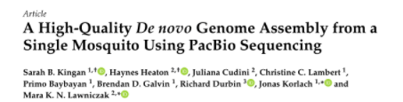
So you want to build a genome?
Genome Assembly options depend both on the quality and quantity of DNA available
-Certain technologies require a lot of high molecular weight DNA (long, intact molecules), while other methods fix the DNA while it’s folded
-Depending on the size/clonality/heterozygosity of your organism, pooling may be necessary, but could complicate things
-Things could also get, well, slime-y
Some organisms are harder to get
higher DNA yields than others due
to inhibitors etc.
-Protocols are getting better at making whole genome libraries with low yields

Slide 118
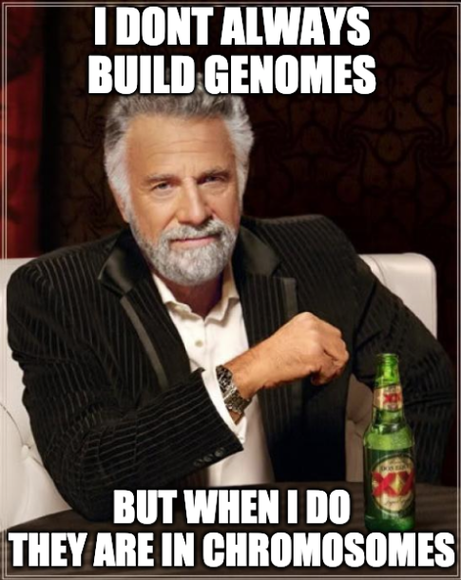
So you want to build a genome?
-Chromosome level assemblies are ideal, but they may not be necessary to answer YOUR question
-Consider what level of information you would need to answer questions about:
  Population structure
  Genomic history
  Structural variation
  Adaptation
  Functional variation
  ???

Slide 119




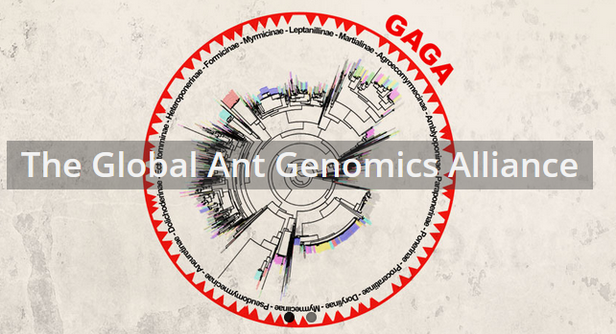
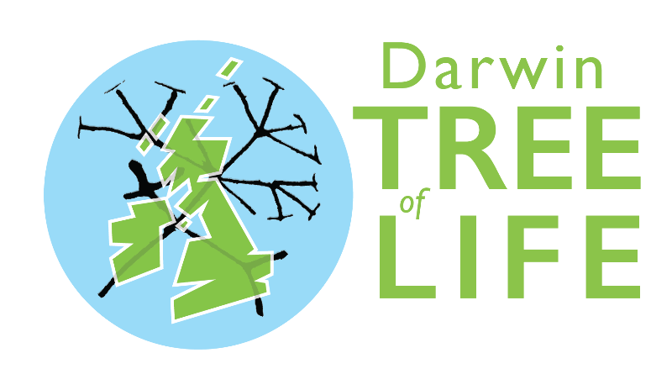



Slide 120
https://gwct.github.io/congen/assembly/

Slide 122
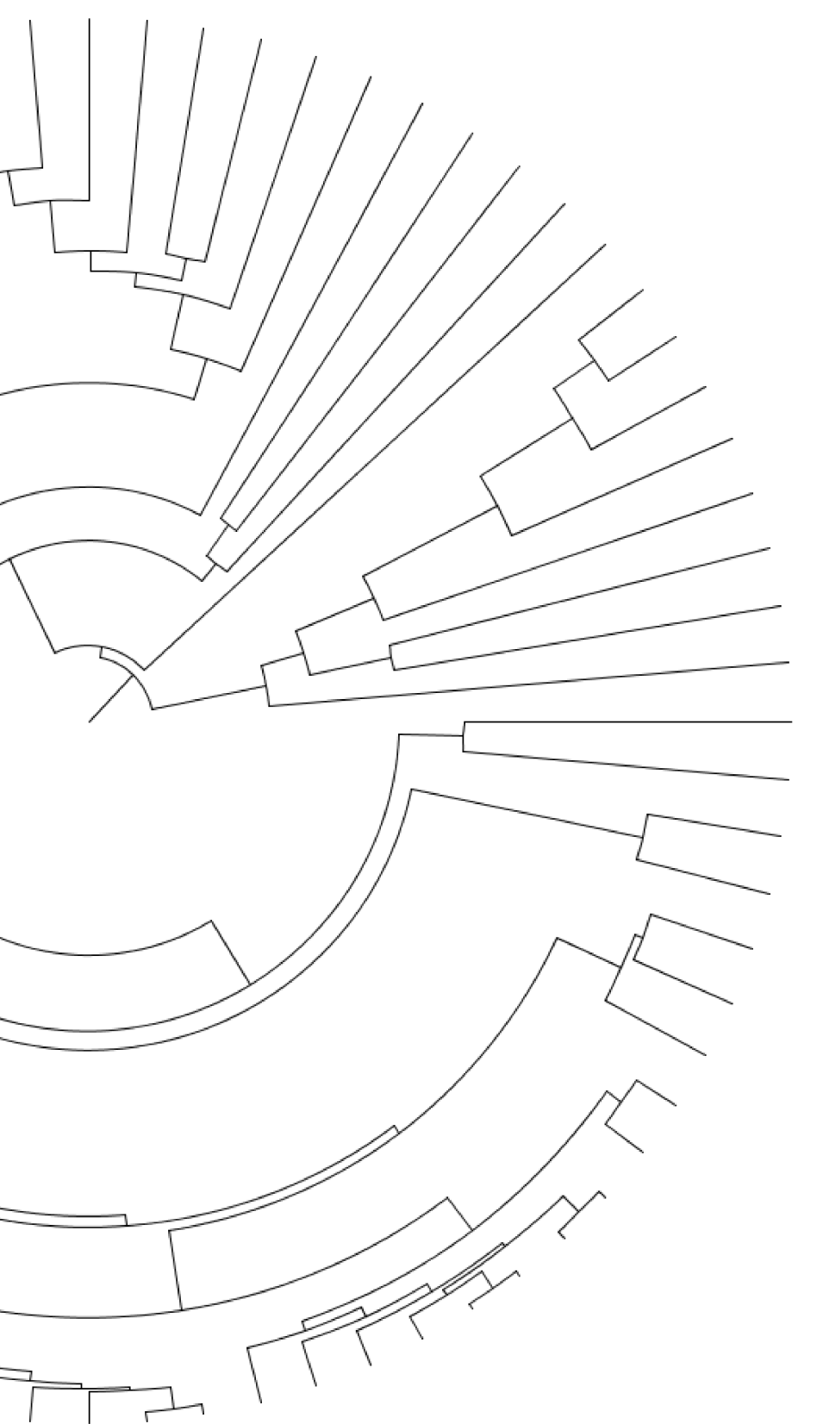

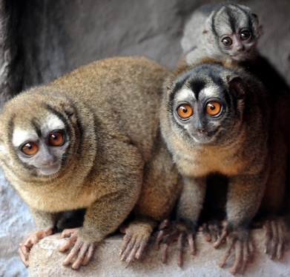
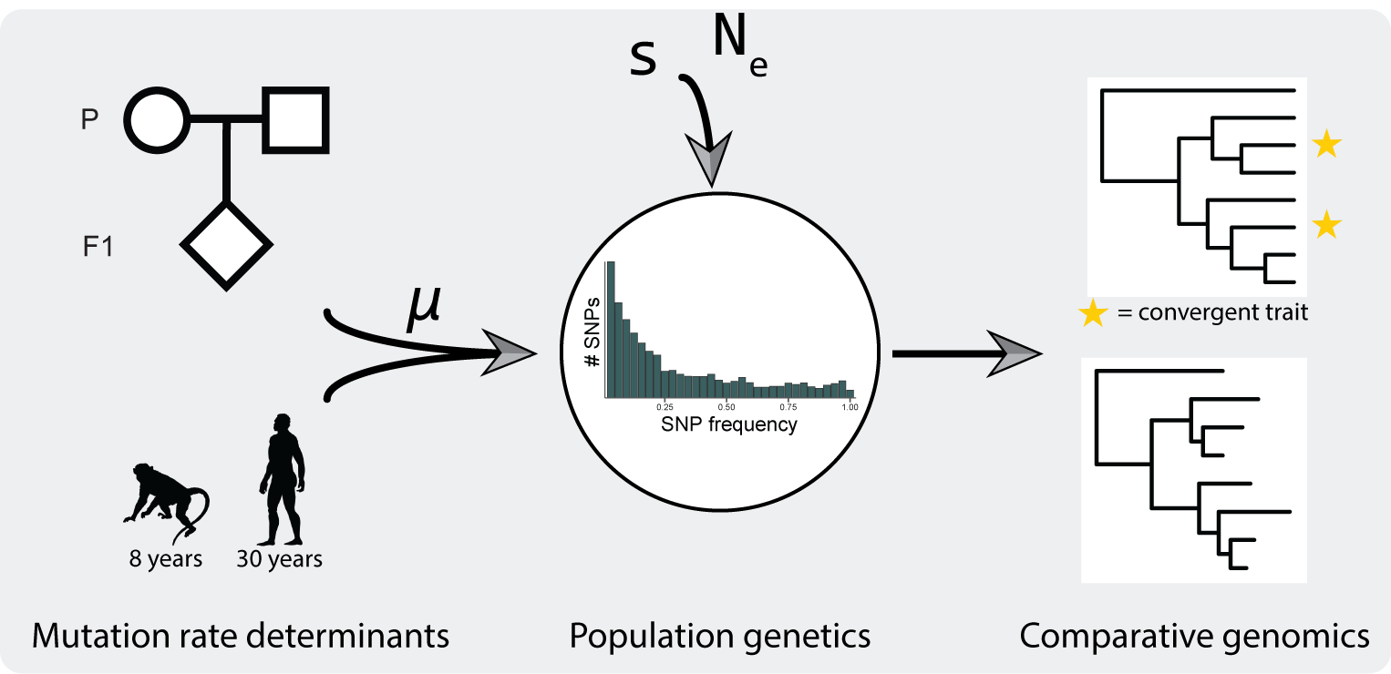
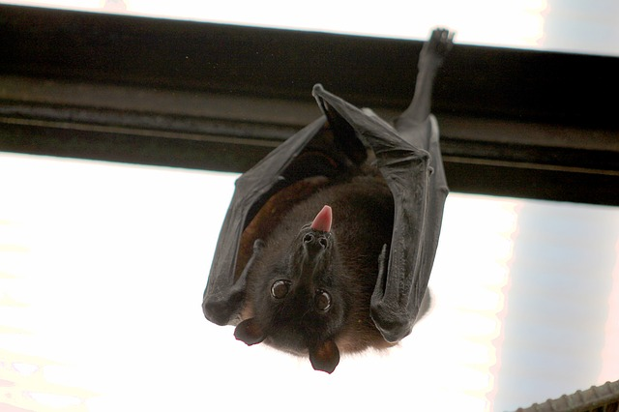
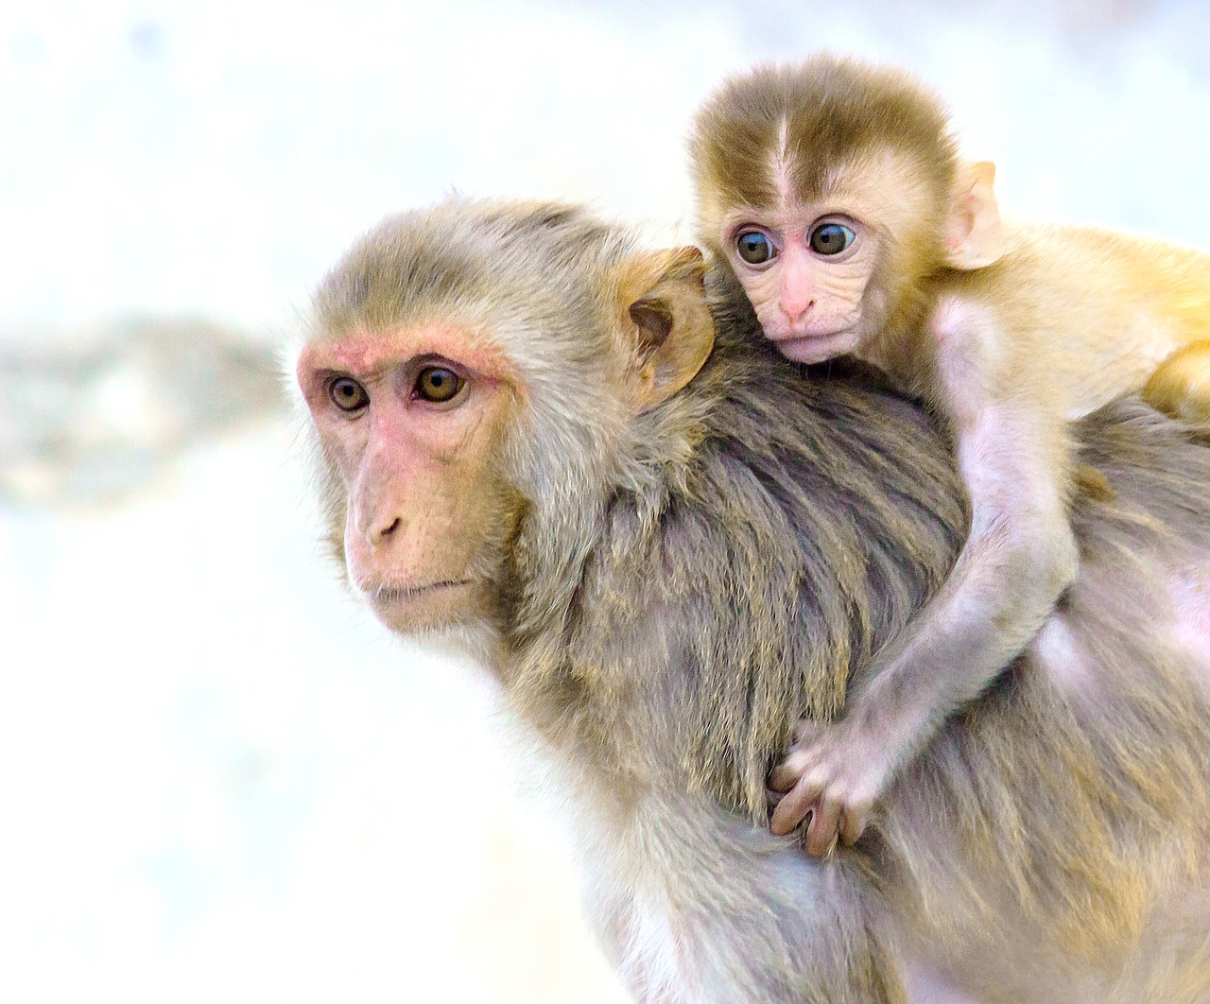
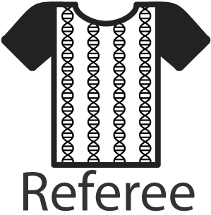



Gregg Thomas
Bioinformatics Scientist
Harvard University
What are the patterns and drivers of molecular evolution?
Owl monkey
Molecular convergence
Macaque
+
Patterns of evolution in
Arthropods
Software/methods development:

