Slide 1
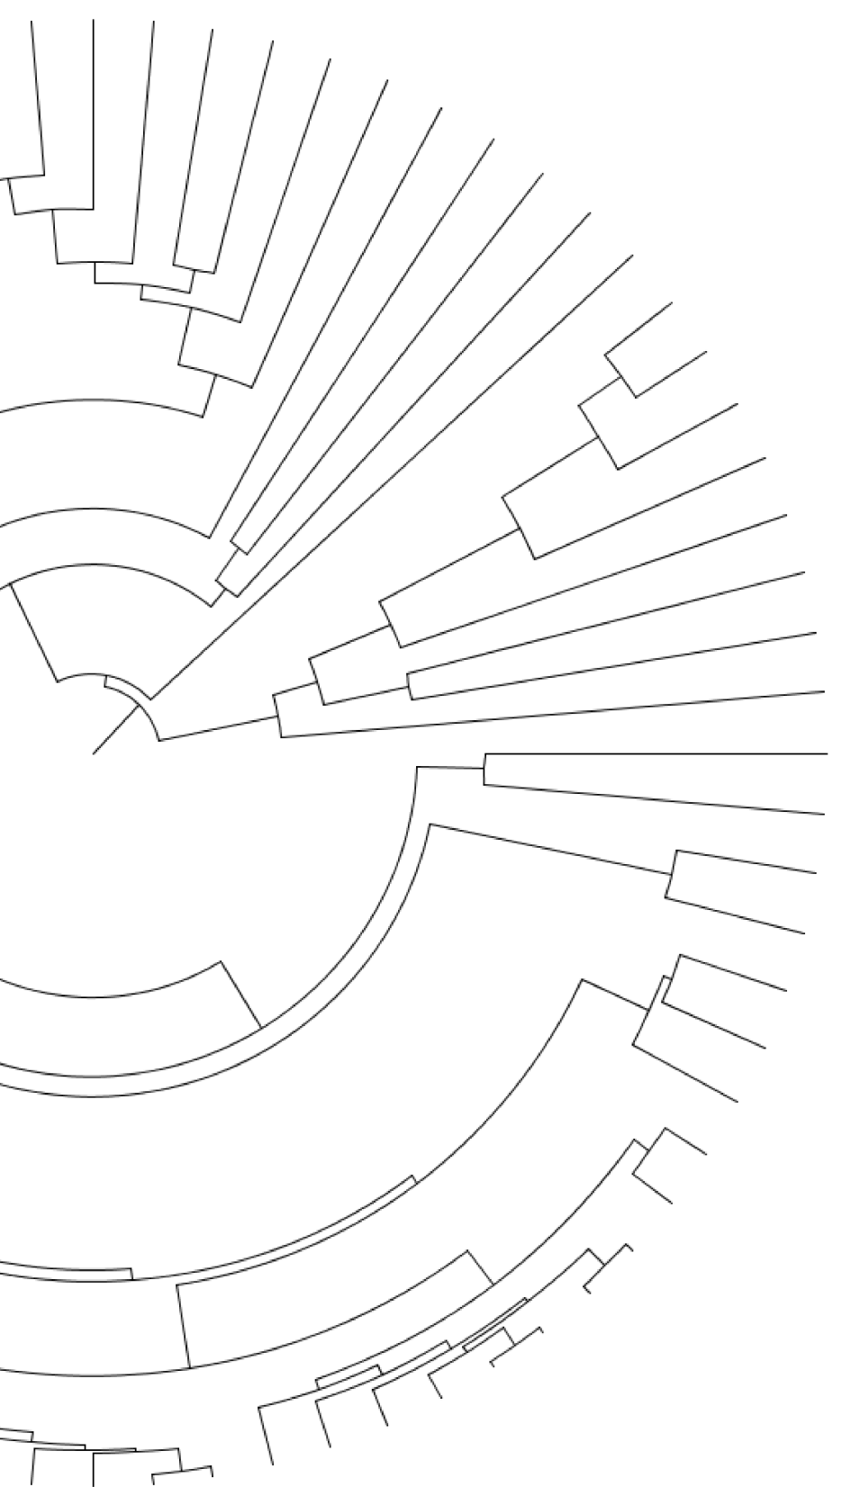


Evolution of the genes and genomes of 76 arthropod species
Gregg Thomas
Indiana University
@greggwcthomas
Arthropod Genomics Symposium, 06.09.17

Slide 2
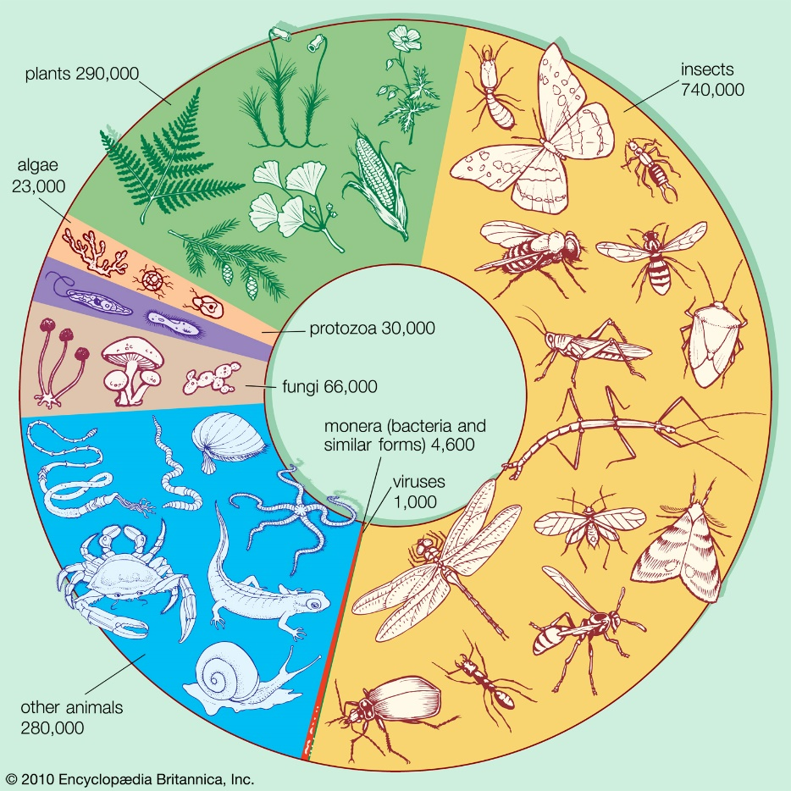
Arthropods are the largest group of multicellular organisms

Slide 3
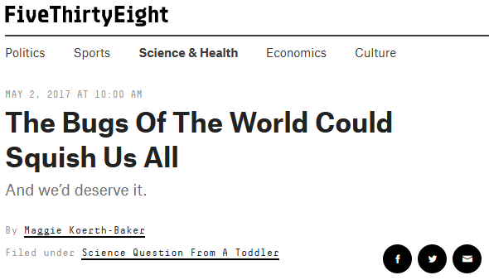
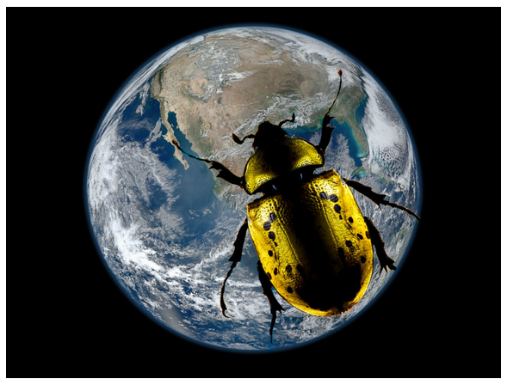
Arthropods are the largest group of multicellular organisms
https://fivethirtyeight.com/features/the-bugs-of-the-world-could-squish-us-all/

Slide 4
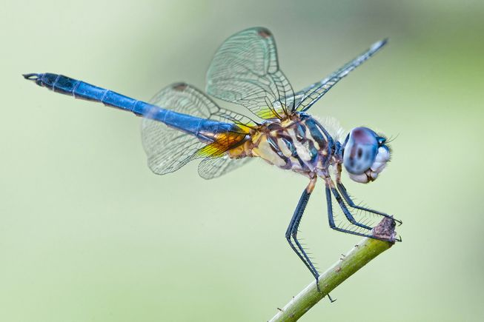
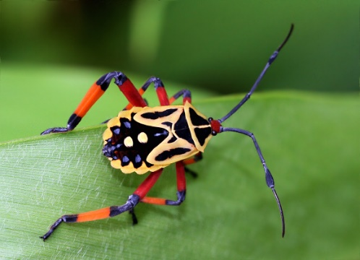
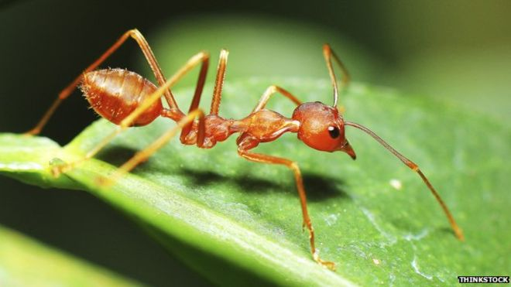
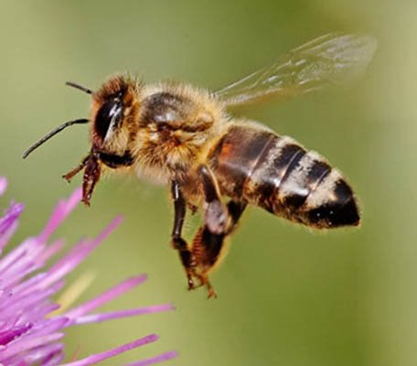
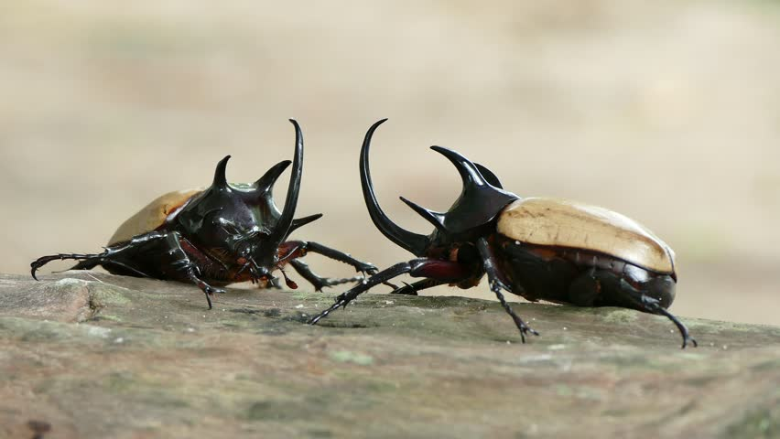
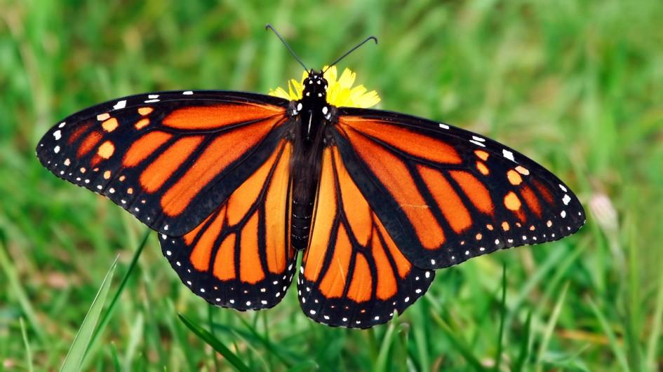
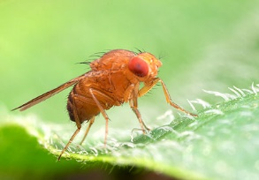
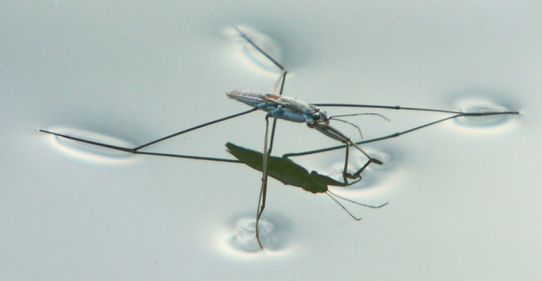
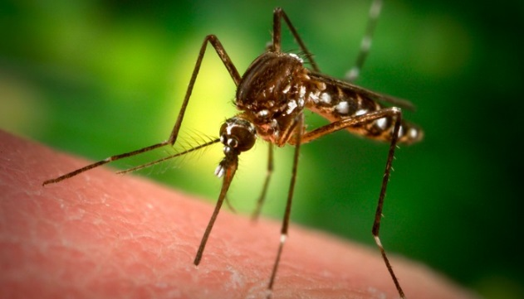
Arthropods exhibit great phenotypic and behavioral diversity

Slide 5
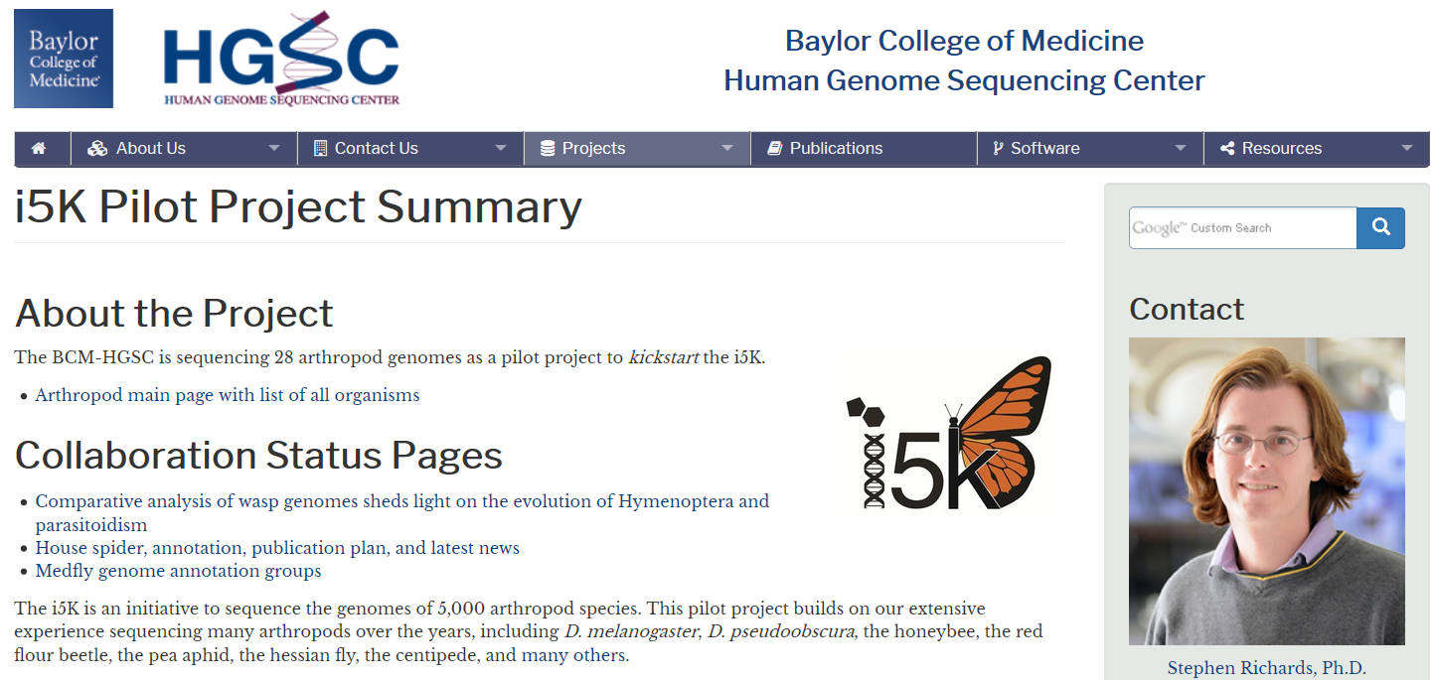
The i5k pilot project has sequenced 27 insect genomes
https://www.hgsc.bcm.edu/arthropods/i5k

Slide 6
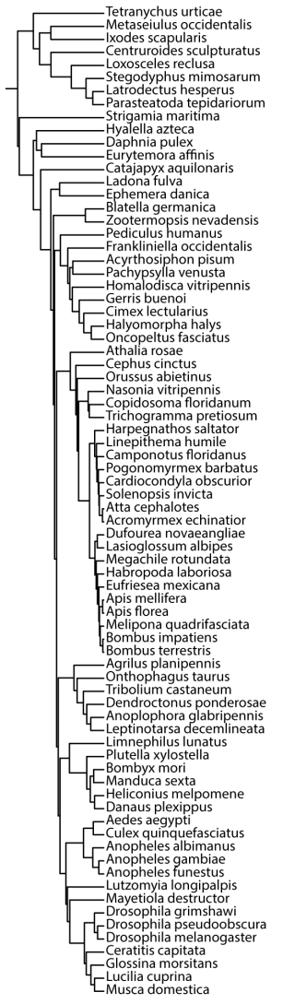
27 genomes sequenced as part of the i5k pilot project

Slide 7
27 genomes sequenced as part of the i5k pilot project
49 previously sequenced arthropod genomes
+

Slide 8
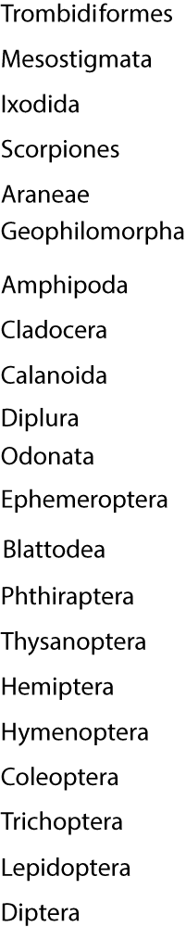
27 genomes sequenced as part of the i5k pilot project
49 previously sequenced arthropod genomes
Spanning 21 arthropod orders
(4 species)
+
(2 species)
(7 species)
(24 species)
(6 species)
(5 species)
(14 species)

Slide 9
Questions
What are the relationships among species and orders?
What are the patterns of genome evolution?
What did the genome of the last insect common ancestor (LICA) look like?

Slide 10
Questions
What are the relationships among species and orders?
What are the patterns of genome evolution?
What did the genome of the last insect common ancestor (LICA) look like?

Slide 11
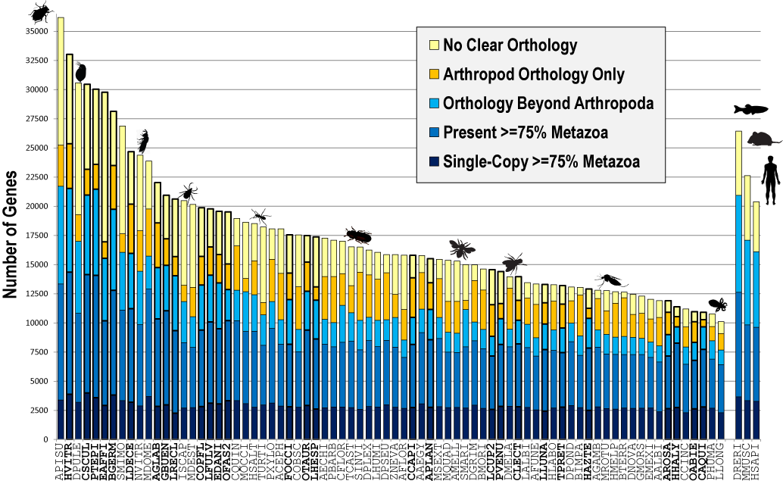
Orthology prediction from OrthoDB
38,195 ortho-groups across 76 arthropod species
Rob Waterhouse

Slide 12
Orthologs for phylogenetics
We rely on single-copy orthologs for species tree reconstruction to minimize gene tree discordance due to duplications and losses
How many are in our data?

Slide 13
Orthologs for phylogenetics
We rely on single-copy orthologs for species tree reconstruction to minimize gene tree discordance due to duplications and losses
How many are in our data?
0

Slide 14
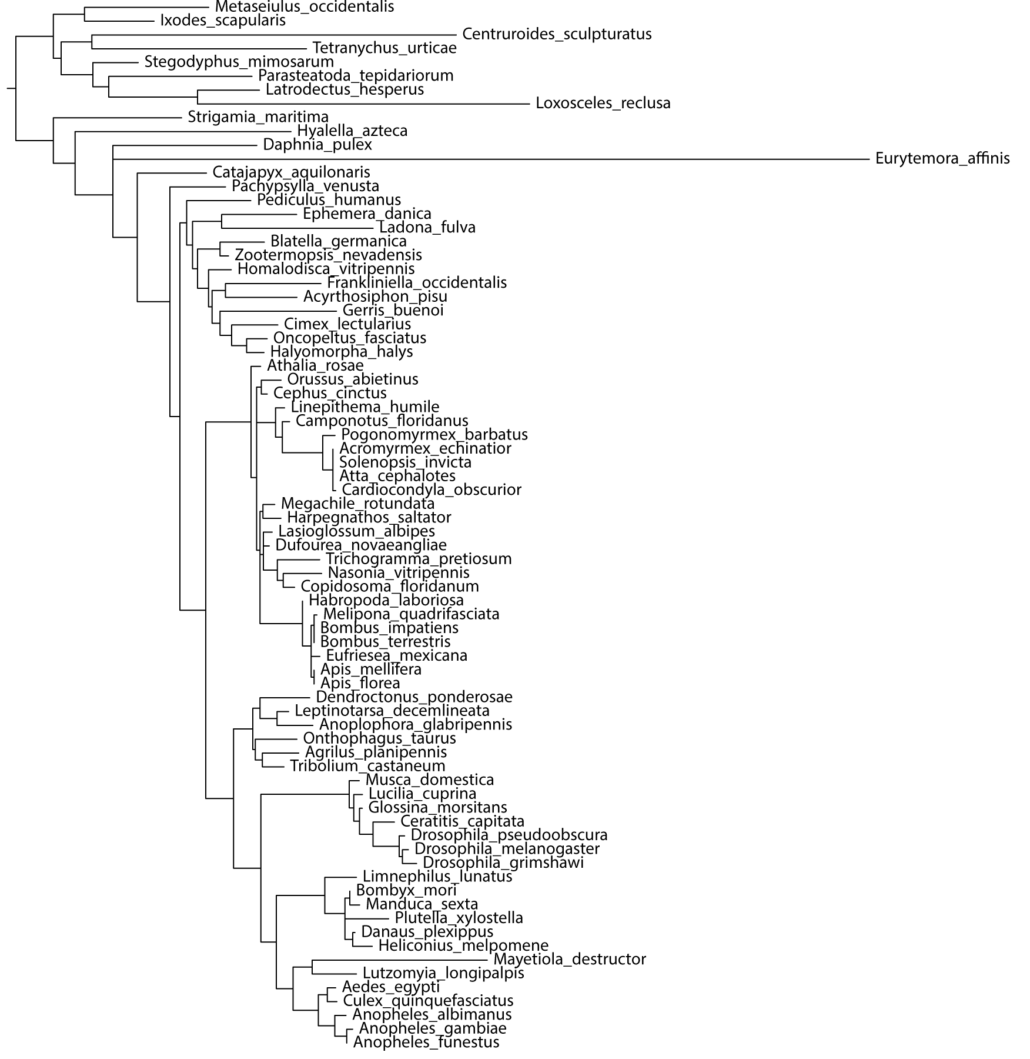
EOG8DFS3J
Single-copy in all but one species
(2 copies in Plutella xylostella)
Notes:
Posttranslational modification, protein turnover, chaperones

Slide 15
EOG8DFS3J
Single-copy in all but one species
(2 copies in Plutella xylostella)
Problem: Hemiptera not monophyletic
Problem: Lepidoptera and Trichoptera within Diptera
Notes:
Posttranslational modification, protein turnover, chaperones

Slide 16
As the number of species increases, the number of sequenced single-copy genes decreases

Slide 17
As the number of species increases, the number of sequenced single-copy genes decreases
How can we turn our species rich data into sequence rich data?

Slide 18
As the number of species increases, the number of sequenced single-copy genes decreases
How can we turn our species rich data into sequence rich data?
Construct a backbone phylogeny by using single-copy orthologs among orders rather than species

Slide 19
Backbone Phylogeny Construction
Phylum | # Orders | # single-copy orthologs
Arthropoda | 21 | 150

Slide 20
Backbone Phylogeny Construction
Phylum | # Orders | # single-copy orthologs
Arthropoda | 21 | 150
Maximum Likelihood gene trees
2 alignment methods
3 species tree methods
MUSCLE
PASTA
Consensus
Concatenation
Coalescent

Slide 21
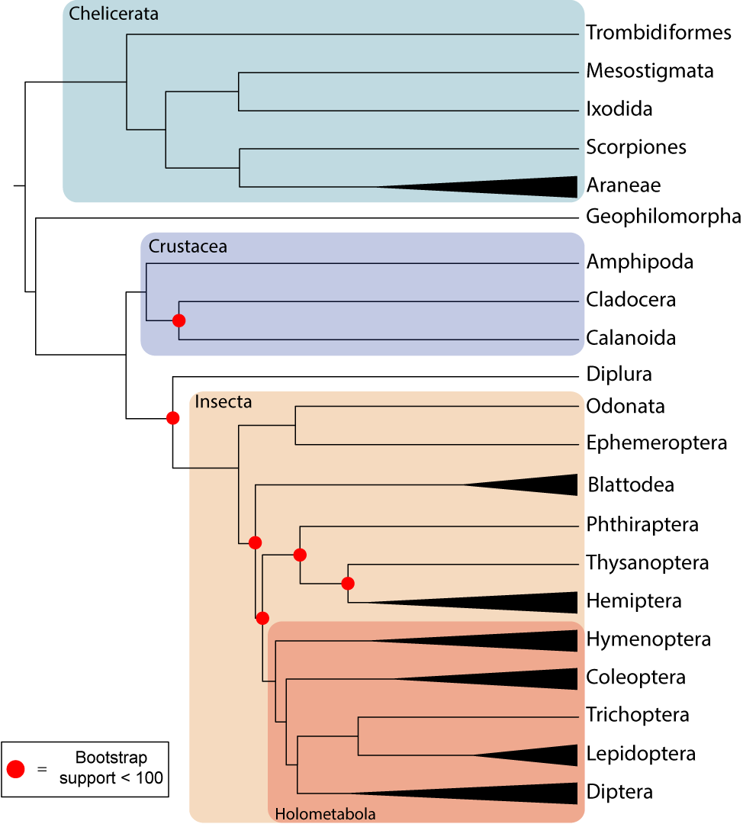
The backbone phylogeny based on:
-150 genes
-Pasta alignment
-ASTRAL
(4 species)
(2 species)
(7 species)
(24 species)
(6 species)
(5 species)
(14 species)

Slide 22
The backbone phylogeny based on:
-150 genes
-Pasta alignment
-ASTRAL
(4 species)
(2 species)
Monophyletic Crustacea??
(7 species)
(24 species)
(6 species)
(5 species)
(14 species)

Slide 23
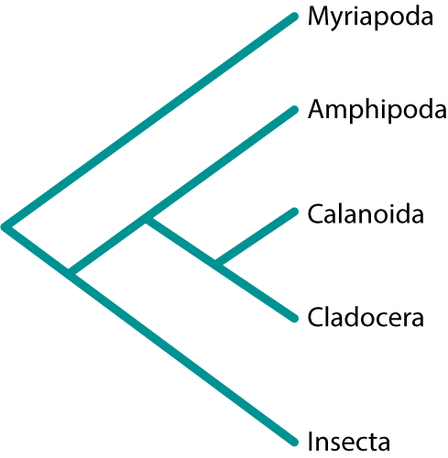
Monophyletic Crustacea?
Our inferred topology…

Slide 24
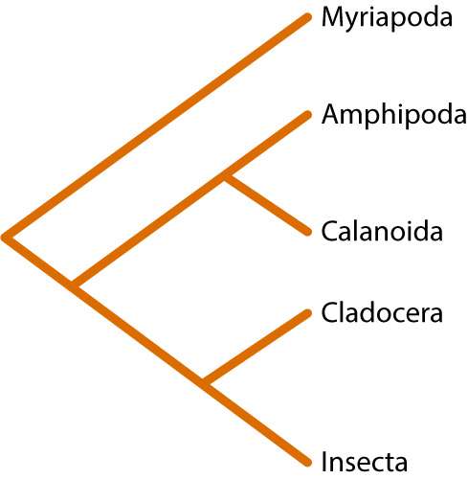
Monophyletic Crustacea?
Our inferred topology…
…differs from other inferred topologies

Slide 25
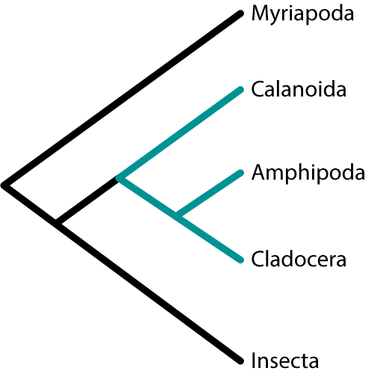

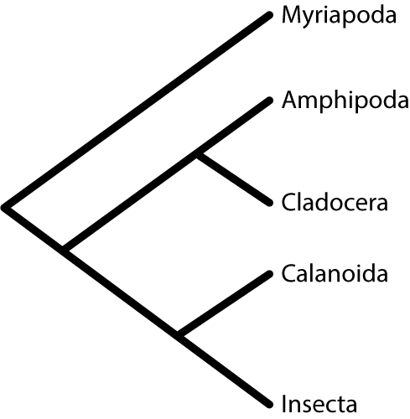
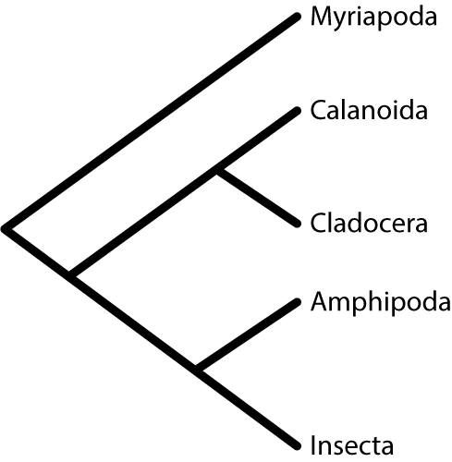
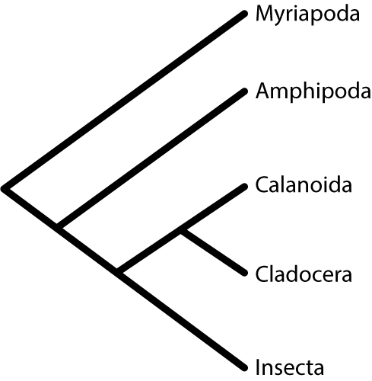
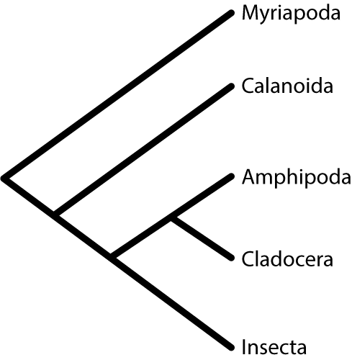
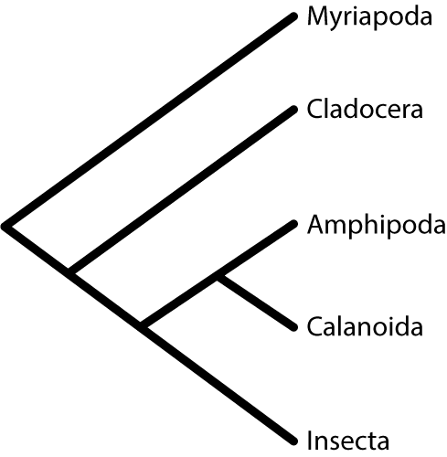
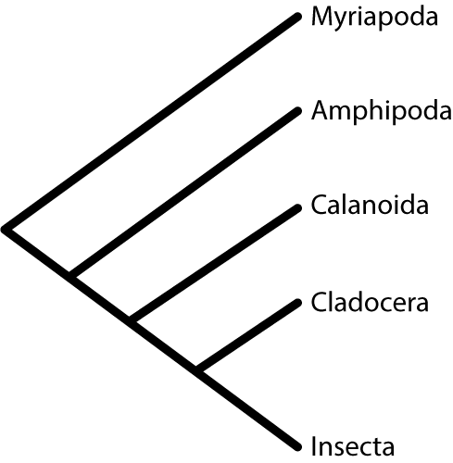
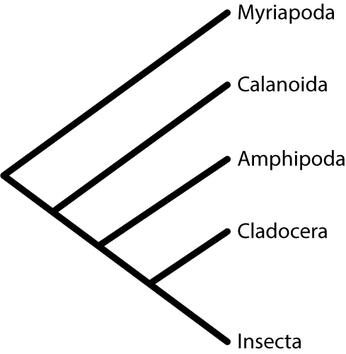
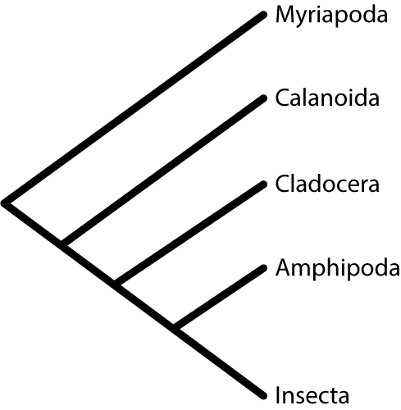
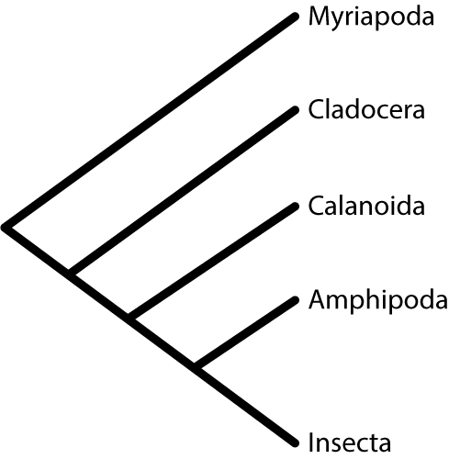
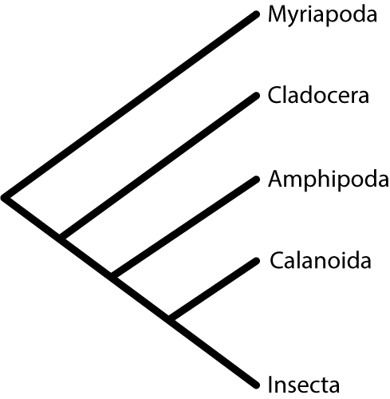
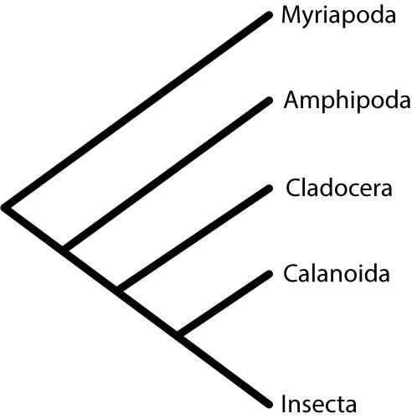

Slide 26

We observe 4 of the 15 possible pancrustacea topologies

Slide 27
We observe 4 of the 15 possible pancrustacea topologies
What happens if we decrease the number of species?

Slide 29
And if we decrease the number of species again?

Slide 31
Monophyletic crustacea?
Even with more genes, methods still disagree on the correct topology
Of the 15 possible topologies, we recovered 8
Half the methods support a monophyletic crustacea

Slide 32
Monophyletic crustacea?
Even with more genes, methods still disagree on the correct topology
Of the 15 possible topologies, we recovered 8
Half the methods support a
monophyletic crustacea

Slide 33
Multi-species order phylogeny construction
Order | # Species | # single-copy orthologs
Araneae | 4 | 1627
Hemiptera | 7 | 2053
Hymenoptera | 24 | 2121
Coleoptera | 6 | 3880
Lepidoptera | 5 | 3660
Diptera | 14 | 1324
Maximum Likelihood gene trees
2 alignment methods
3 species tree methods
MUSCLE
PASTA
Consensus
Concatenation
Coalescent

Slide 34
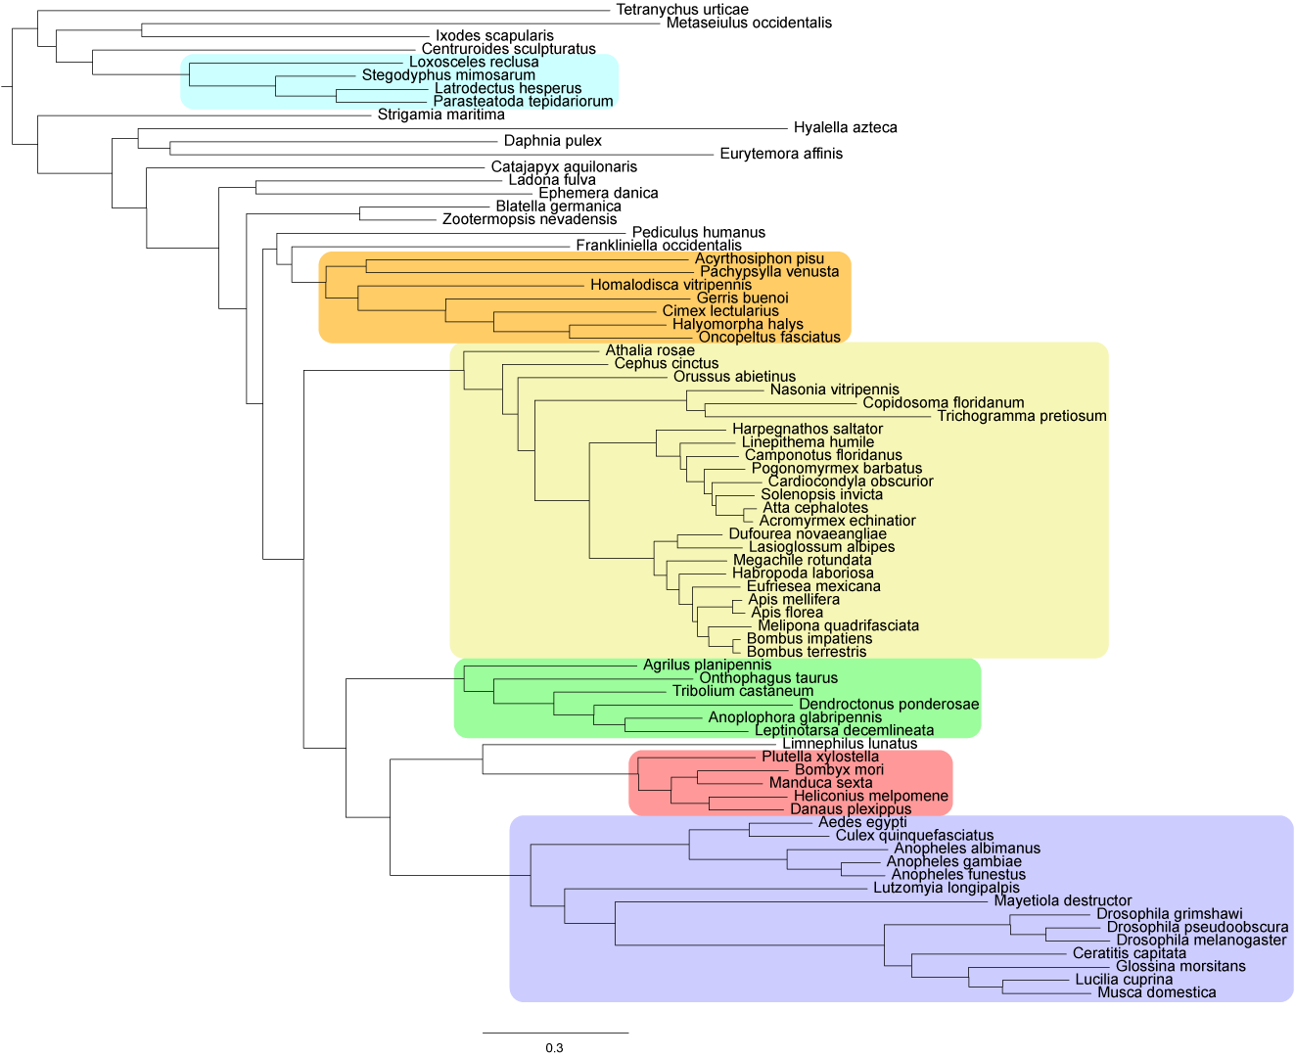
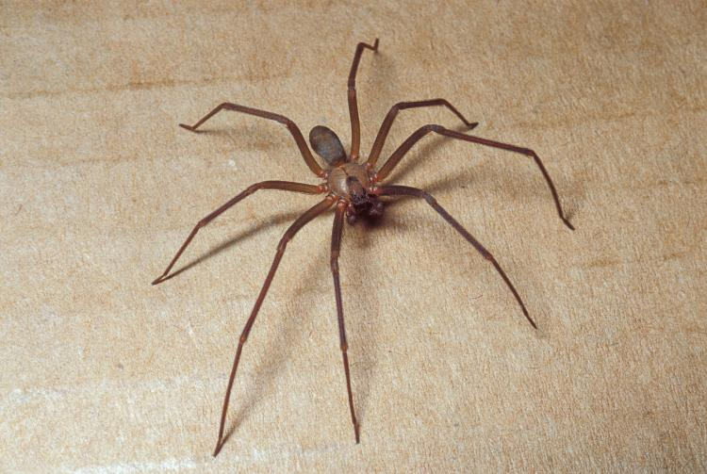
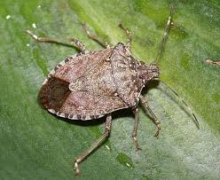

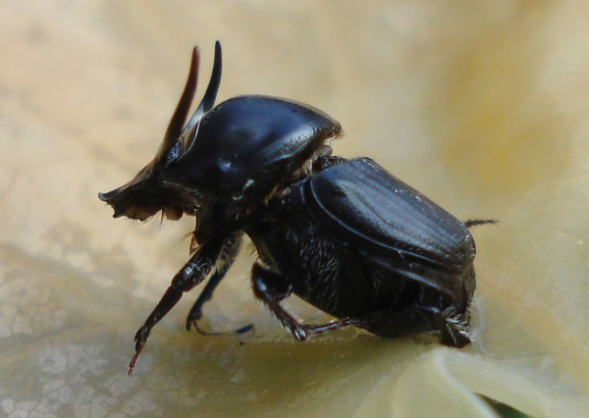

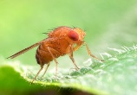
The Arthropod phylogeny
Araneae: 1627 genes
Hemiptera: 2053 genes
Hymenoptera: 2121 genes
Coleoptera: 3880 genes
Lepidoptera: 3660 genes
Diptera: 1324 genes

Slide 35
All methods agree
Araneae: 1627 genes
Hemiptera: 2053 genes
Hymenoptera: 2121 genes
Coleoptera: 3880 genes
Lepidoptera: 3660 genes
Diptera: 1324 genes

Slide 36
Disagreement between methods
Araneae: 1627 genes
Hemiptera: 2053 genes
Hymenoptera: 2121 genes
Coleoptera: 3880 genes
Lepidoptera: 3660 genes
Diptera: 1324 genes

Slide 37
Questions
What are the relationships among species and orders?
What are the patterns of genome evolution?
What did the genome of the last insect common ancestor (LICA) look like?

Slide 38
What are the rates of evolution?
  Amino acid substitution rates
  Gene gain/loss rates

Slide 39
Evolutionary rates require a time tree
Used a non-parametric method to smooth the tree
Used several fossil calibrations from Misof et al.

Slide 40
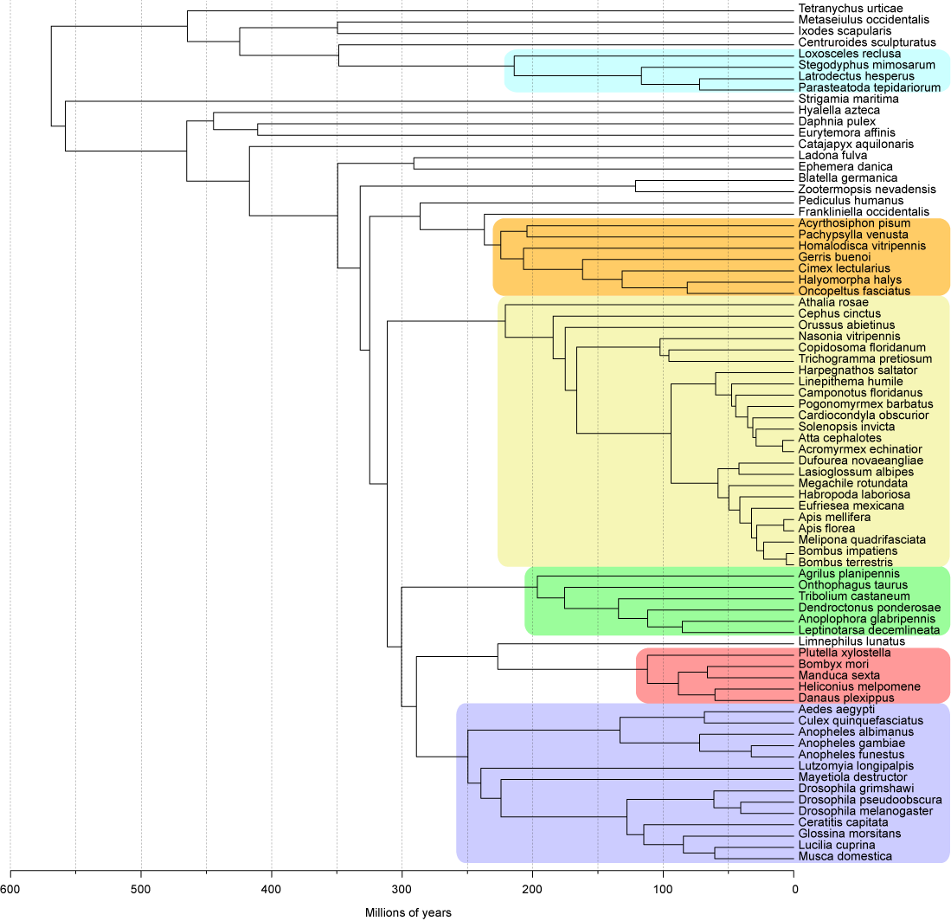
Arthropod Time Tree
LICA
350 mya
Holometabola
311 mya

Slide 41
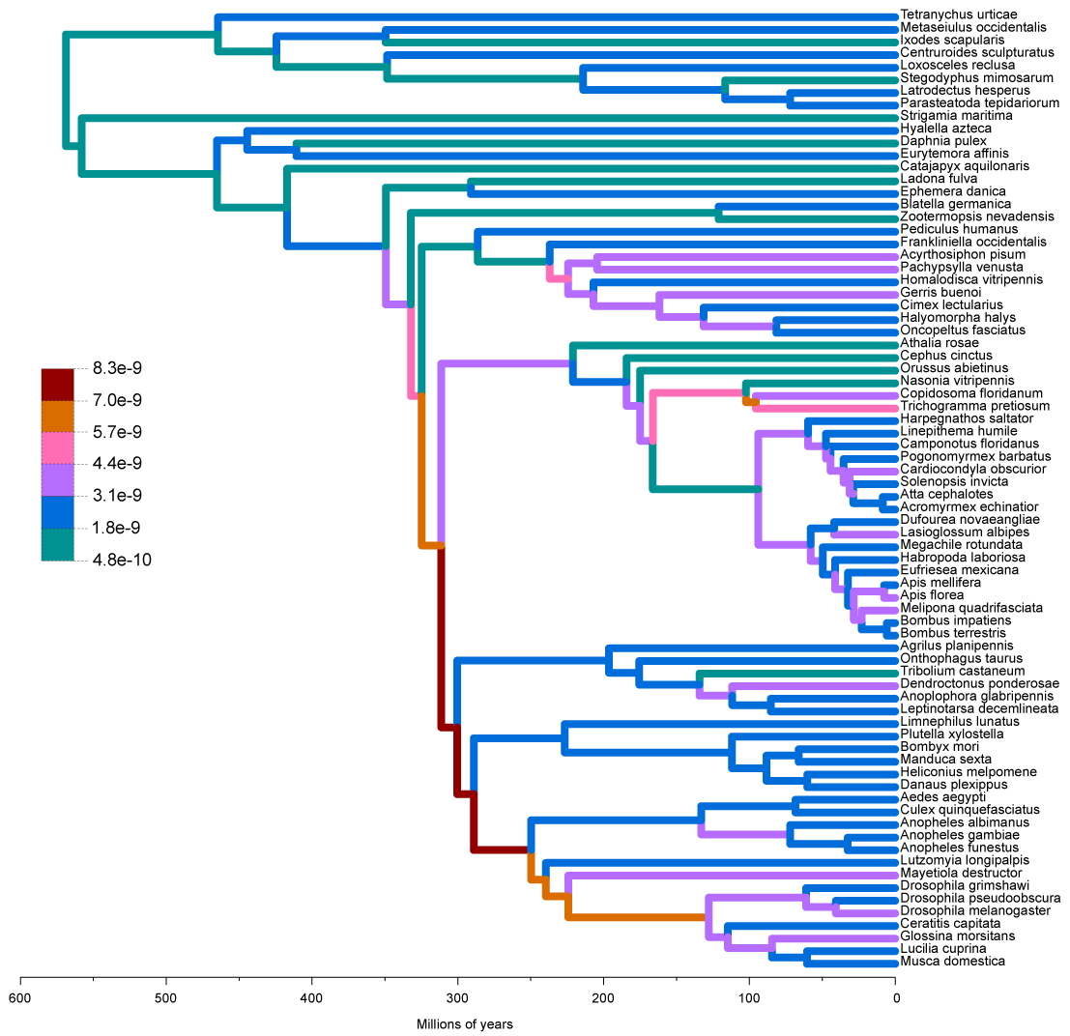
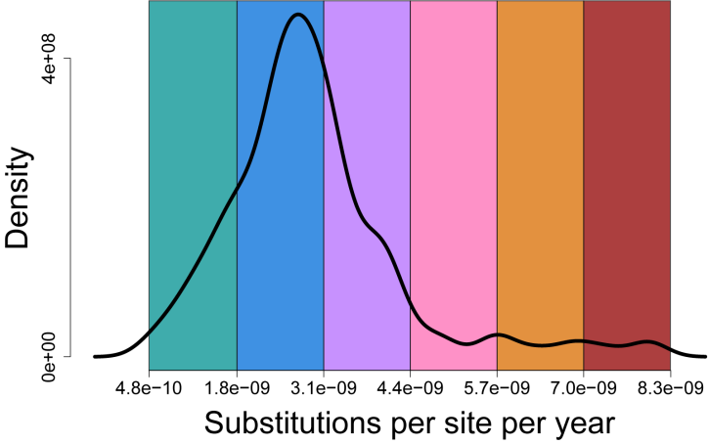
Substitution rates per site per year

Slide 42
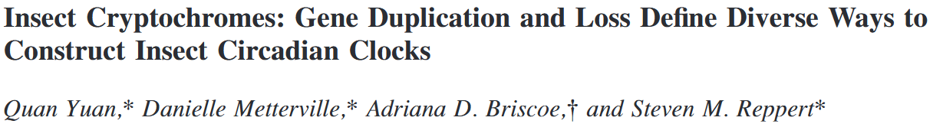

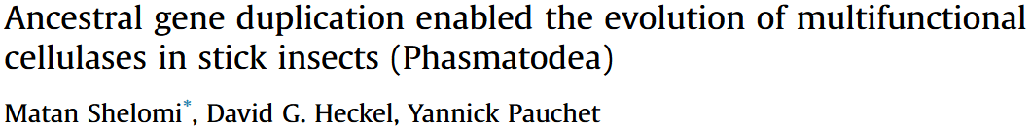
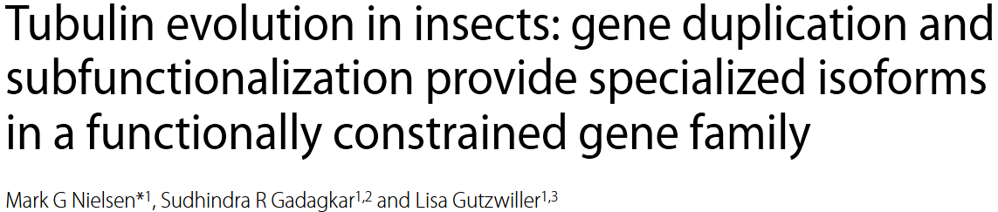
Gene duplications can lead to important functional evolution
Notes:
Gene families can change size between species due to lineage specific duplications or losses
Gene families that change in size significantly along a lineage may correspond with functional changes

Slide 43
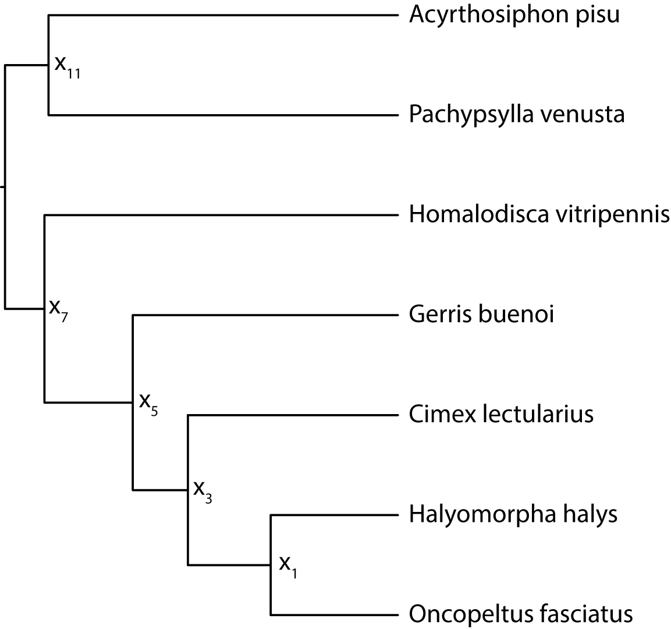

Gene family analysis: Example
1
Tips: observed variables
x_{i}: hidden variables
3
1
1
1
0
0

Slide 44
Gene family analysis: Example
1
Tips: observed variables
x_{i}: hidden variables
Our goal is to infer the states of the internal nodes of the tree
1
3
1
1
1
1
1
1
0
0
0

Slide 45
Gene family analysis: Example
1
Tips: observed variables
x_{i}: hidden variables
Our goal is to infer the states of the internal nodes of the tree
Then we can count changes along each lineage
1
+2
3
1
1
1
1
1
1
0
0
-1
0

Slide 46
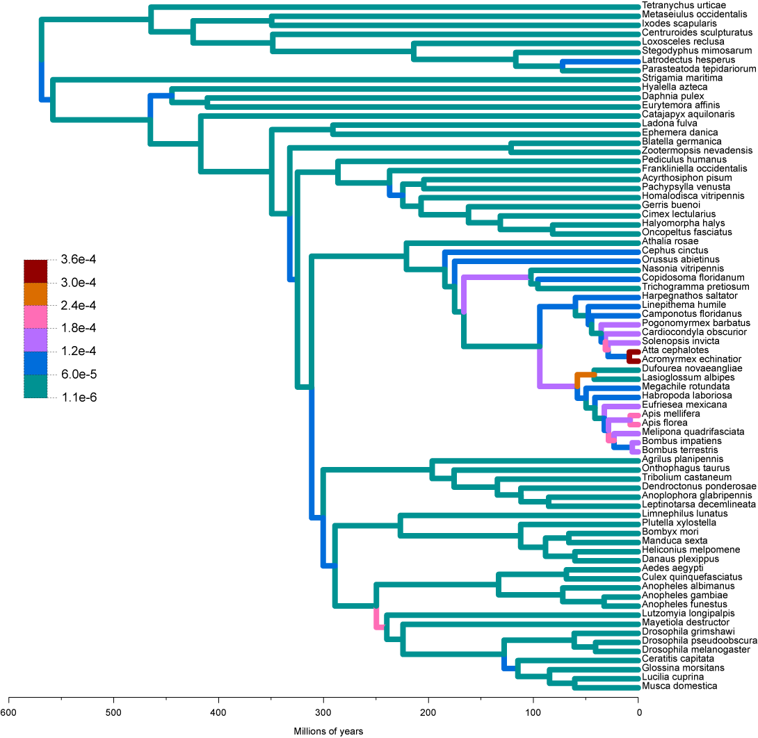
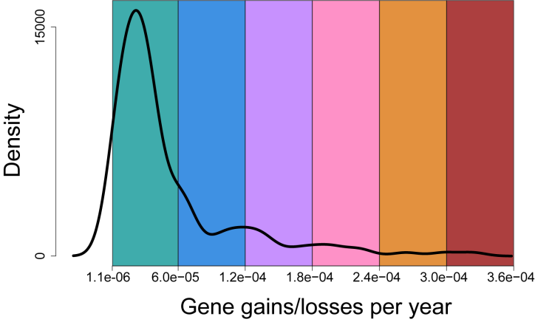
Genes gained/lost per year

Slide 47
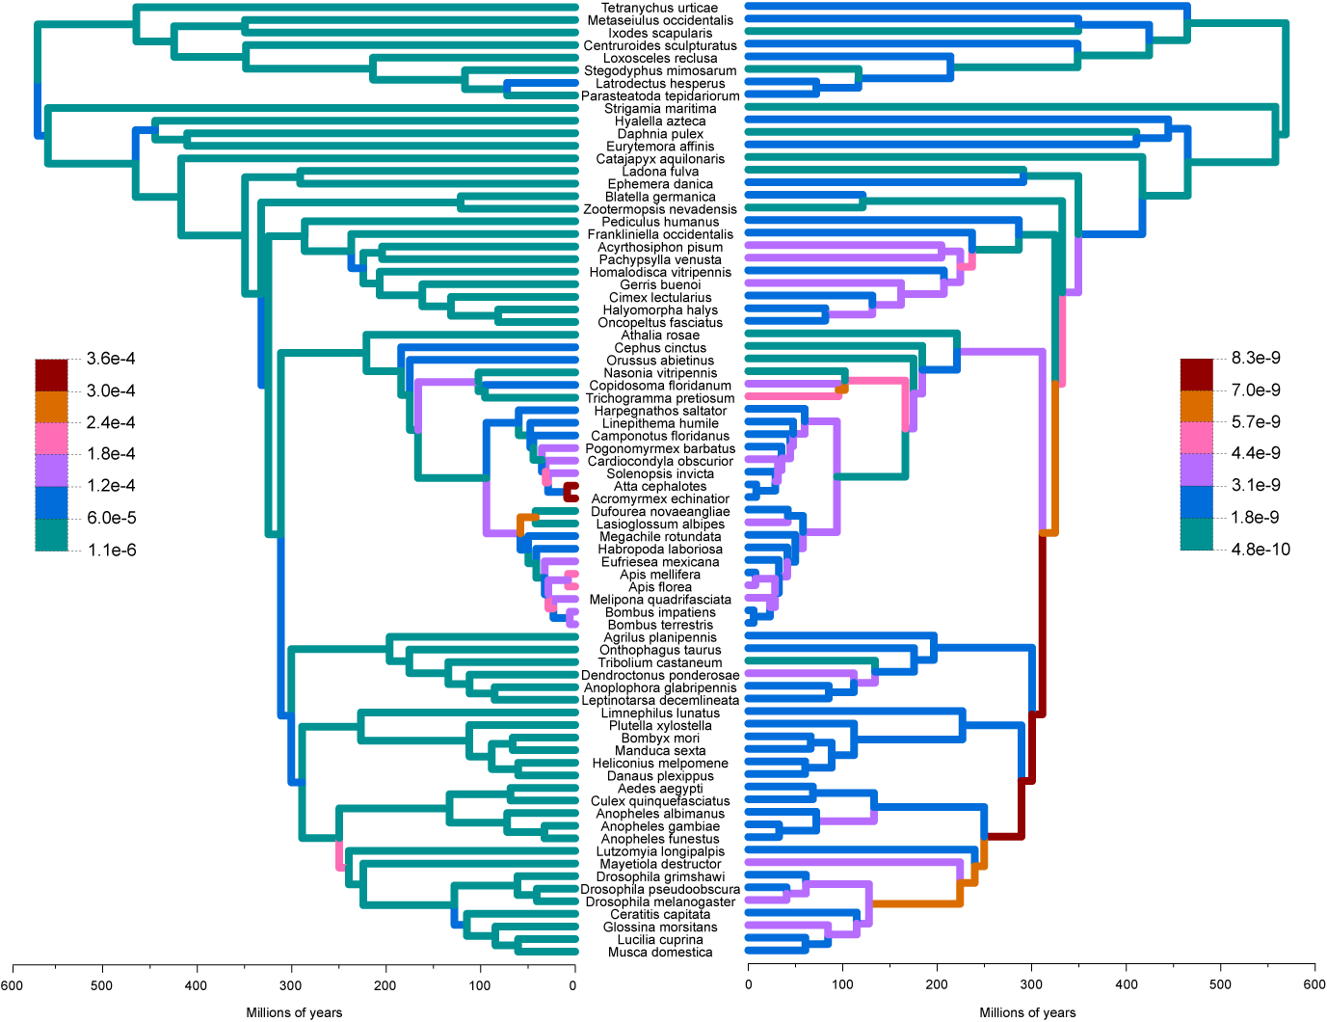
No correlation between gain/loss rates and substitution rates
Genes gained/lost per year
Substitutions per site per year

Slide 48
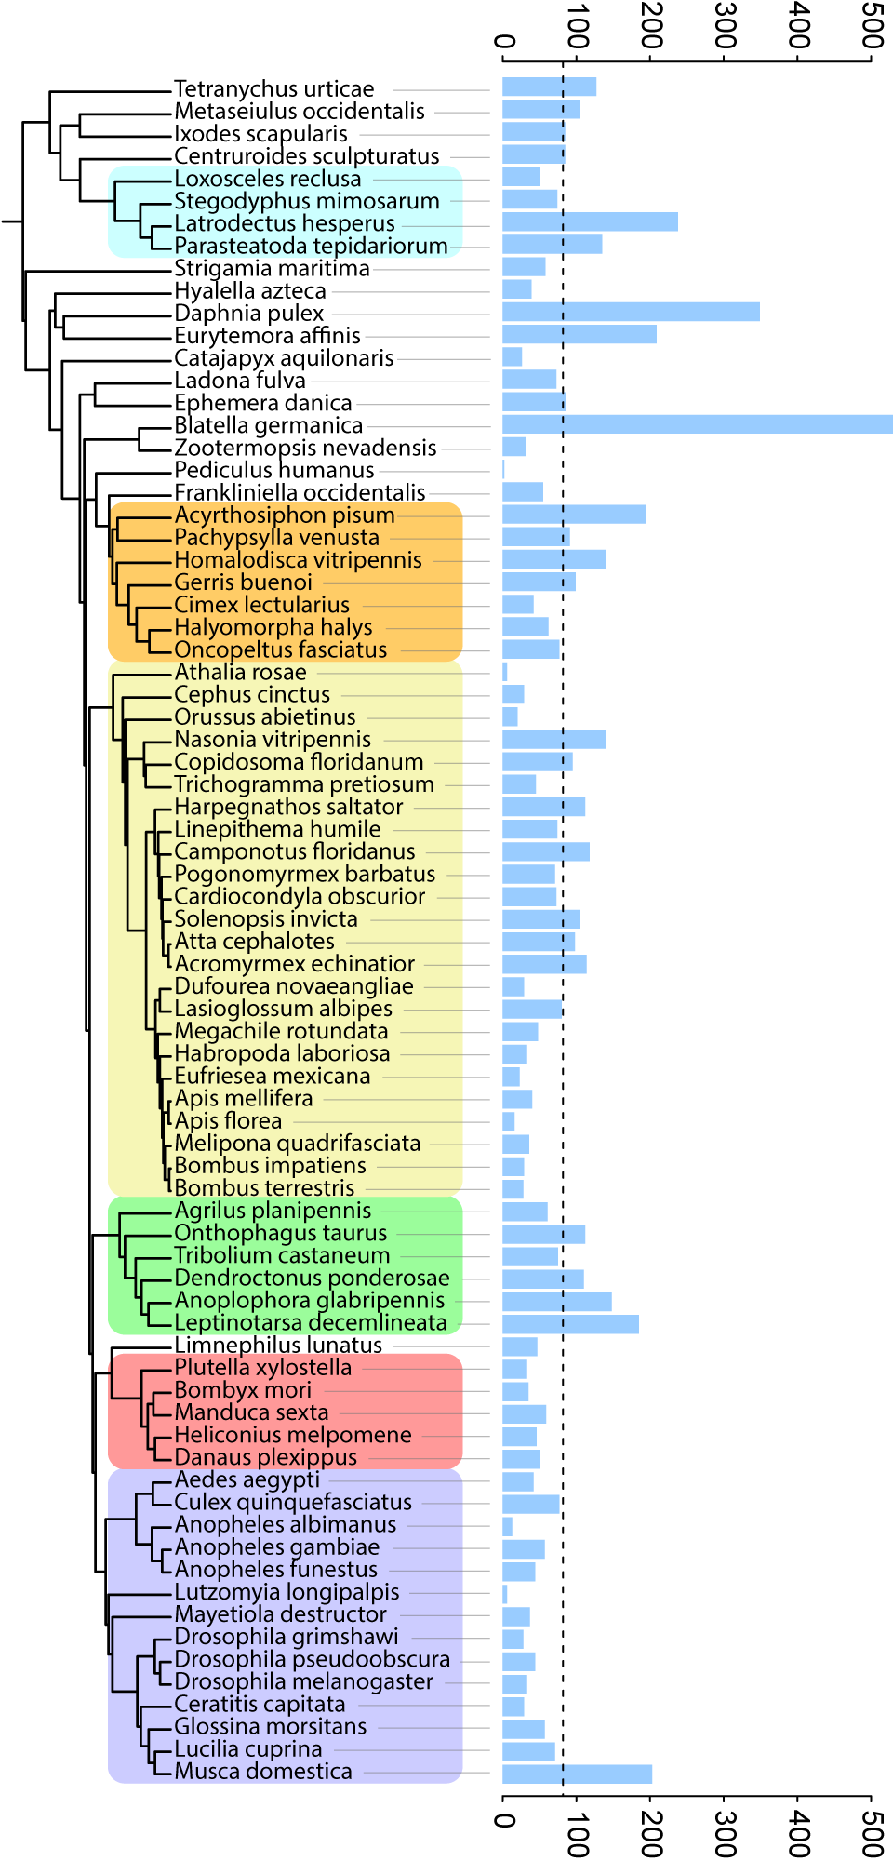
Rapidly evolving gene families
# of rapidly evolving families

Slide 49
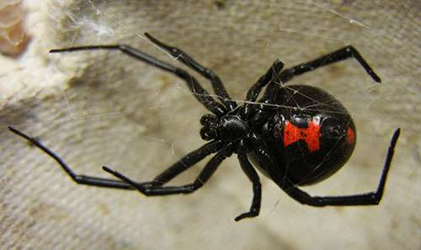

Rapidly evolving gene families
Several families related to venom and silk production rapidly expanding among spiders
Jessica Garb
# of rapidly evolving families

Slide 50
Rapidly evolving gene families
German cockroach has highest number of rapidly evolving families, despite low gene gain/loss rate
EOG8D294J rapidly evolving only in Blatella germanica
Gained 34 genes
response to light stimulus
locomotor rhythm
# of rapidly evolving families

Slide 51

Rapidly evolving gene families
German cockroach has highest number of rapidly evolving families, despite low gene gain/loss rate
EOG8D294J rapidly evolving only in Blatella germanica
Gained 34 genes
response to light stimulus
locomotor rhythm
# of rapidly evolving families

Slide 52

Tip-specific gene families
Families present only in a single species
Spikes occur in both species with low quality AND highly annotated genomes
# of tip specific families

Slide 53

Order-specific gene families
Families that are found only in that order AND in every species in that order
# of order specific families

Slide 54
Order-specific gene families
Families that are found only in that order AND in every species in that order
Large number of Lepidoptera specific families
5 families with odorant/olfactory functions
3 families involved in response to stress
# of order specific families

Slide 55
Questions
What are the relationships among species and orders?
What are the patterns of genome evolution?
What did the genome of the last insect common ancestor (LICA) look like?

Slide 56



What does the ancestral insect look like?

Slide 57
What does the ancestral insect look like?
How can we infer characteristics about the genome of the last insect common ancestor (LICA)?

Slide 58

How can we infer characteristics of the genome of LICA?
0
2
x₁₉
x₁₇
2
x₁₈
2
x₁₆
1
2
4
x₁₅
x₁₃
2
x₁₂
2
x₁₄
0
2
x₁₁
x₉
2
x₁₀
0
LICA
5
x₈
x₆
2
x₅
3
x₇
1
1
x₄
1
x₁
0
x₃
x₂
1

Slide 59
How can we infer characteristics of the genome of LICA?
0
2
x₁₉
x₁₇
2
x₁₈
2
x₁₆
1
2
4
x₁₅
x₁₃
2
x₁₂
2
How many genes were present in the LICA genome?
x₁₄
0
2
x₁₁
x₉
2
x₁₀
0
LICA
5
x₈
x₆
2
x₅
3
x₇
1
1
x₄
1
x₁
0
x₃
x₂
1

Slide 60
How can we infer characteristics of the genome of LICA?
0
2
x₁₉
x₁₇
2
x₁₈
2
x₁₆
1
2
4
x₁₅
x₁₃
2
x₁₂
2
How many genes were present in the LICA genome?
x₁₄
0
2
x₁₁
x₉
2
x₁₀
9,601 genes
0
LICA
5
x₈
x₆
2
x₅
3
x₇
1
1
x₄
1
x₁
0
x₃
x₂
1

Slide 61

Estimates of ancestral genome size are biased because of extinct gene families
LICA

Slide 62

Corrected # of genes in the LICA genome:
14,615
LICA
LICA
# of genes

Slide 63
How can we infer characteristics of the genome of LICA?
0
0
0
0
0
0
0
0
0
0
0
0
0
0
Which families were ‘born’ during the transition to insects?
0
0
0
0
2
0
2
2
+1
1
0
5
1
2
2
2
3
2
1
1
1
1
1
0
1
1
1

Slide 64
How can we infer characteristics of the genome of LICA?
0
0
0
0
0
0
0
0
0
0
0
0
0
0
Which families were ‘born’ during the transition to insects?
0
0
0
0
2
0
2
2
+1
1
0
5
147 novel insect families
1
2
2
2
3
2
1
1
1
1
1
0
1
1
1

Slide 65
Novel insect families correspond to insect lifestyle adaptations
Changes in exoskeleton development
7 chitin and cuticle production families

Slide 66
Novel insect families correspond to insect lifestyle adaptations
Changes in exoskeleton development
7 chitin and cuticle production families
Ability to sense in a terrestrial environment
1 visual learning and behavior family
2 odorant binding families
5 families involved in neural activity

Slide 67
Novel insect families correspond to insect lifestyle adaptations
Changes in exoskeleton development
7 chitin and cuticle production families
Ability to sense in a terrestrial environment
1 visual learning and behavior family
2 odorant binding families
5 families involved in neural activity
Unique development
1 larval behavior family
4 imaginal disk development families

Slide 68
Novel insect families correspond to insect lifestyle adaptations
Changes in exoskeleton development
7 chitin and cuticle production families
Ability to sense in a terrestrial environment
1 visual learning and behavior family
2 odorant binding families
5 families involved in neural activity
Unique development
1 larval behavior family
4 imaginal disk development families
Flight
3 wing morphogenesis families

Slide 69

All data has been made available in our online tool https://cgi.soic.indiana.edu/~grthomas/i5k/i5k_phylo.html

Slide 70

All data has been made available in our online tool https://cgi.soic.indiana.edu/~grthomas/i5k/i5k_phylo.html

Slide 71
Acknowledgments
Matthew Hahn
Stephen Richards
Rob Waterhouse
Jessica Garb
Elias Dohmen
Ariel Chipman
The i5k community
The Hahn lab + Clara Boothby
i5k website:
http://i5k.github.io/
Gene family website: https://cgi.soic.indiana.edu/~grthomas/i5k/i5k_phylo.html

