Slide 1
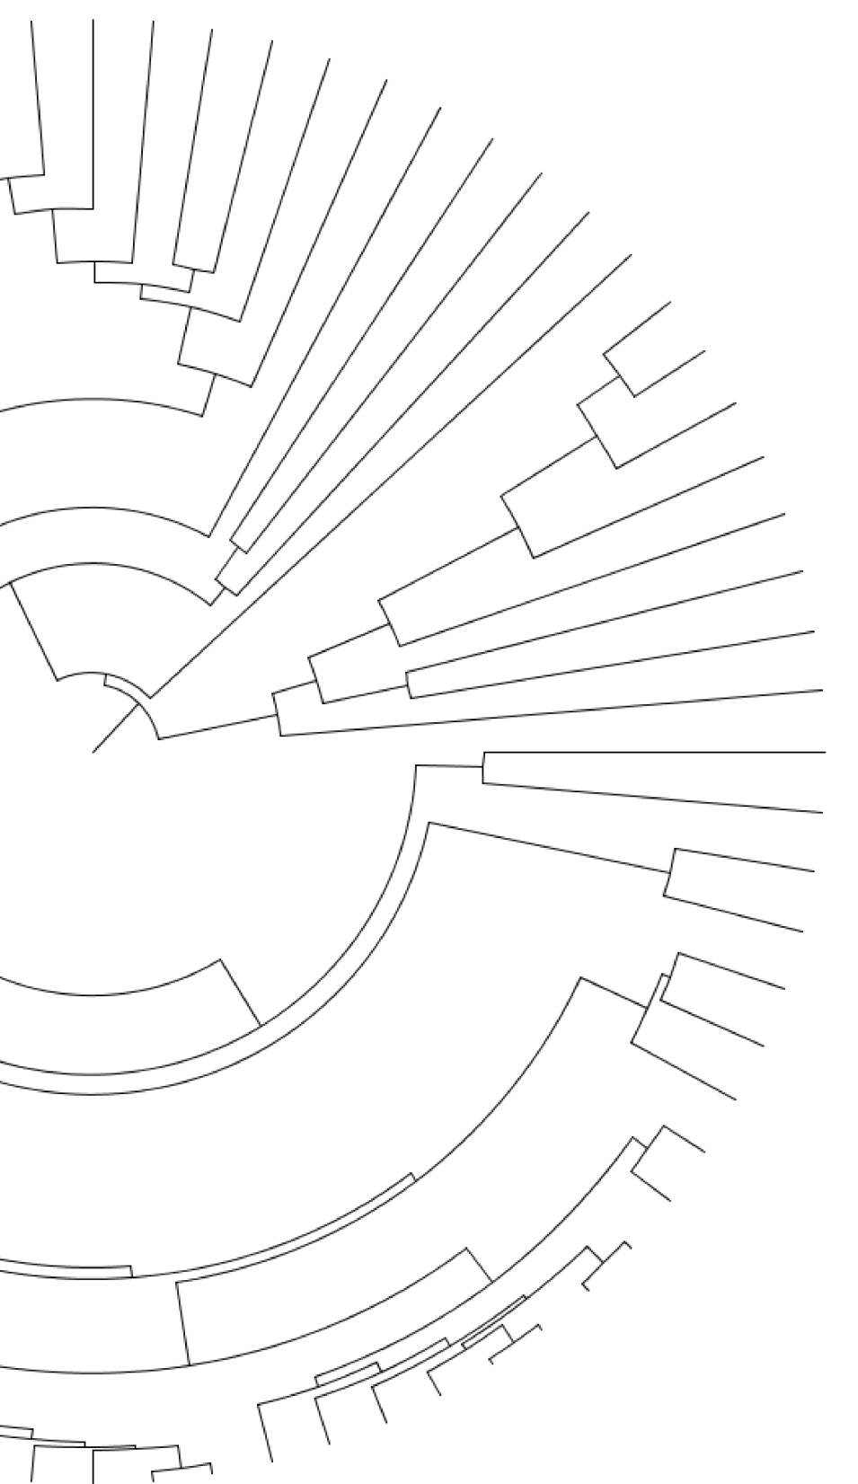
Evolution of the genes and genomes of 76 arthropod species
Gregg Thomas
Indiana University
@greggwcthomas
Evolution, 06.26.17

Slide 2
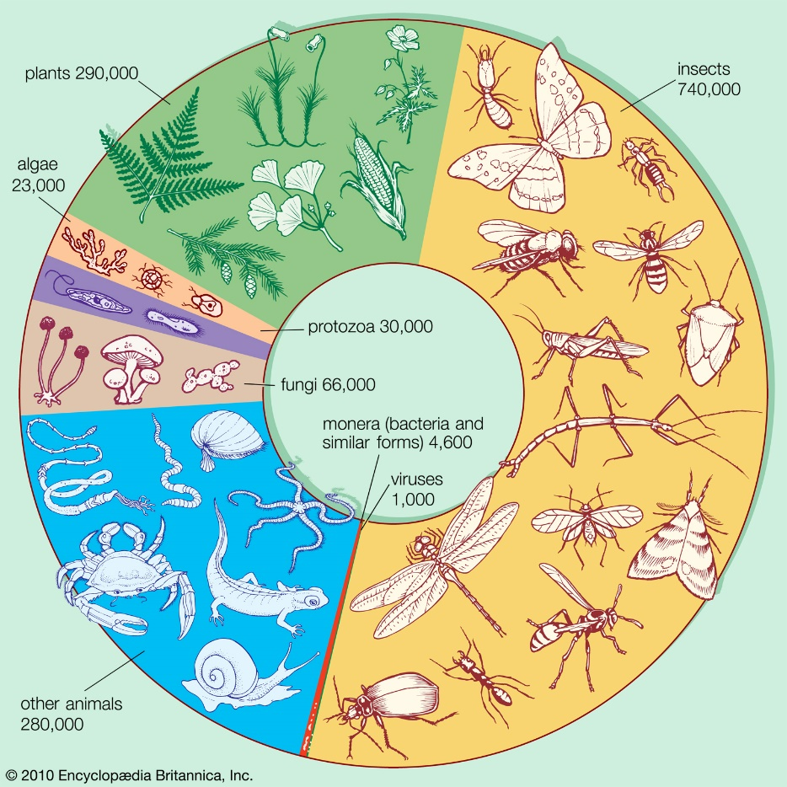
Arthropods are the largest group of multicellular organisms

Slide 3
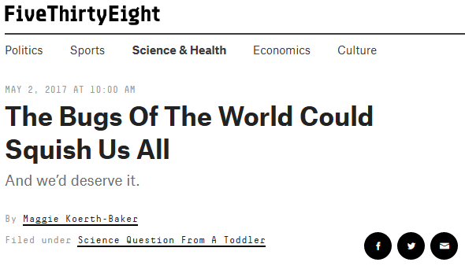
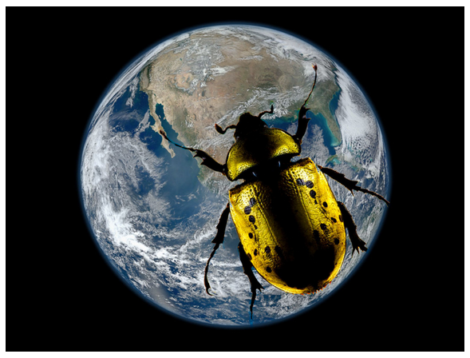
Arthropods are the largest group of multicellular organisms
https://fivethirtyeight.com/features/the-bugs-of-the-world-could-squish-us-all/

Slide 4
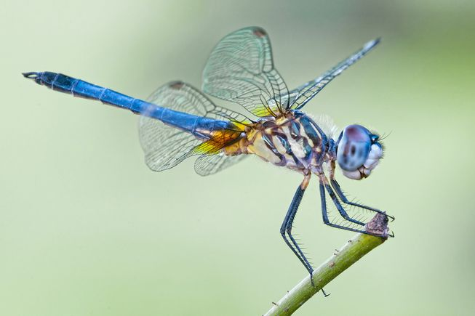
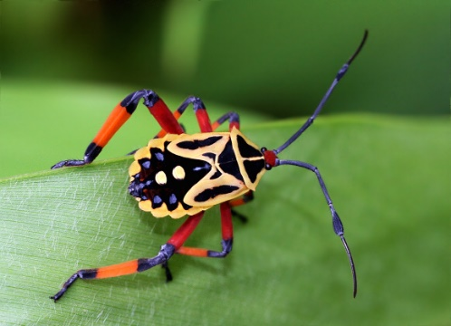
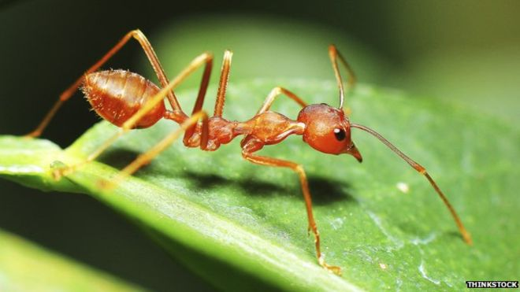
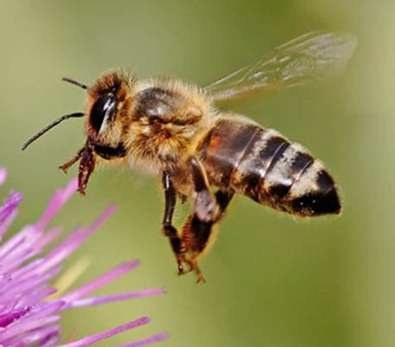
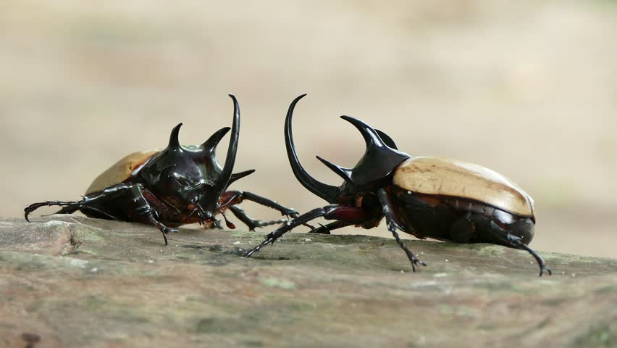
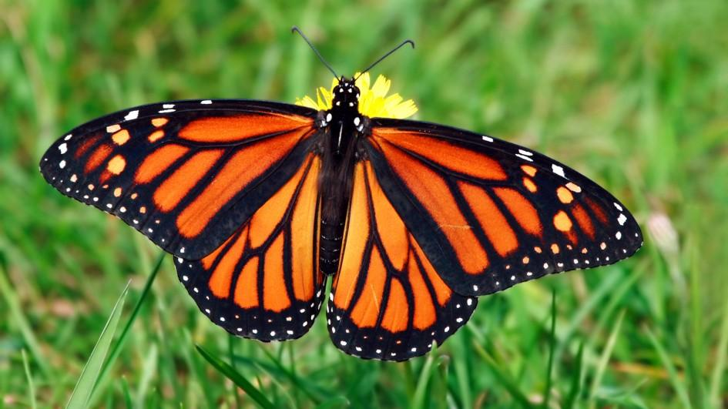
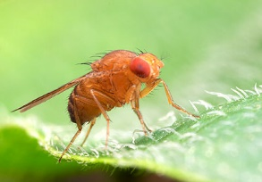
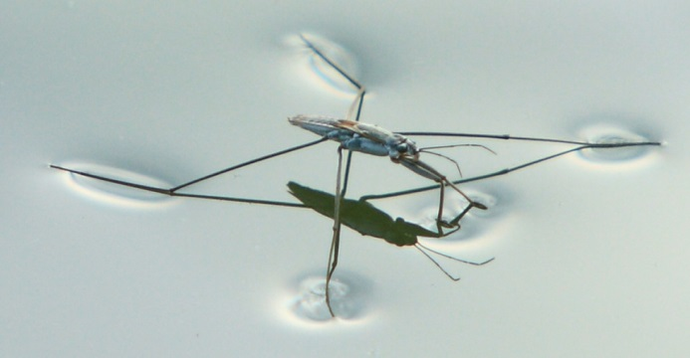
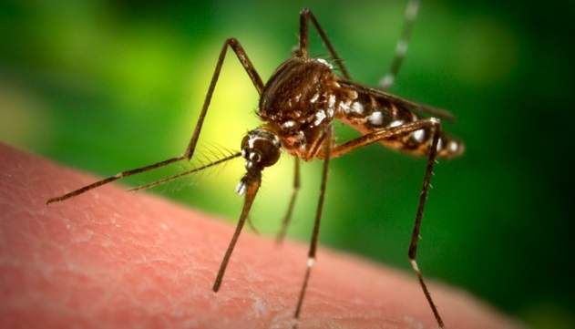
Arthropods exhibit great phenotypic and behavioral diversity

Slide 5
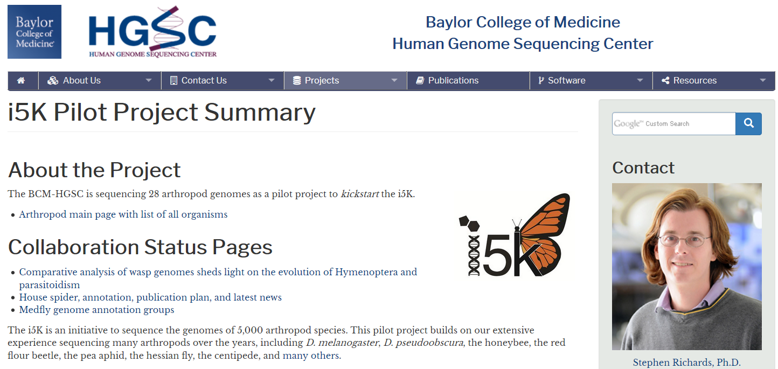
The i5k pilot project has sequenced 27 insect genomes
https://www.hgsc.bcm.edu/arthropods/i5k

Slide 6
27 genomes sequenced as part of the i5k pilot project

Slide 7
27 genomes sequenced as part of the i5k pilot project
49 previously sequenced arthropod genomes
+

Slide 8
27 genomes sequenced as part of the i5k pilot project
49 previously sequenced arthropod genomes
Spanning 21 arthropod orders
(4 species)
+
(2 species)
(7 species)
(24 species)
(6 species)
(5 species)
(14 species)

Slide 9
Questions
What are the relationships among species and orders?
What are the patterns of genome evolution?
What did the genome of the last insect common ancestor (LICA) look like?

Slide 10
Questions
What are the relationships among species and orders?
What are the patterns of genome evolution?
What did the genome of the last insect common ancestor (LICA) look like?

Slide 11
Orthology prediction from OrthoDB
38,195 ortho-groups across 76 arthropod species
Rob Waterhouse

Slide 12
Backbone Phylogeny Construction
Phylum | # Orders | # single-copy orthologs
Arthropoda | 21 | 150

Slide 13
Backbone Phylogeny Construction
Phylum | # Orders | # single-copy orthologs
Arthropoda | 21 | 150
Maximum Likelihood gene trees
2 alignment methods
3 species tree methods
MUSCLE
PASTA
Consensus
Concatenation
Coalescent

Slide 14
The backbone phylogeny based on:
-150 genes
-PASTA alignment
-ASTRAL
(4 species)
(2 species)
(7 species)
(24 species)
(6 species)
(5 species)
(14 species)

Slide 15
The backbone phylogeny based on:
-150 genes
-Pasta alignment
-ASTRAL
(4 species)
(2 species)
Monophyletic Crustacea??
(7 species)
(24 species)
(6 species)
(5 species)
(14 species)

Slide 16
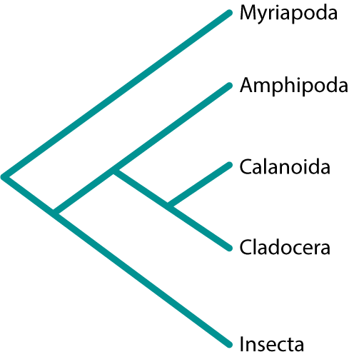
Monophyletic Crustacea?
Our inferred topology…

Slide 17
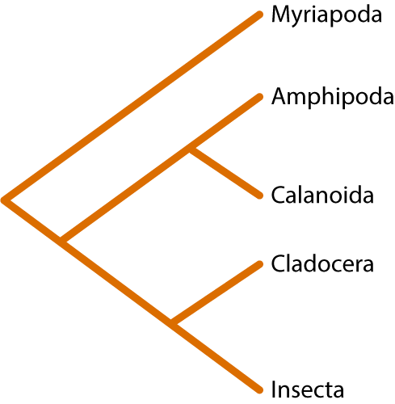
Monophyletic Crustacea?
Our inferred topology…
…differs from other inferred topologies

Slide 18
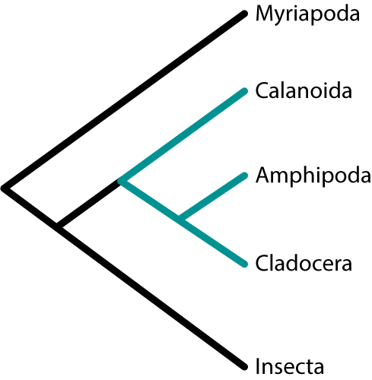
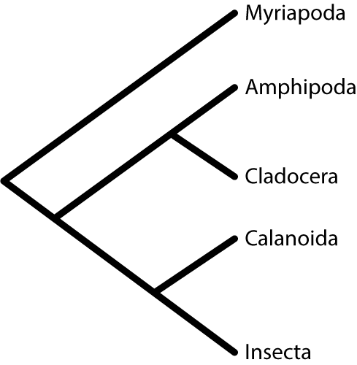
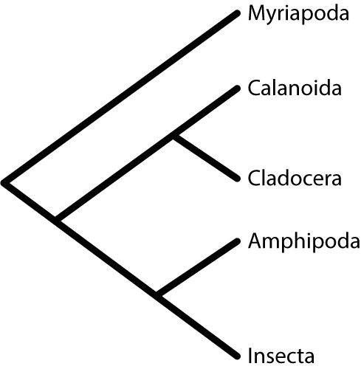
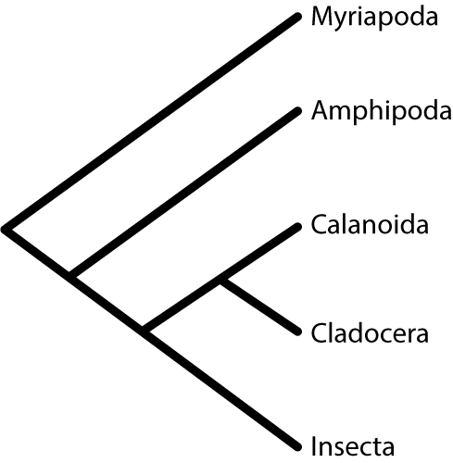
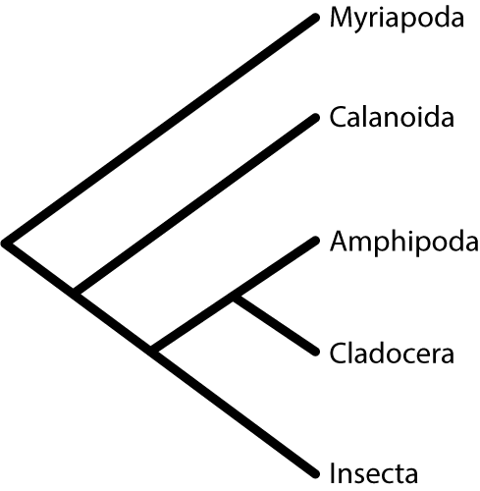
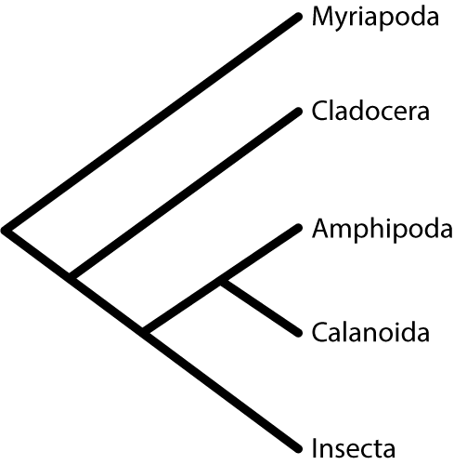
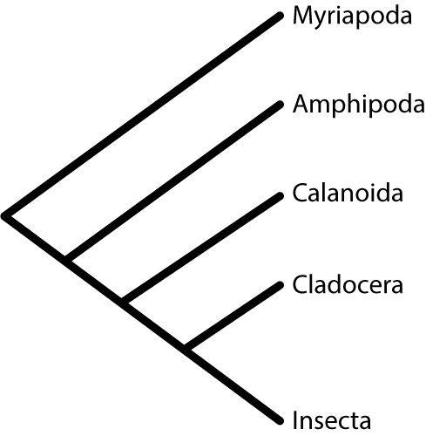
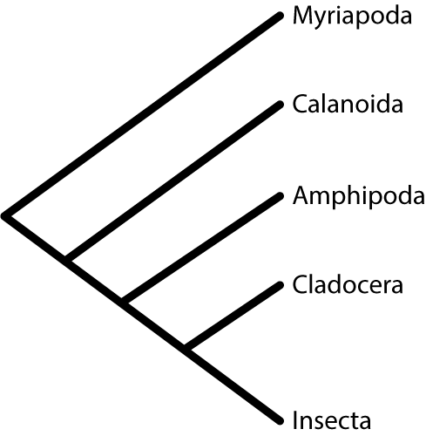
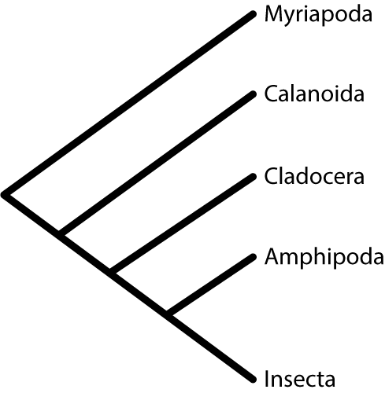
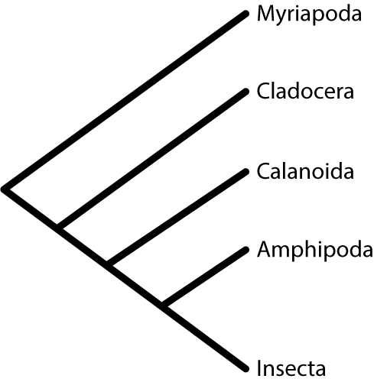
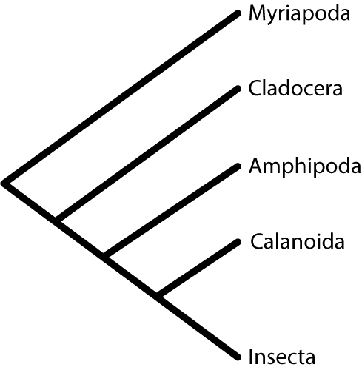
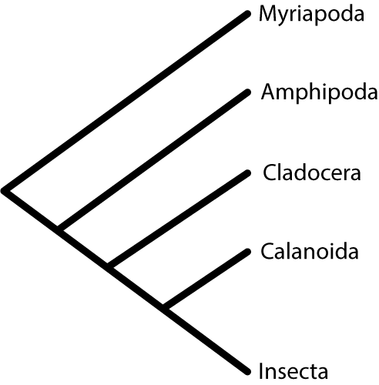

Slide 19
We observe 4 of the 15 possible pancrustacea topologies

Slide 20
We observe 4 of the 15 possible pancrustacea topologies
What happens if we decrease the number of species?

Slide 22
And if we decrease the number of species again?

Slide 24
Monophyletic crustacea?
Even with more genes, methods still disagree on the correct topology
Of the 15 possible topologies, we recovered 9
Half the methods support a monophyletic crustacea

Slide 25
Monophyletic crustacea?
Even with more genes, methods still disagree on the correct topology
Of the 15 possible topologies, we recovered 8
Half the methods support a
monophyletic crustacea

Slide 26
Multi-species order phylogeny construction
Order | # Species | # single-copy orthologs
Araneae | 4 | 1627
Hemiptera | 7 | 2053
Hymenoptera | 24 | 2121
Coleoptera | 6 | 3880
Lepidoptera | 5 | 3660
Diptera | 14 | 1324
Maximum Likelihood gene trees
2 alignment methods
3 species tree methods
MUSCLE
PASTA
Consensus
Concatenation
Coalescent

Slide 27
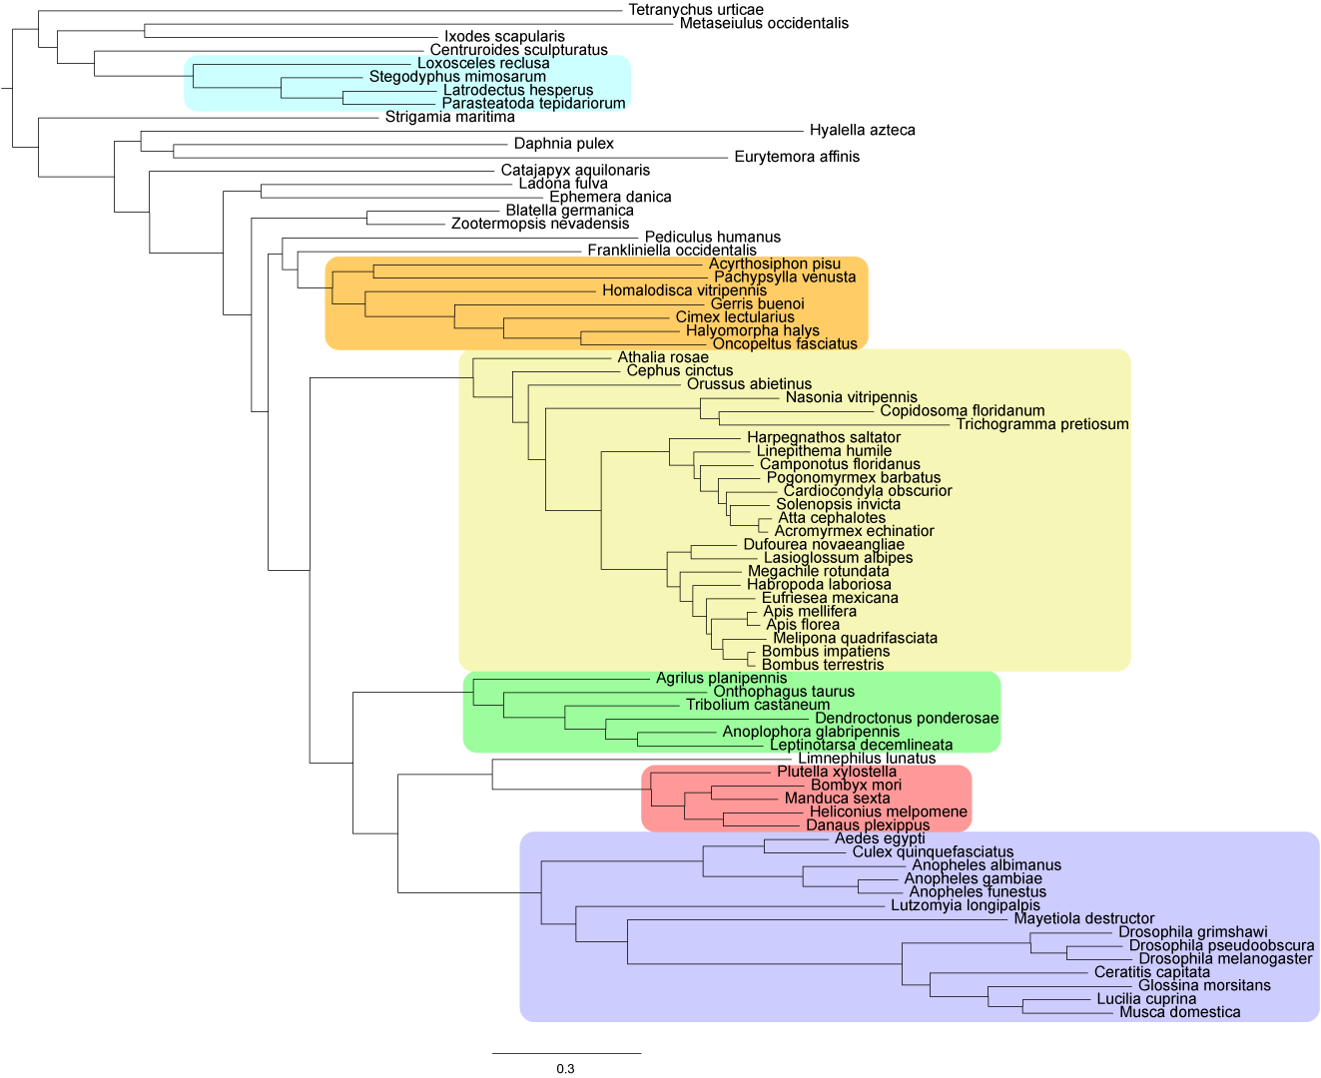
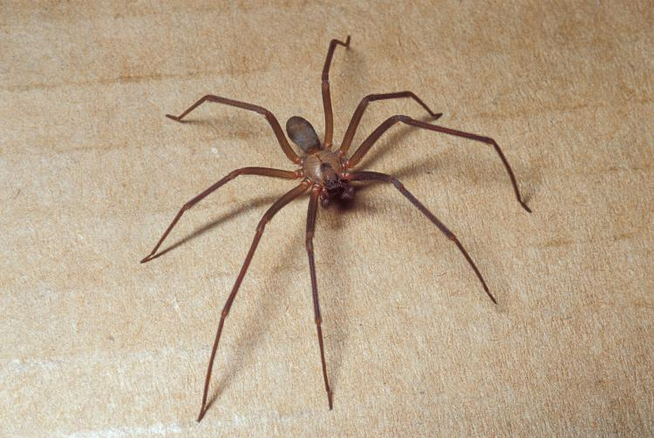
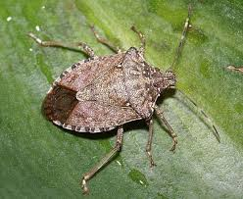
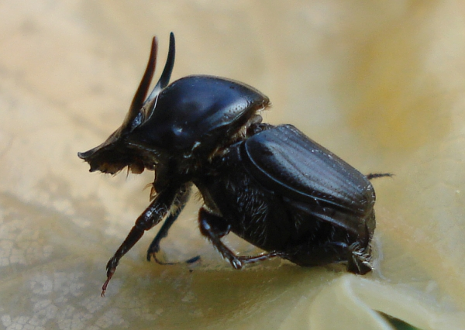
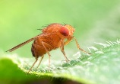
The Arthropod phylogeny
Araneae: 1627 genes
Hemiptera: 2053 genes
Hymenoptera: 2121 genes
Coleoptera: 3880 genes
Lepidoptera: 3660 genes
Diptera: 1324 genes

Slide 28
All methods agree
Araneae: 1627 genes
Hemiptera: 2053 genes
Hymenoptera: 2121 genes
Coleoptera: 3880 genes
Lepidoptera: 3660 genes
Diptera: 1324 genes

Slide 29
Disagreement between methods
Araneae: 1627 genes
Hemiptera: 2053 genes
Hymenoptera: 2121 genes
Coleoptera: 3880 genes
Lepidoptera: 3660 genes
Diptera: 1324 genes

Slide 30
Questions
What are the relationships among species and orders?
What are the patterns of genome evolution?
What did the genome of the last insect common ancestor (LICA) look like?

Slide 31
What are the rates of evolution?
Amino acid substitution rates
Gene gain/loss rates

Slide 32
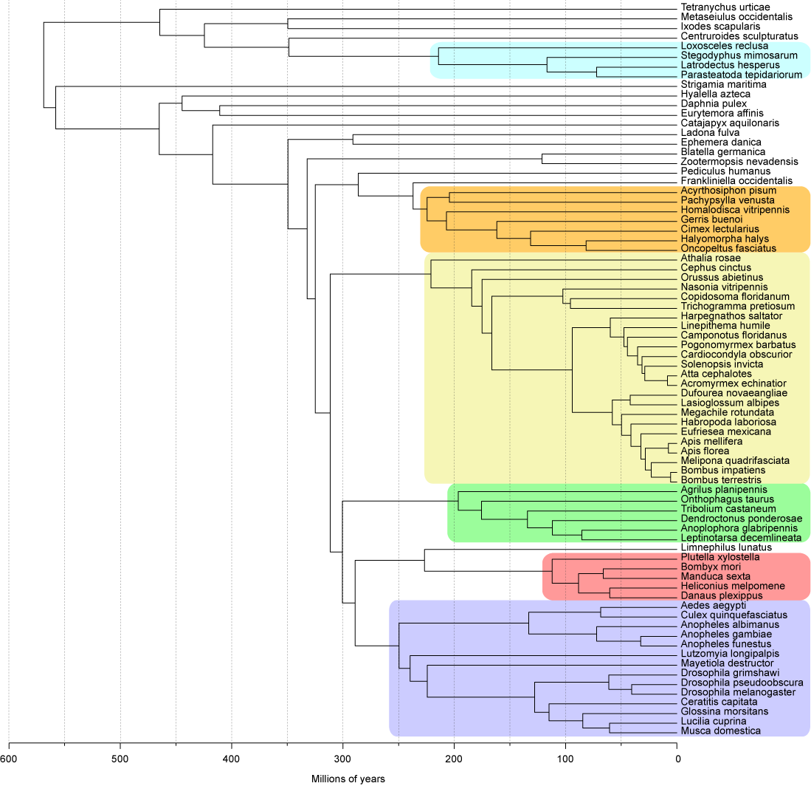
Arthropod Time Tree
LICA
350 mya
Holometabola
311 mya

Slide 33
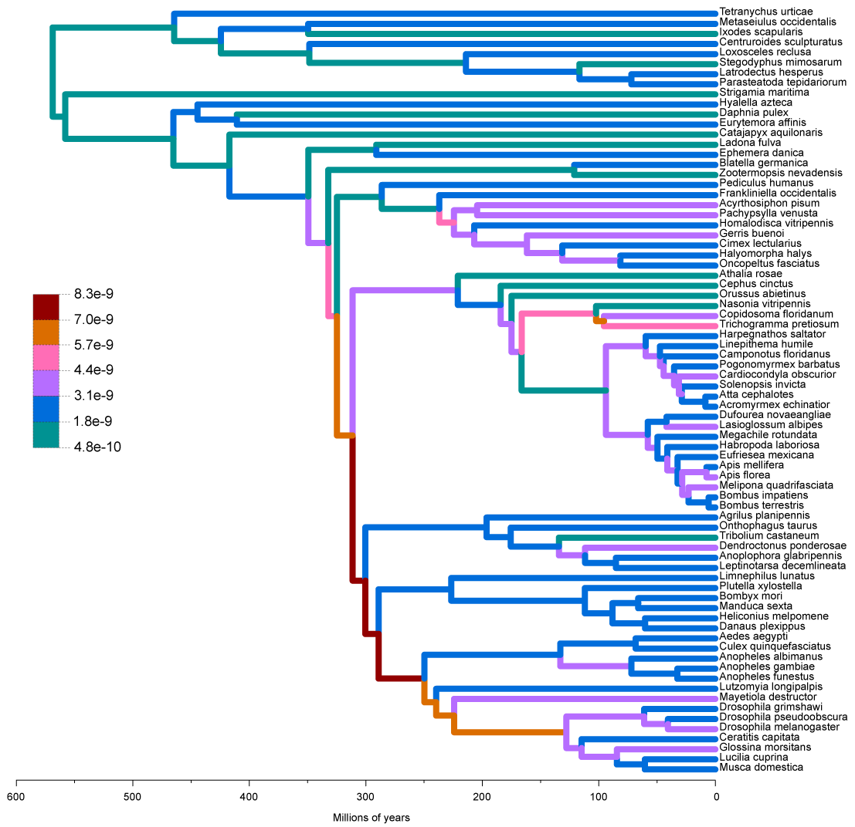
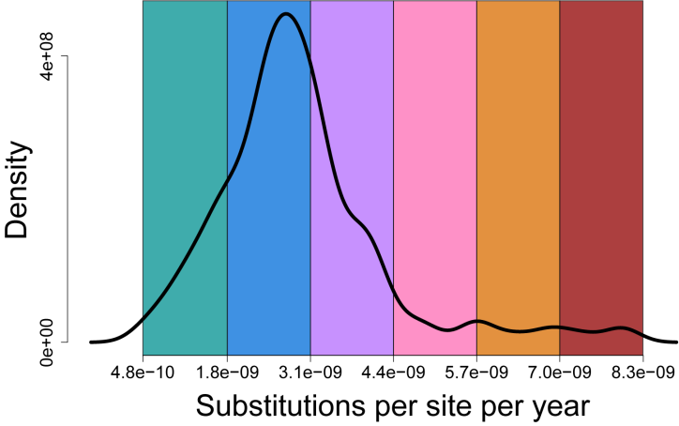
Substitution rates per site per year

Slide 34
Genes gained/lost per year

Slide 35
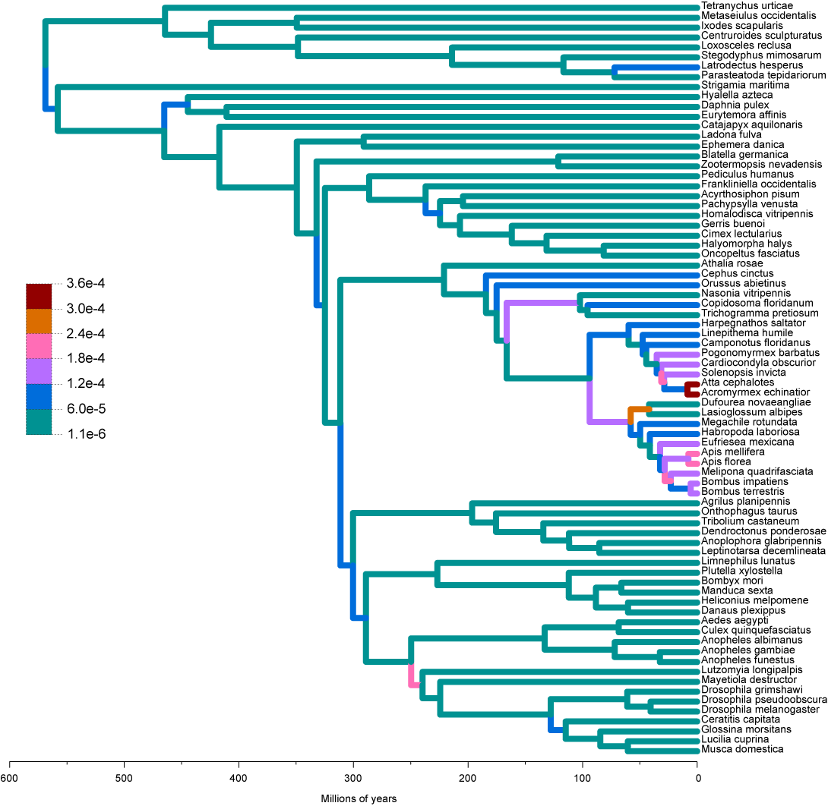
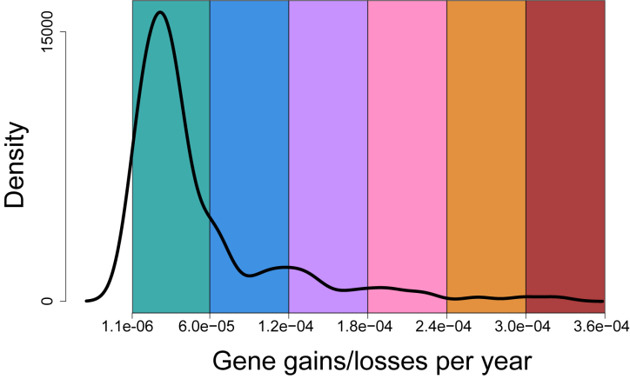
Genes gained/lost per year

Slide 36
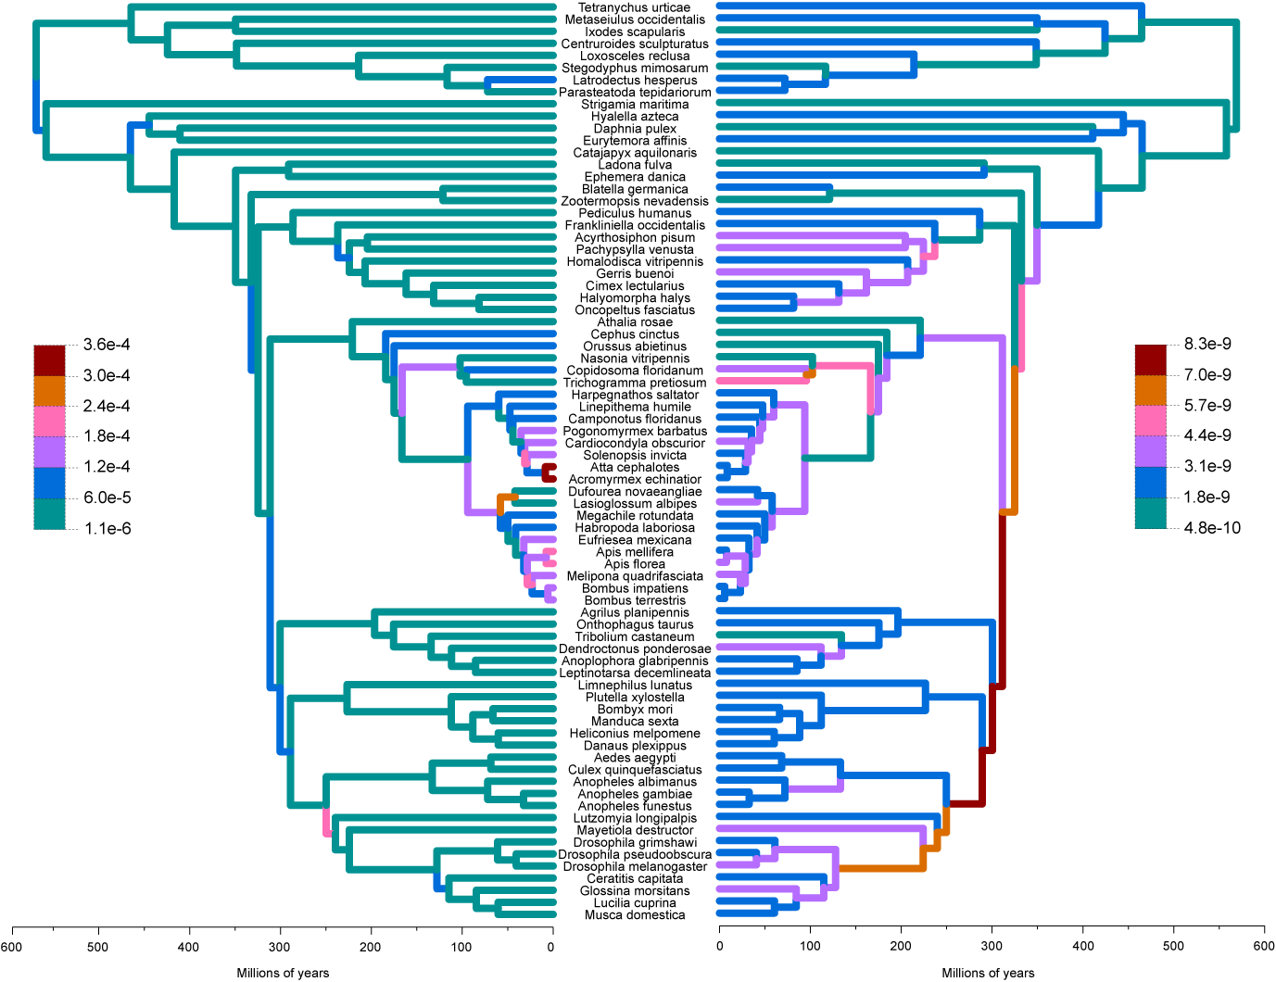
No correlation between gain/loss rates and substitution rates
Genes gained/lost per year
Substitutions per site per year

Slide 37
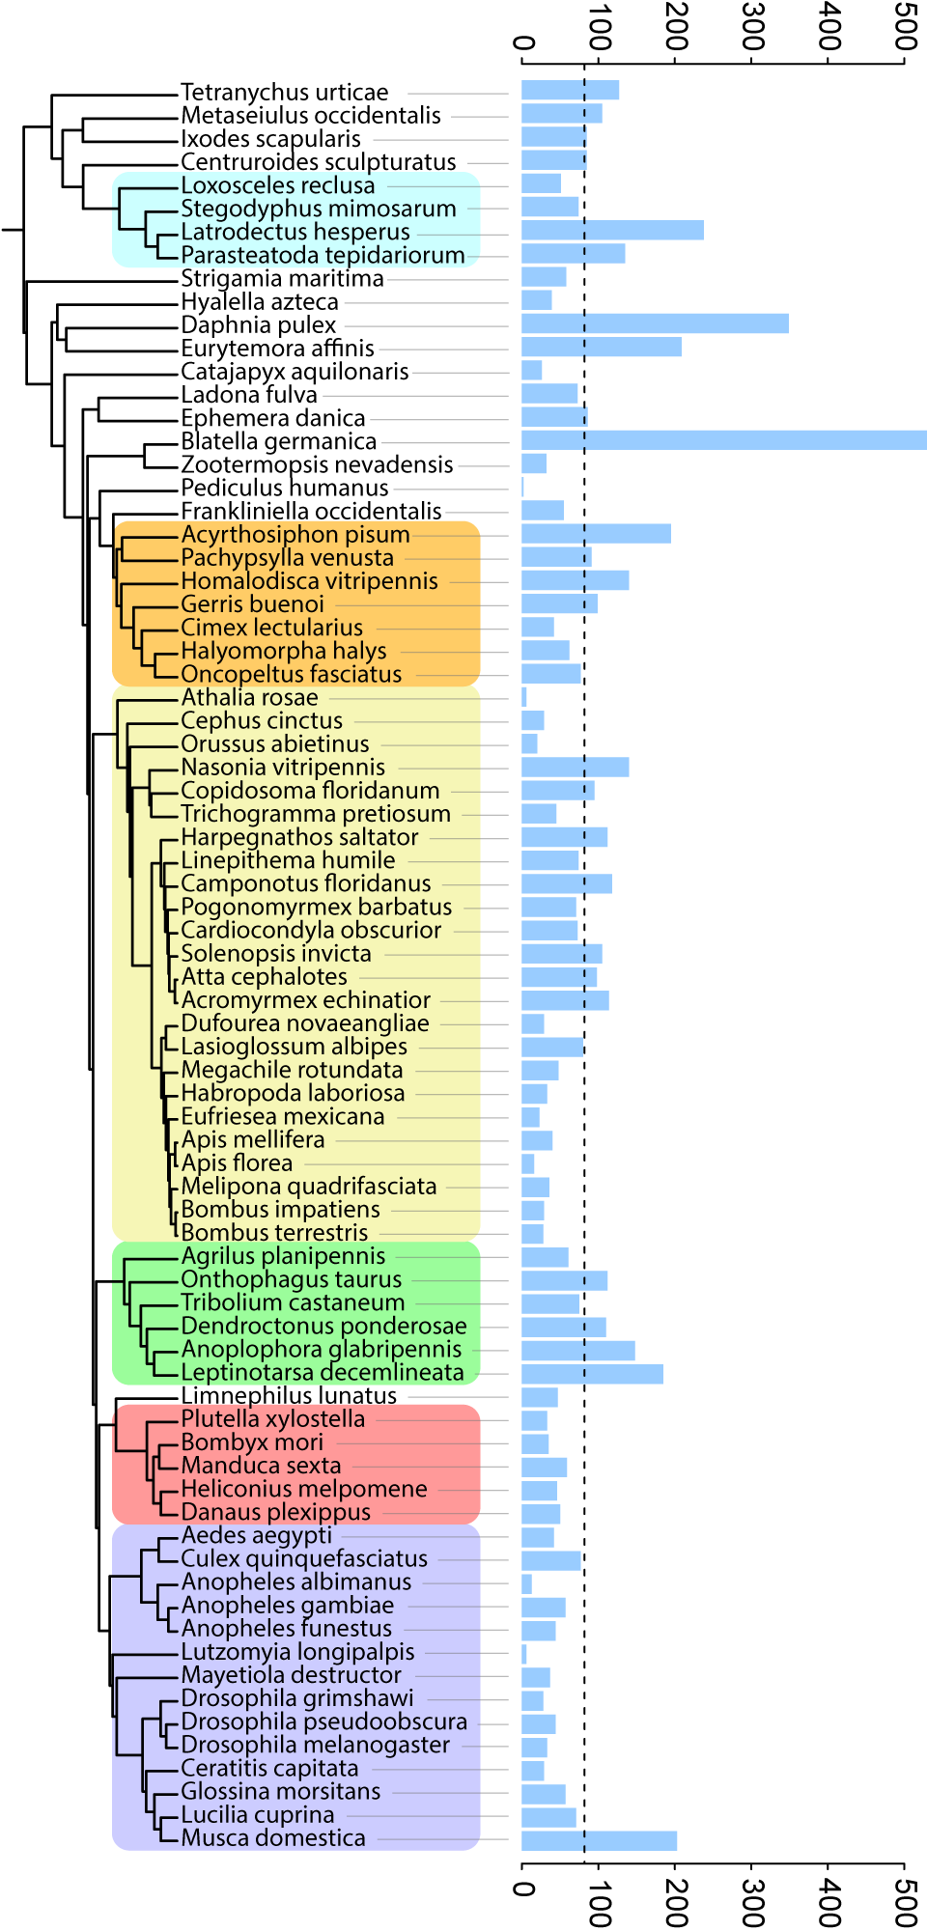
Rapidly evolving gene families
# of rapidly evolving families

Slide 38
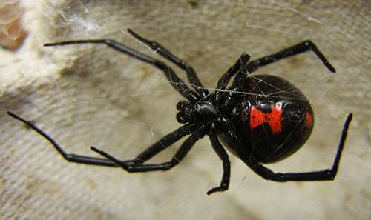
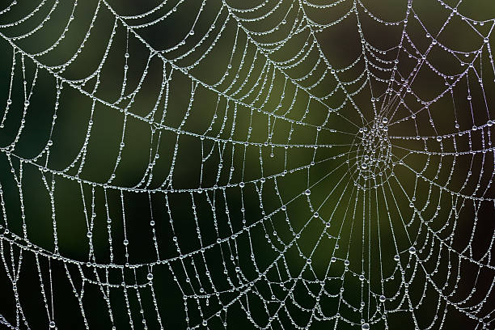
Rapidly evolving gene families
Several families related to venom and silk production rapidly expanding among spiders
Jessica Garb
# of rapidly evolving families

Slide 39
Rapidly evolving gene families
German cockroach has highest number of rapidly evolving families, despite low gene gain/loss rate
EOG8D294J rapidly evolving only in Blatella germanica
Gained 34 genes
response to light stimulus
locomotor rhythm
# of rapidly evolving families

Slide 40
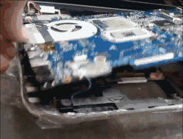
Rapidly evolving gene families
German cockroach has highest number of rapidly evolving families, despite low gene gain/loss rate
EOG8D294J rapidly evolving only in Blatella germanica
Gained 34 genes
response to light stimulus
locomotor rhythm
# of rapidly evolving families

Slide 41
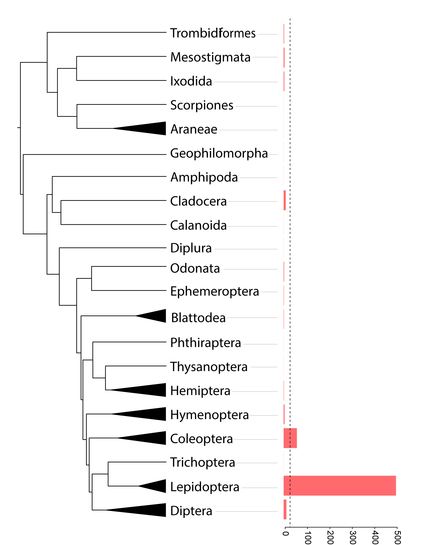
Order-specific gene families
Families that are found only in that order AND in every species in that order
# of order specific families

Slide 42
Order-specific gene families
Families that are found only in that order AND in every species in that order
Large number of Lepidoptera specific families
5 families with odorant/olfactory functions
3 families involved in response to stress
# of order specific families

Slide 43
Questions
What are the relationships among species and orders?
What are the patterns of genome evolution?
What did the genome of the last insect common ancestor (LICA) look like?

Slide 44
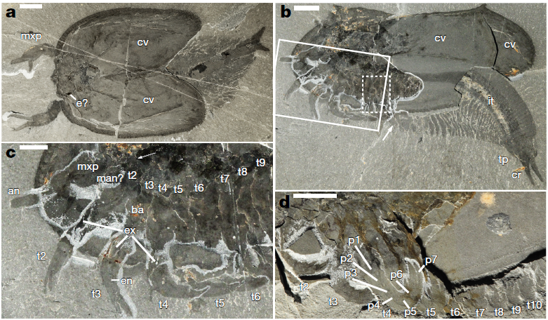
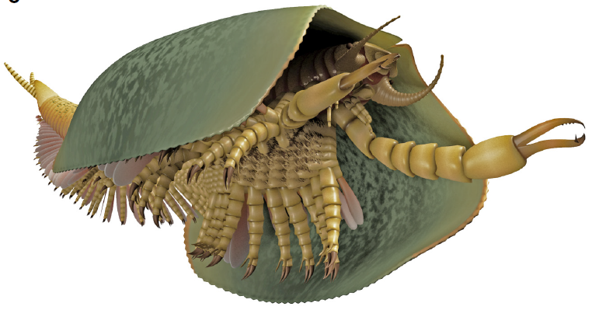
What does the ancestral insect look like?

Slide 45
What does the ancestral insect look like?
How can we infer characteristics about the genome of the last insect common ancestor (LICA)?

Slide 46
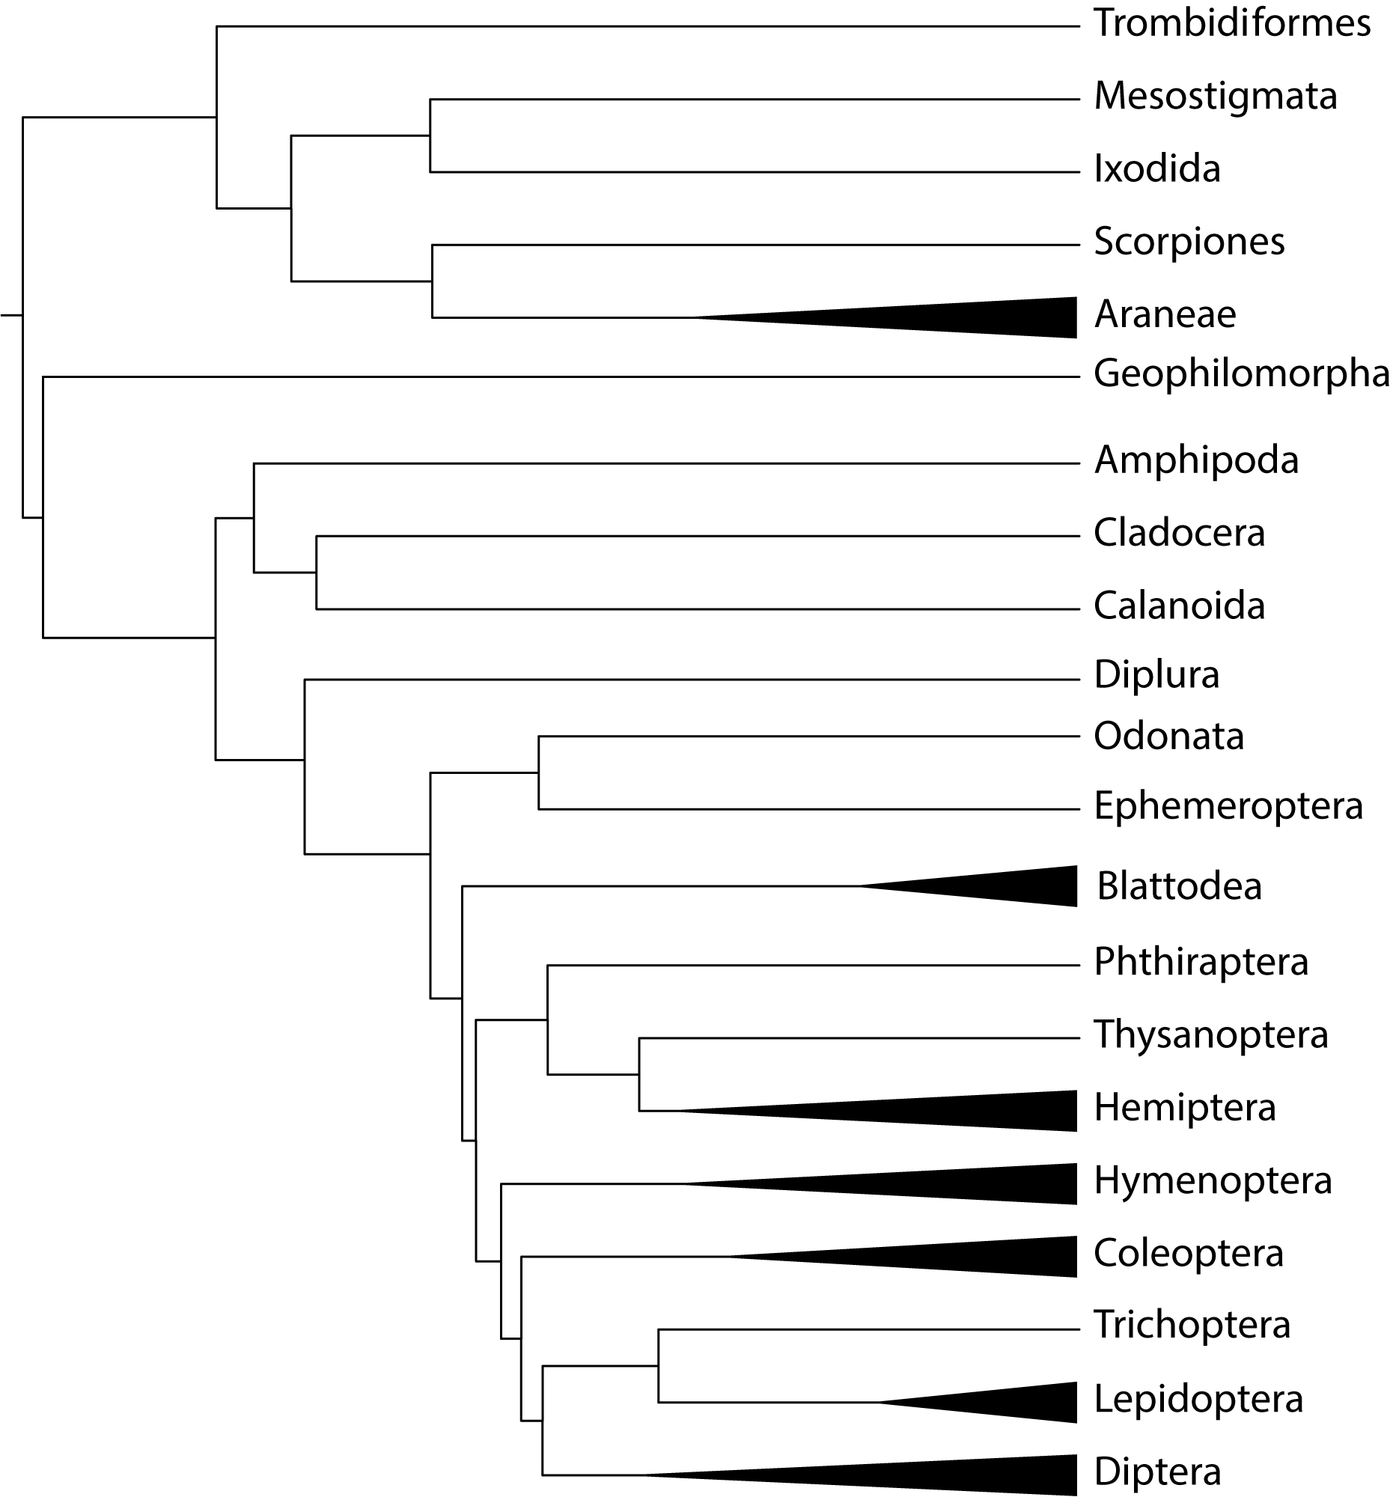
How can we infer characteristics of the genome of LICA?
0
2
x₁₉
x₁₇
2
x₁₈
2
x₁₆
1
2
4
x₁₅
x₁₃
2
x₁₂
2
x₁₄
0
2
x₁₁
x₉
2
x₁₀
0
LICA
5
x₈
x₆
2
x₅
3
x₇
1
1
x₄
1
x₁
0
x₃
x₂
1

Slide 47
How can we infer characteristics of the genome of LICA?
0
2
x₁₉
x₁₇
2
x₁₈
2
x₁₆
1
2
4
x₁₅
x₁₃
2
x₁₂
2
How many genes were present in the LICA genome?
x₁₄
0
2
x₁₁
x₉
2
x₁₀
0
LICA
5
x₈
x₆
2
x₅
3
x₇
1
1
x₄
1
x₁
0
x₃
x₂
1

Slide 48
How can we infer characteristics of the genome of LICA?
0
2
x₁₉
x₁₇
2
x₁₈
2
x₁₆
1
2
4
x₁₅
x₁₃
2
x₁₂
2
How many genes were present in the LICA genome?
x₁₄
0
2
x₁₁
x₉
2
x₁₀
9,601 genes
0
LICA
5
x₈
x₆
2
x₅
3
x₇
1
1
x₄
1
x₁
0
x₃
x₂
1

Slide 49
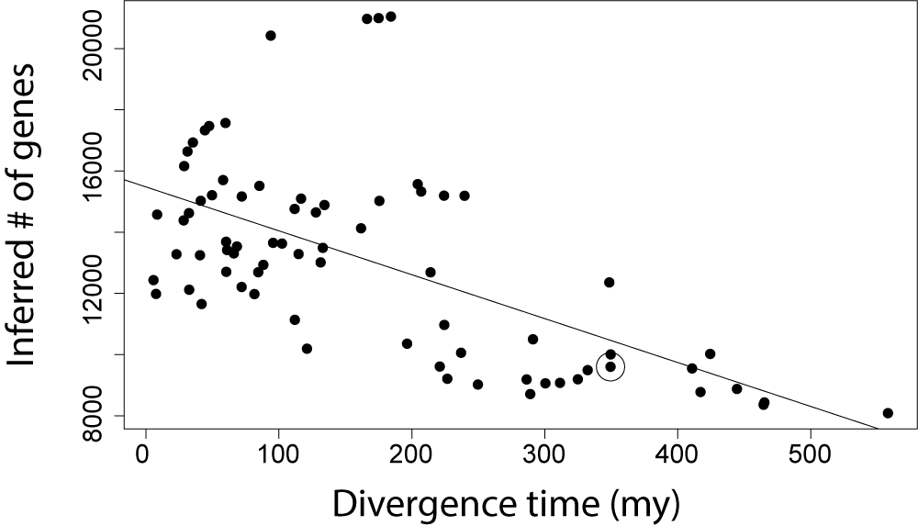
Estimates of ancestral genome size are biased because of extinct gene families
LICA

Slide 50
Corrected # of genes in the LICA genome:
14,615
LICA
LICA
# of genes

Slide 51
How can we infer characteristics of the genome of LICA?
0
0
0
0
0
0
0
0
0
0
0
0
0
0
Which families were ‘born’ during the transition to insects?
0
0
0
0
2
0
2
2
+1
1
0
5
1
2
2
2
3
2
1
1
1
1
1
0
1
1
1

Slide 52
How can we infer characteristics of the genome of LICA?
0
0
0
0
0
0
0
0
0
0
0
0
0
0
Which families were ‘born’ during the transition to insects?
0
0
0
0
2
0
2
2
+1
1
0
5
147 novel insect families
1
2
2
2
3
2
1
1
1
1
1
0
1
1
1

Slide 53
Novel insect families correspond to insect lifestyle adaptations
Changes in exoskeleton development
7 chitin and cuticle production families

Slide 54
Novel insect families correspond to insect lifestyle adaptations
Changes in exoskeleton development
7 chitin and cuticle production families
Ability to sense in a terrestrial environment
1 visual learning and behavior family
2 odorant binding families
5 families involved in neural activity

Slide 55
Novel insect families correspond to insect lifestyle adaptations
Changes in exoskeleton development
7 chitin and cuticle production families
Ability to sense in a terrestrial environment
1 visual learning and behavior family
2 odorant binding families
5 families involved in neural activity
Unique development
1 larval behavior family
4 imaginal disk development families

Slide 56
Novel insect families correspond to insect lifestyle adaptations
Changes in exoskeleton development
7 chitin and cuticle production families
Ability to sense in a terrestrial environment
1 visual learning and behavior family
2 odorant binding families
5 families involved in neural activity
Unique development
1 larval behavior family
4 imaginal disk development families
Flight
3 wing morphogenesis families

Slide 57
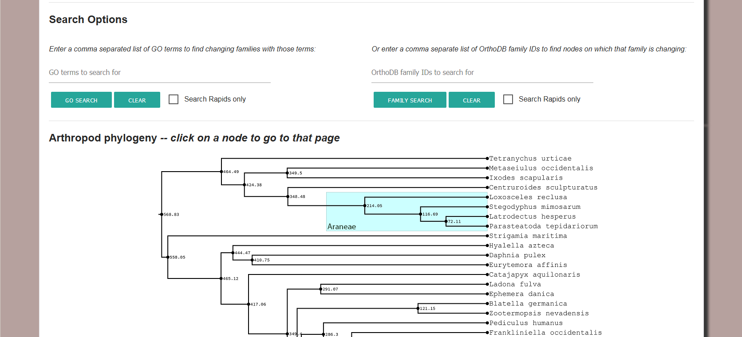
All data has been made available in our online tool https://cgi.soic.indiana.edu/~grthomas/i5k/i5k_phylo.html

Slide 58
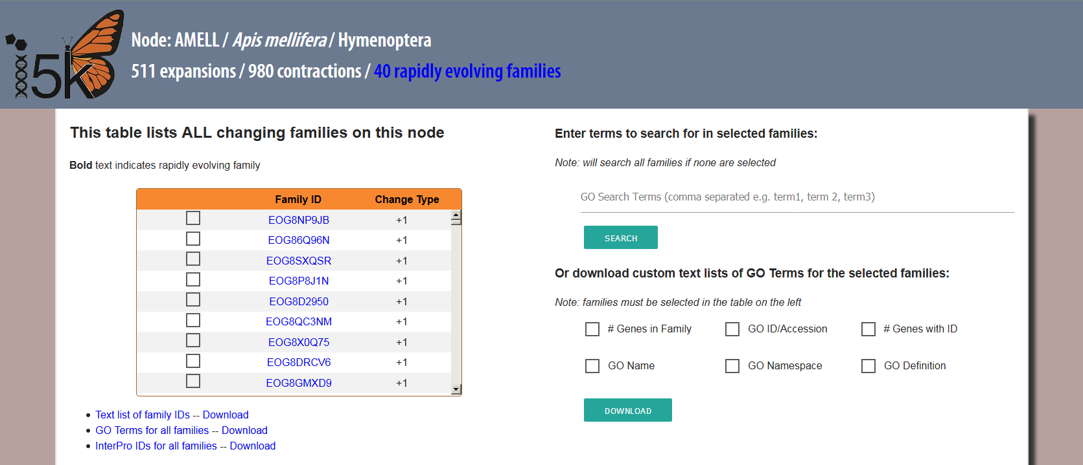
All data has been made available in our online tool https://cgi.soic.indiana.edu/~grthomas/i5k/i5k_phylo.html

Slide 59
Acknowledgments
Matthew Hahn
Stephen Richards
Rob Waterhouse
Jessica Garb
Elias Dohmen
Ariel Chipman
The i5k community
Presentation feedback:
The Hahn lab + Clara Boothby
i5k website:
http://i5k.github.io/
@greggwcthomas
Gene family website: https://cgi.soic.indiana.edu/~grthomas/i5k/i5k_phylo.html

