Slide 1
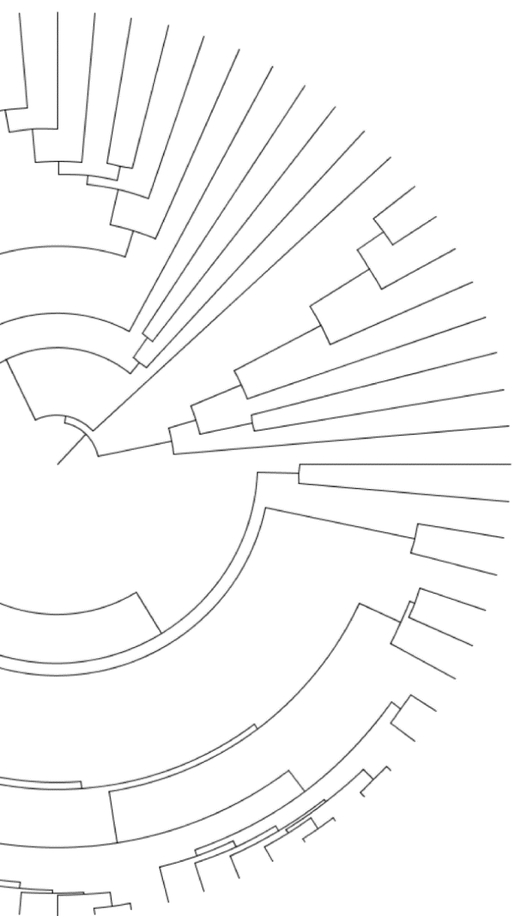

Patterns of genomic variation across the tree of life
Gregg Thomas
Harvard University Informatics Group
https://gwct.github.io/
@greggwcthomas
UMass-Lowell Departmental Seminar
March 25, 2022

Slide 2
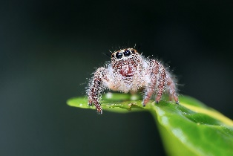
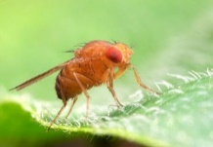
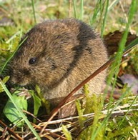
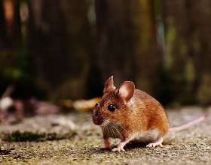
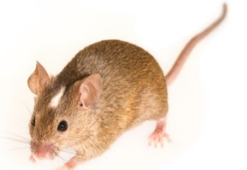

Slide 3
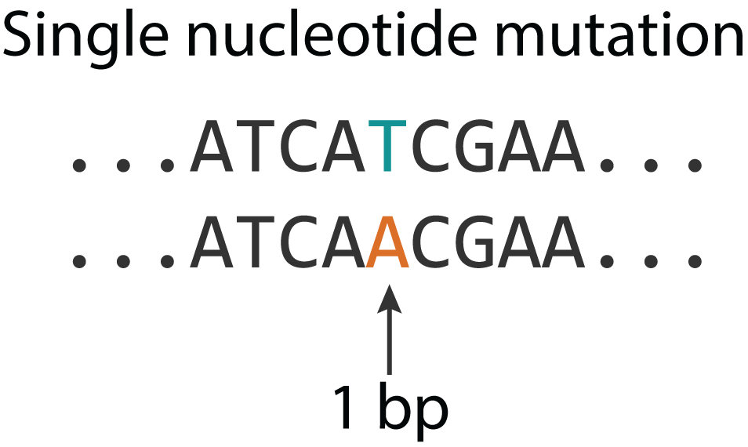
Origins of variation

Slide 4
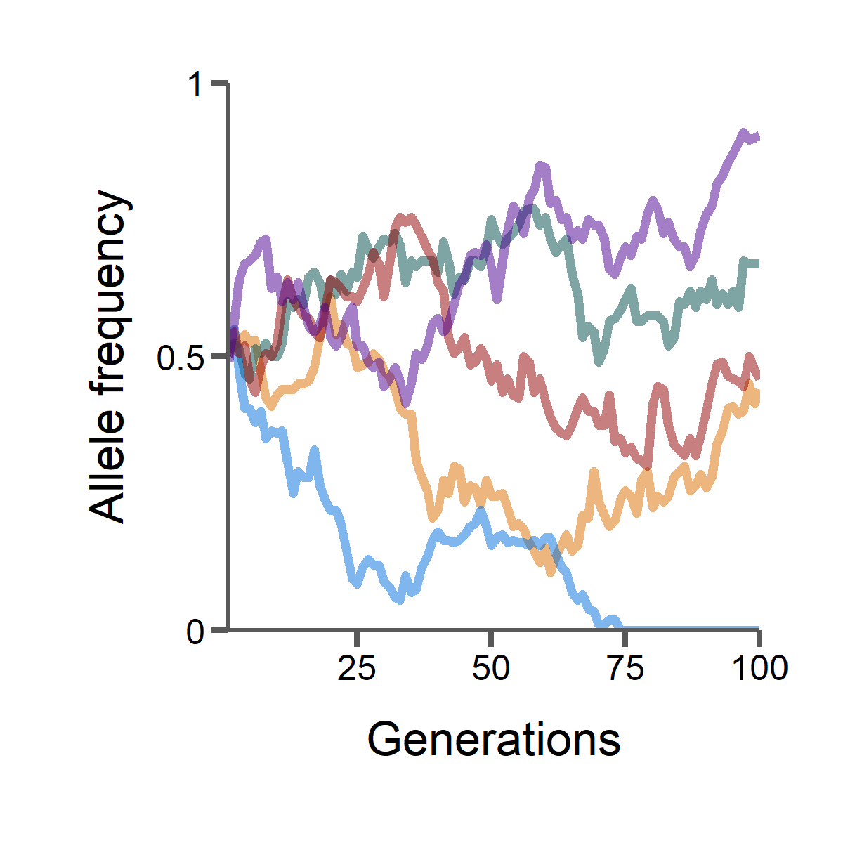
Origins and long-term patterns of variation

Slide 5
Origins and long-term patterns of variation across the tree of life

Slide 6




Arthropods
Murine rodents

Slide 7
Arthropods
Murine rodents
Phylum | Subfamily
>1,000,000 species
600 million years

Slide 8
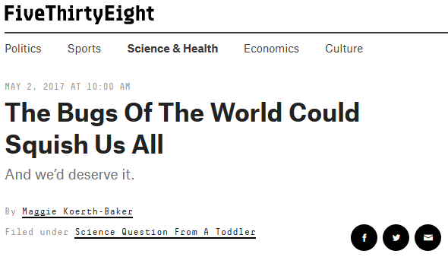
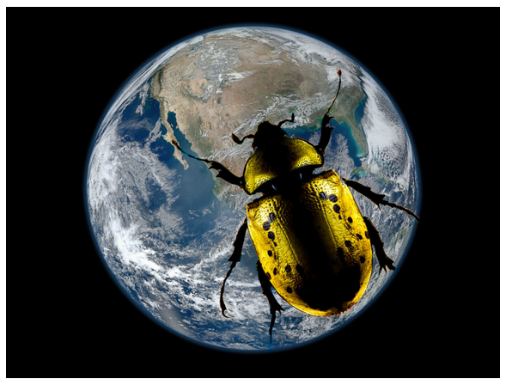
Arthropods
Phylum
>1,000,000 species
600 million years
https://fivethirtyeight.com/features/the-bugs-of-the-world-could-squish-us-all/

Slide 9
Arthropods
Murine rodents
Phylum | Subfamily
>1,000,000 species | >600 species
600 million years | 15 million years

Slide 10
Arthropods
Murine rodents
Deep time
76 whole genomes
General patterns of molecular evolution

Slide 11
Arthropods
Murine rodents
Deep time | Rapid speciation
76 whole genomes | 210 targeted exomes Skull shape measurements Sperm morphology
General patterns of molecular evolution | Molecular evolution of radiations Link genotype to phenotype

Slide 12
Arthropods
Murine rodents
Deep time | Rapid speciation
76 whole genomes | 210 targeted exomes Skull shape measurements Sperm morphology
Sparse data

Slide 13
Arthropods
Murine rodents
Deep time | Rapid speciation
76 whole genomes | 210 targeted exomes Skull shape measurements Sperm morphology
Sparse data | Phylogenetic discordance

Slide 14

i5k pilot project
http://i5k.github.io
https://arthrofam.org/
Image: Rob Waterhouse

Slide 15
i5k pilot project
Stephen Richards
Elias Dohmen
Yiyuan Li
Erich Bornberg-Bauer
Rob Waterhouse
Ariel Chipman
Jessica Garb
Monica Poelchau
Kristen Panfilio
Matt Hahn
Image: Rob Waterhouse

Slide 16
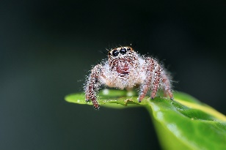
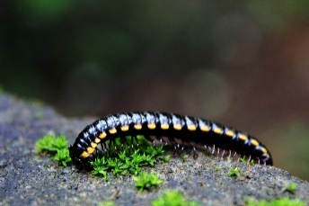
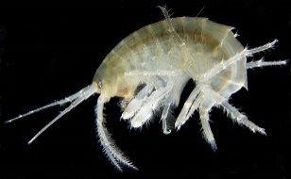
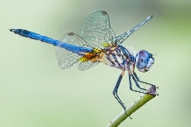
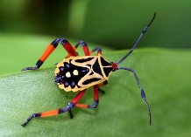
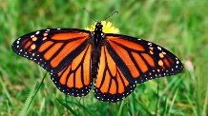
Arthropods exhibit great phenotypic and behavioral diversity

Slide 17
How does molecular evolution drive adaptation?
?
…CGGACTGCAGTAAACTGATCC…

Slide 18
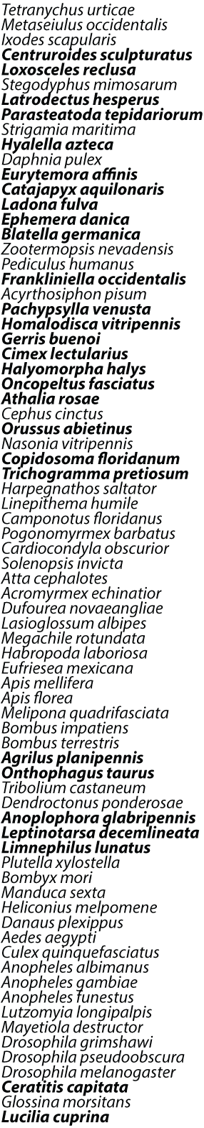

i5K pilot project
Sequence 28 new arthropod genomes
+
48 previously sequenced genomes
Step 1: Sequencing and annotation

Slide 19
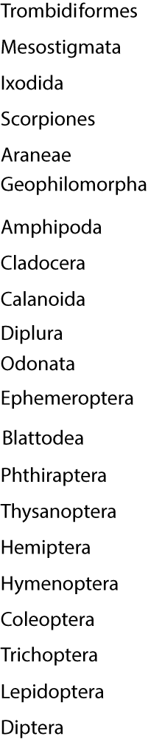
i5K pilot project
(4 species)
Sequence 28 new arthropod genomes
+
48 previously sequenced genomes
=
76 genomes spanning 21 orders
Step 1: Sequencing and annotation
(2 species)
(7 species)
(24 species)
(6 species)
(5 species)
(14 species)

Slide 20

i5K pilot project
(4 species)
Sequence 28 new arthropod genomes
+
48 previously sequenced genomes
=
76 genomes spanning 21 orders
Step 1: Sequencing and annotation
(2 species)
Step 2: Orthology
1 million gene sequences clustered into ~38,000 orthogroups
(7 species)
(24 species)
(6 species)
(5 species)
(14 species)

Slide 21
i5K pilot project
(4 species)
Sequence 28 new arthropod genomes
+
48 previously sequenced genomes
=
76 genomes spanning 21 orders
Step 1: Sequencing and annotation
(2 species)
Step 2: Orthology
1 million gene sequences clustered into ~38,000 orthogroups
(7 species)
(24 species)
(6 species)
Step 3: Phylogeny
Reconstruct the evolutionary history of arthropods
(5 species)
(14 species)

Slide 22
Reconstructing the phylogeny of arthropods
Out of 38,000 orthogroups, how many single-copy groups are there?

Slide 23
Reconstructing the phylogeny of arthropods
Out of 38,000 orthogroups, how many single-copy groups are there?
0

Slide 24
Reconstructing the phylogeny of arthropods
Out of 38,000 orthogroups, how many single-copy groups are there?
0
How can we turn our species rich data into sequence rich data?

Slide 25
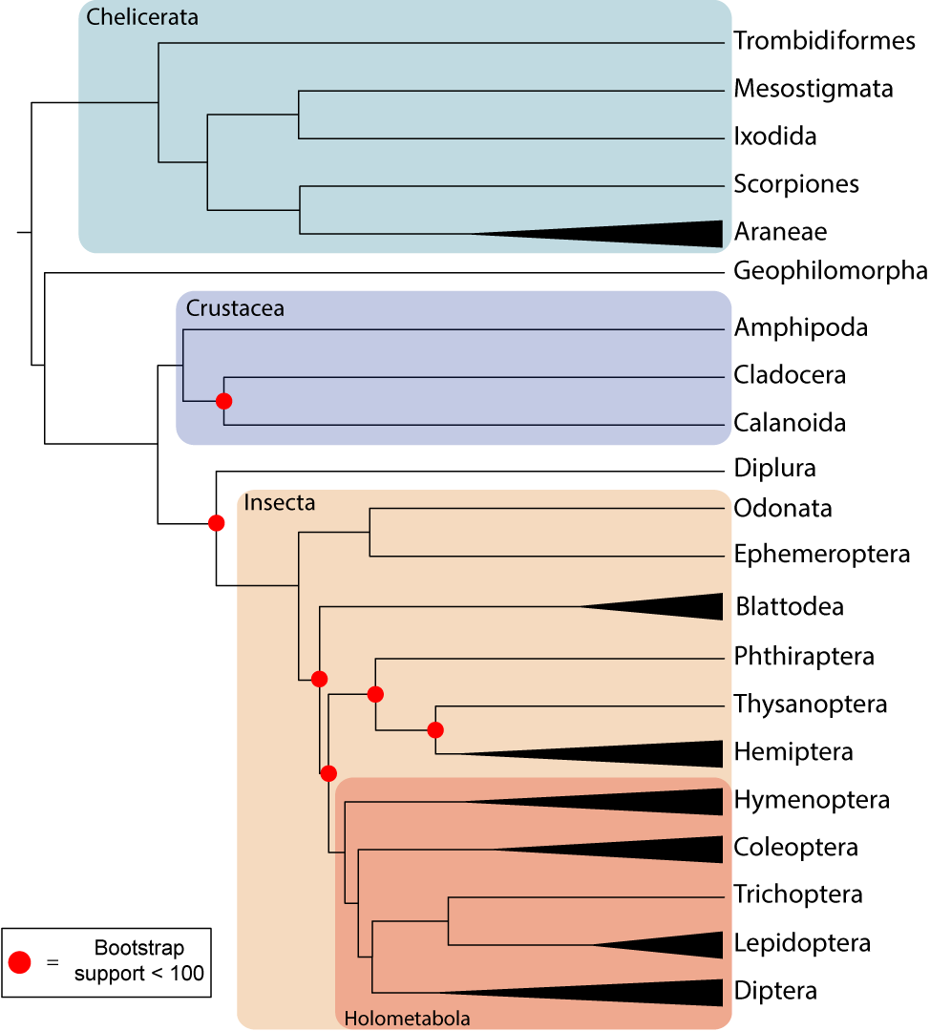
Construct a backbone phylogeny
150 genes that are single-copy in at least one species in each order

Slide 26
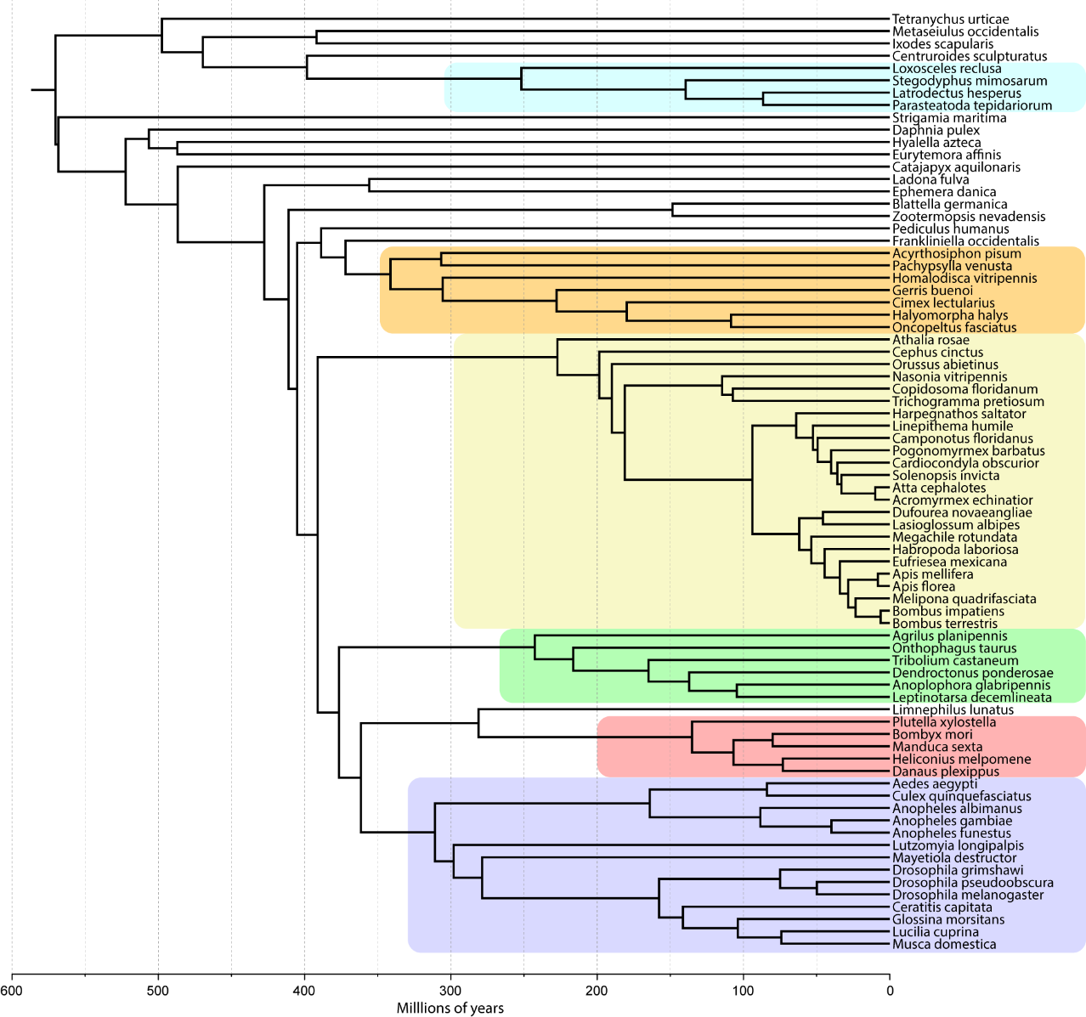
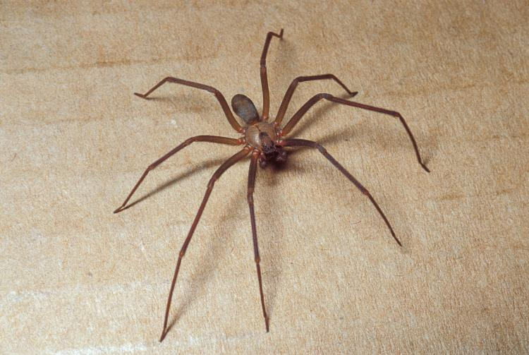
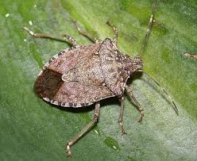
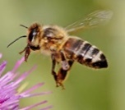
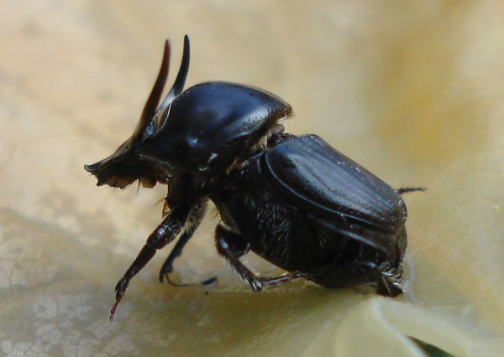

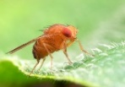
Construct order level phylogenies
Araneae
1627 genes
Hemiptera
2053 genes
Hymenoptera
2121 genes
Coleoptera
3880 genes
Lepidoptera
3660 genes
Diptera
1324 genes

Slide 27
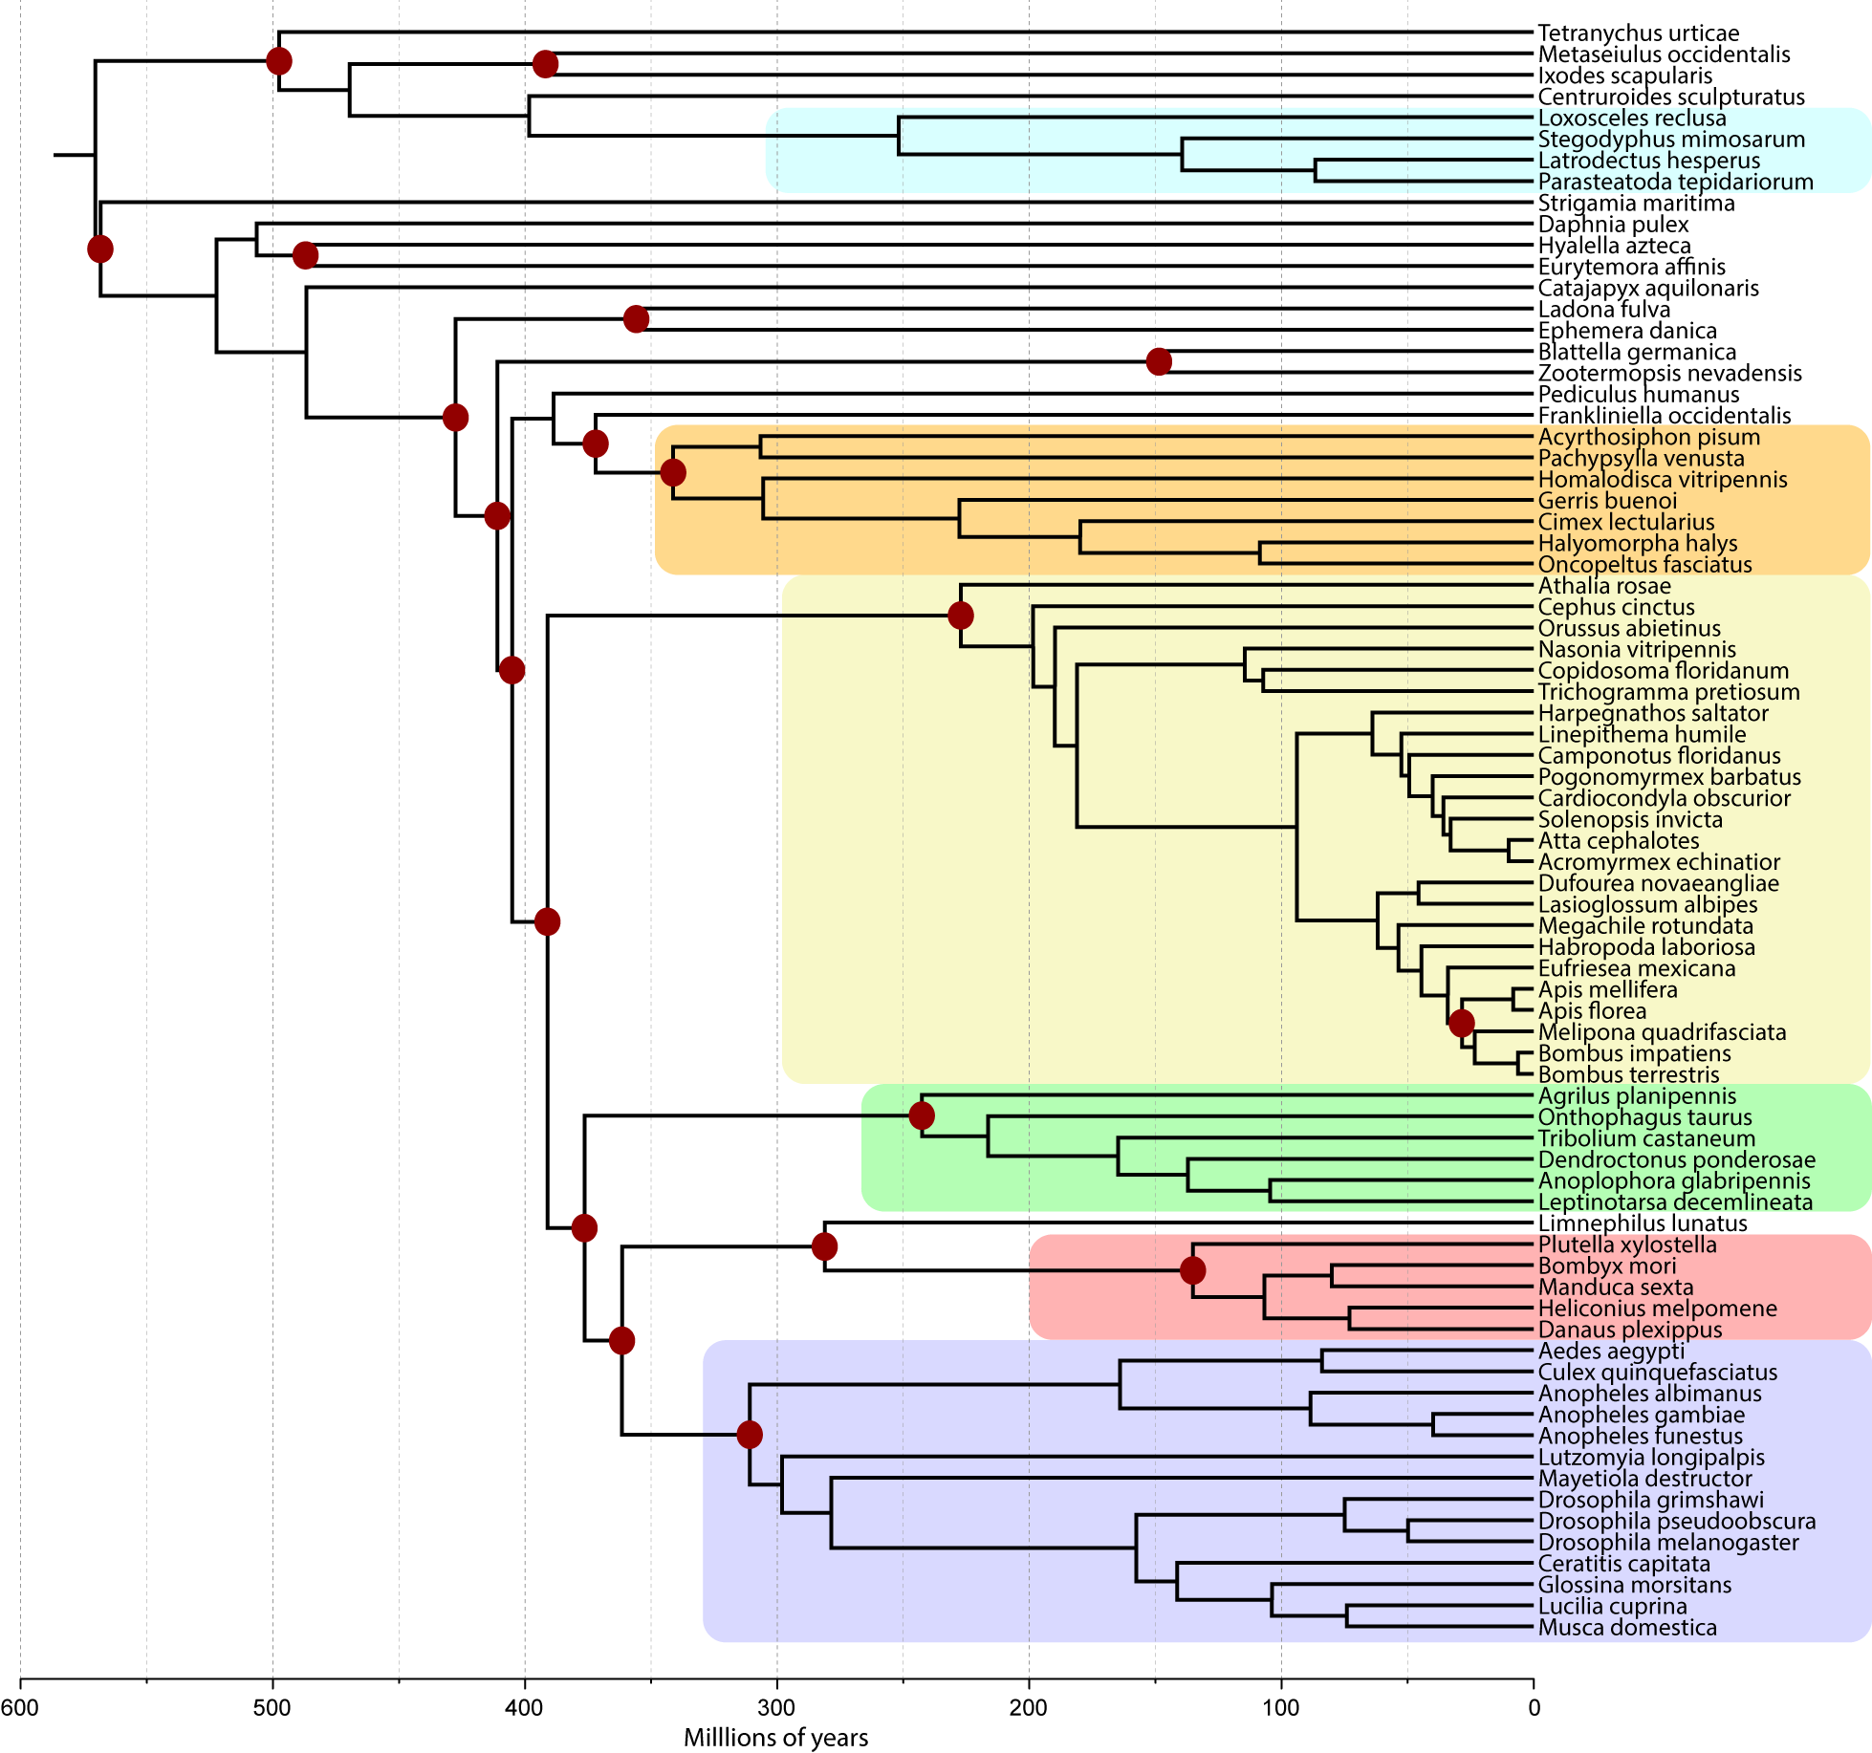
Construct order level phylogenies
Araneae
1627 genes
Hemiptera
2053 genes
21 fossil calibration points for dating
Hymenoptera
2121 genes
Coleoptera
3880 genes
Lepidoptera
3660 genes
Diptera
1324 genes

Slide 28

Araneae
1627 genes
Hemiptera
2053 genes
What are the general patterns of molecular evolution in arthropods?
Hymenoptera
2121 genes
Coleoptera
3880 genes
Lepidoptera
3660 genes
Diptera
1324 genes

Slide 29
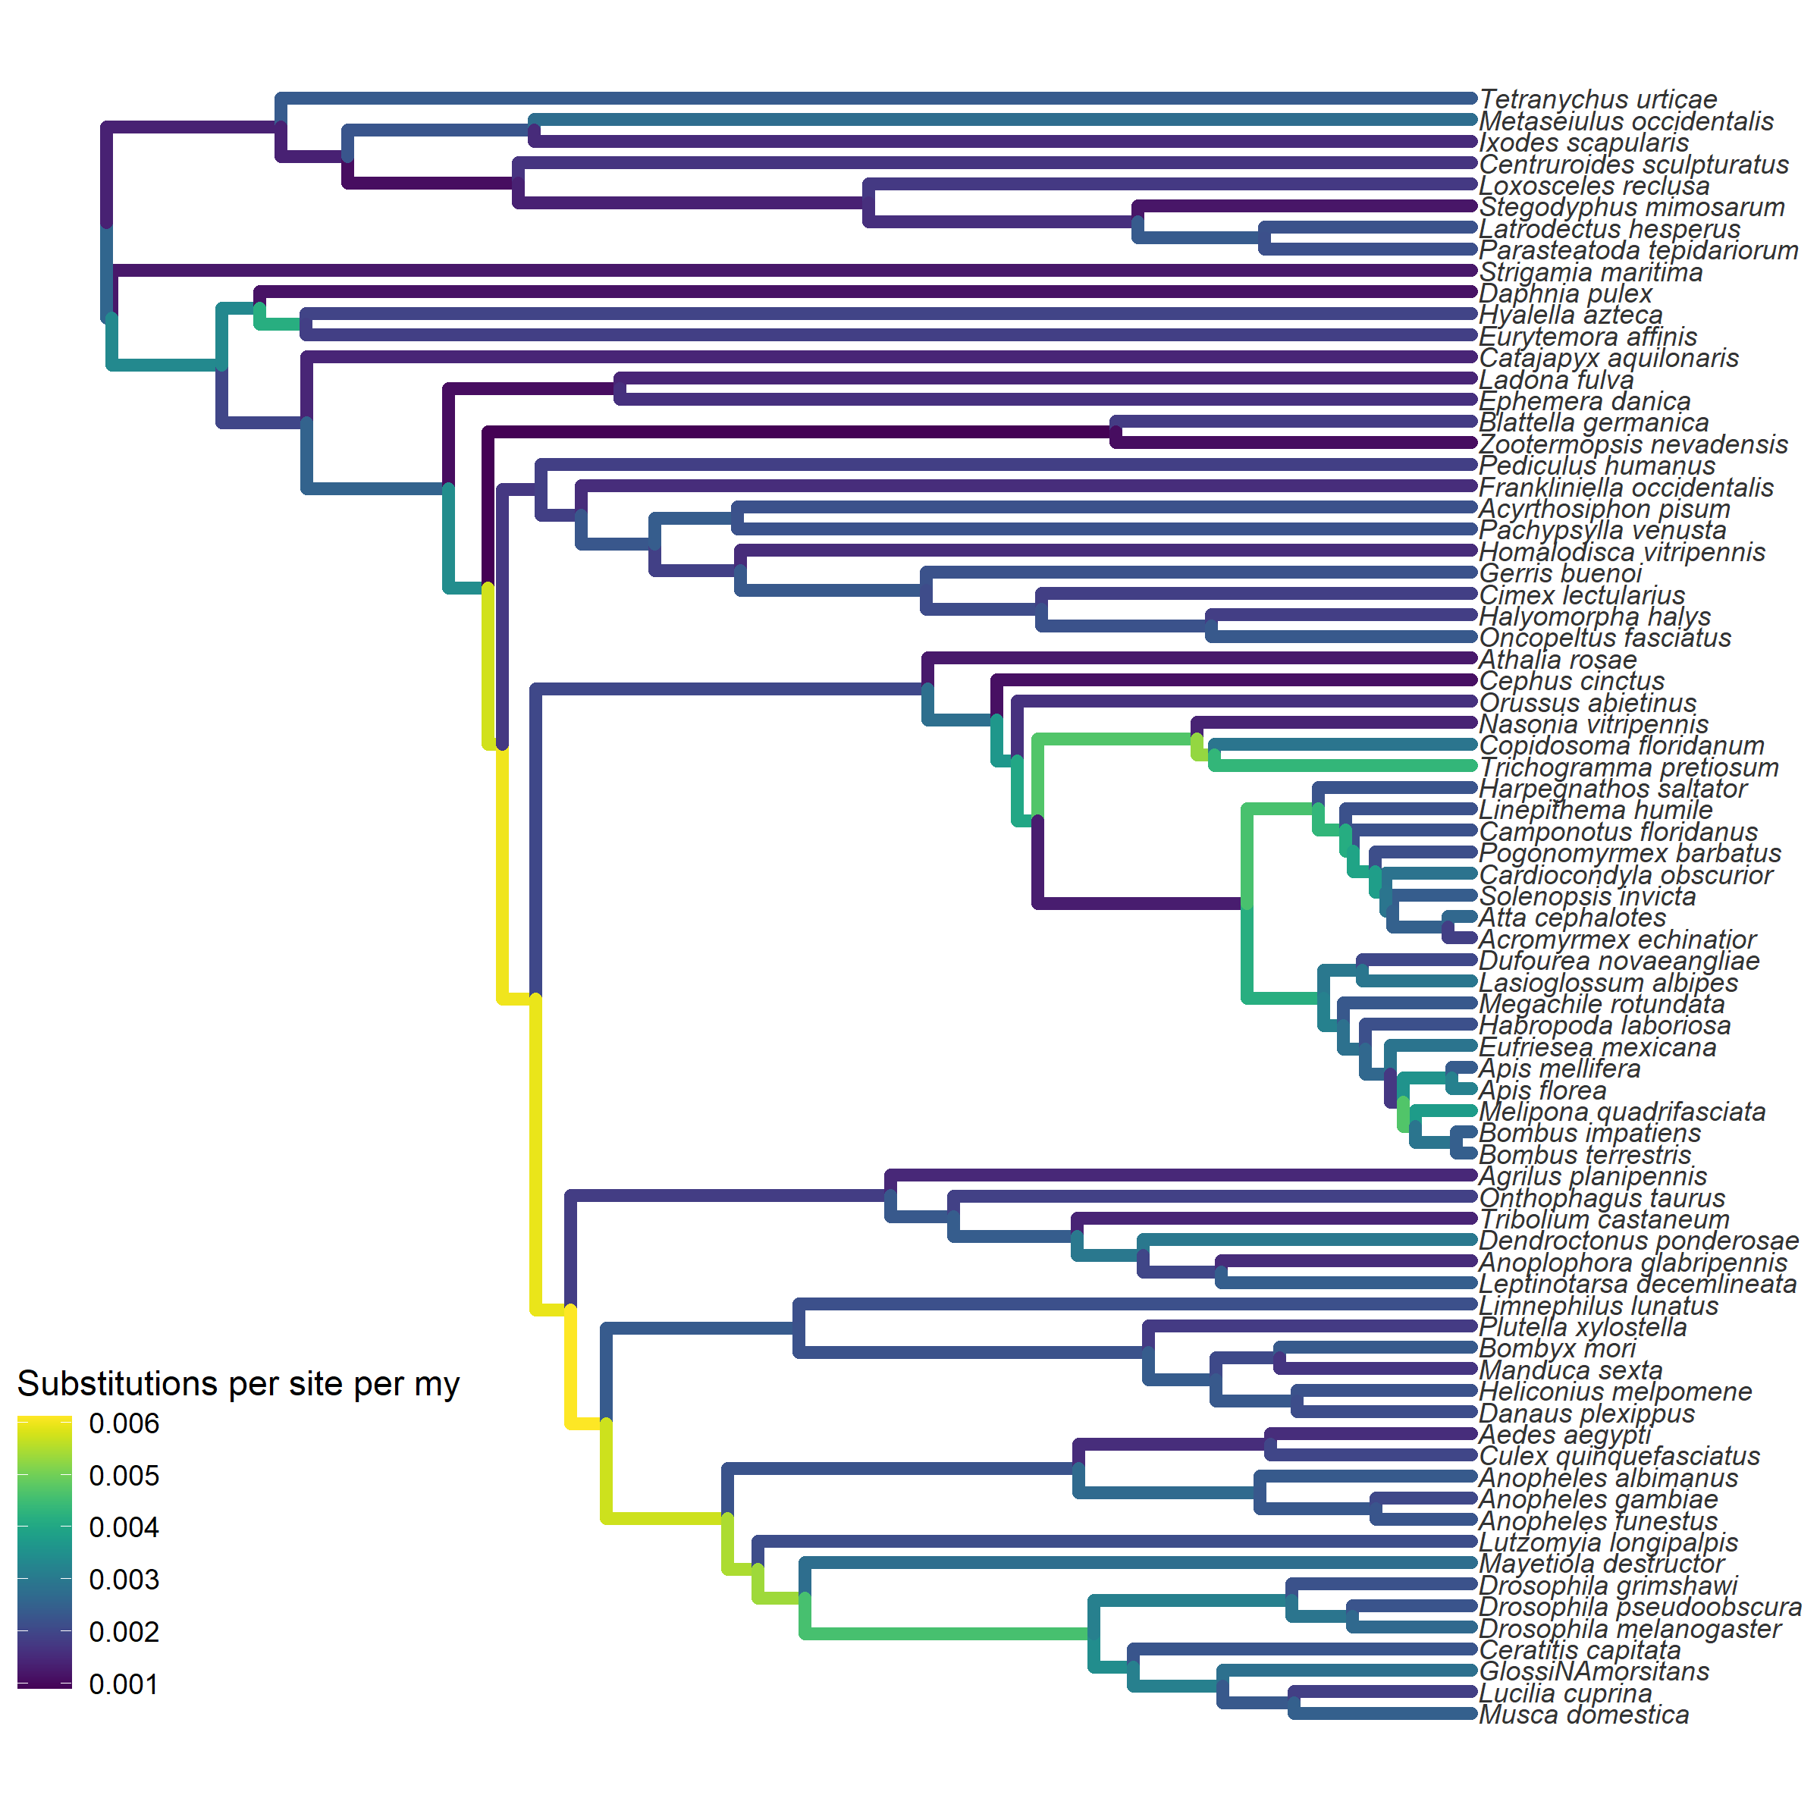
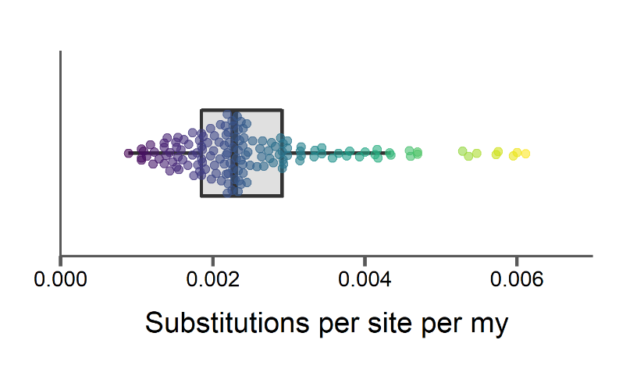
Arthropod substitution rates vary little, but are not clock-like

Slide 30
Arthropod substitution rates vary little, but are not clock-like
Amino acid substitutions only

Slide 31
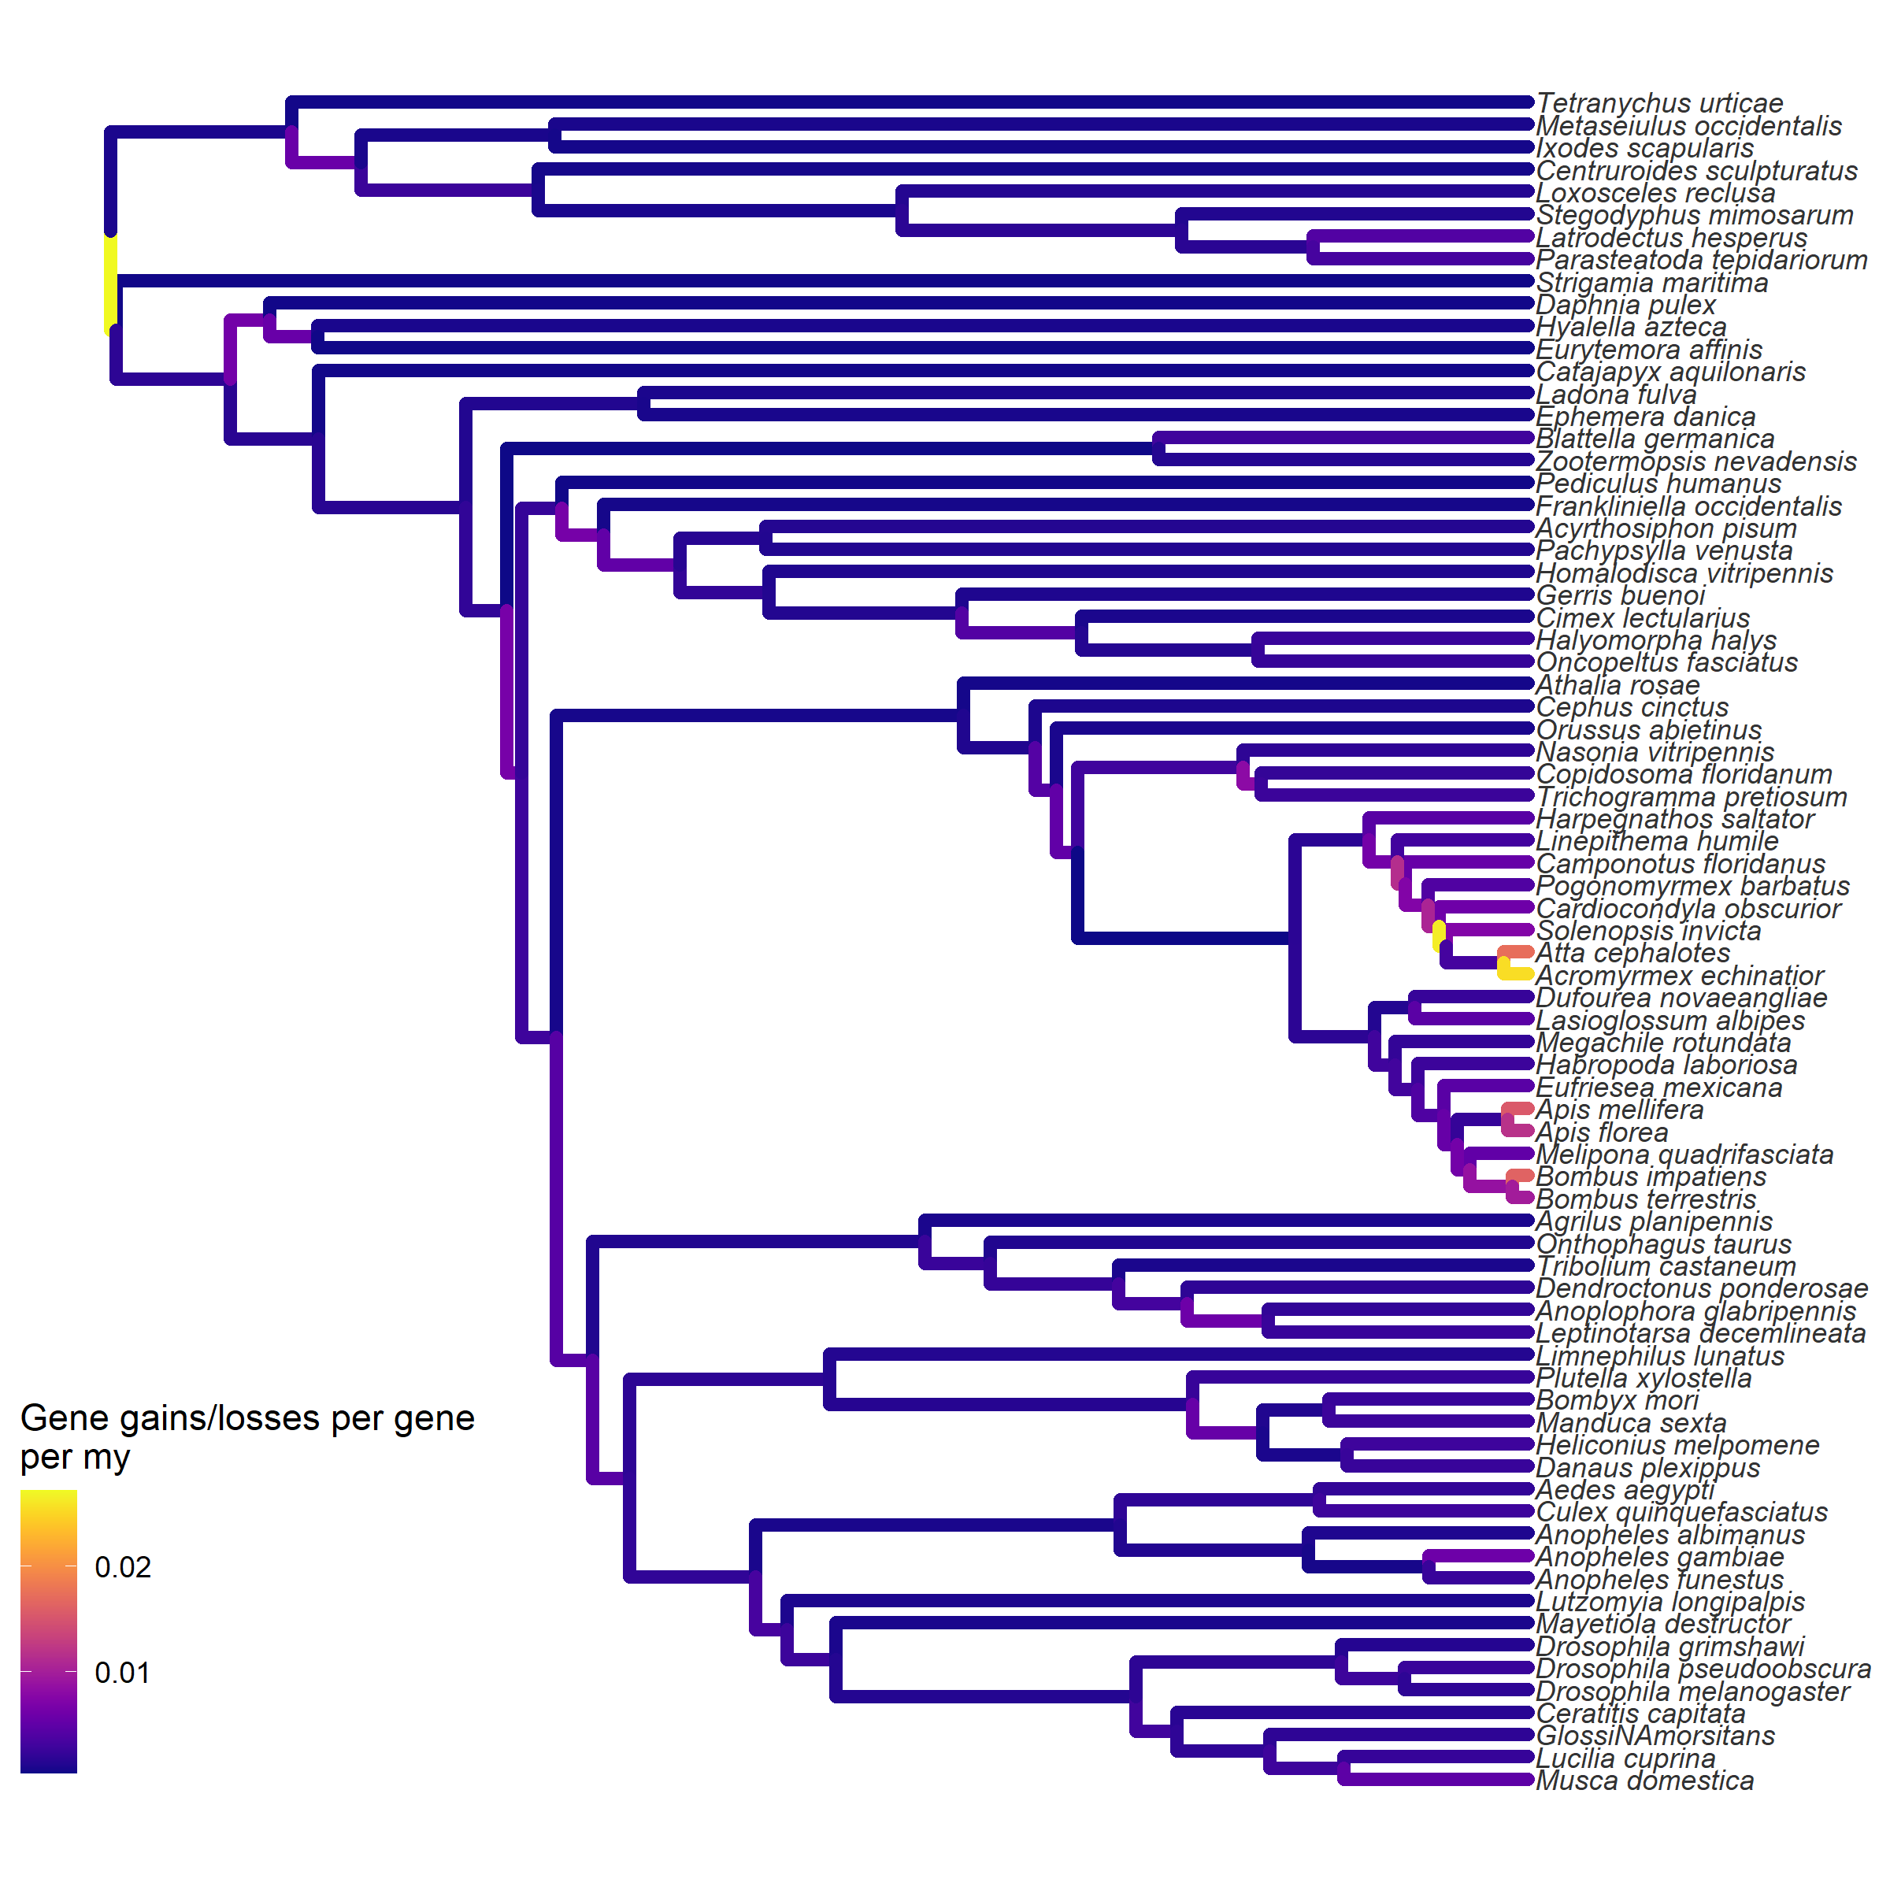
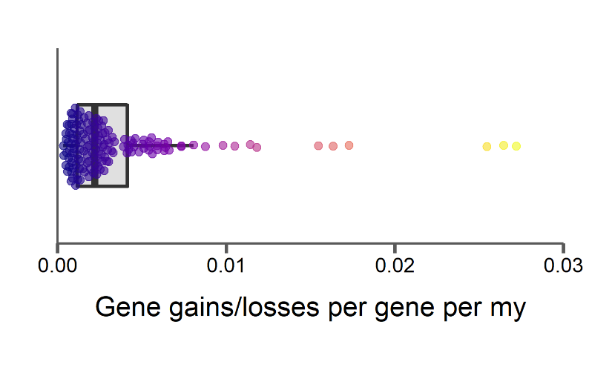
Arthropod gene gain and loss rates are surprisingly constant

Slide 32
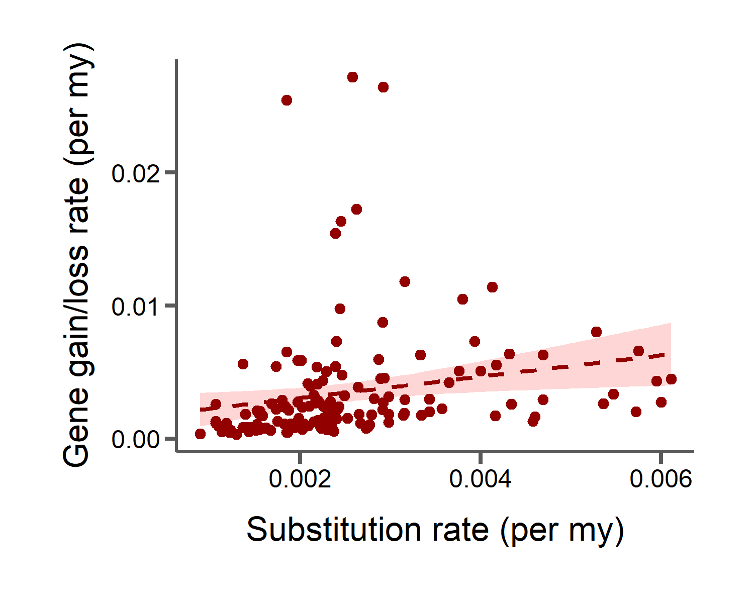
No correlation between amino acid substitution rates and gene gain/loss rates

Slide 33
No correlation between amino acid substitution rates and gene gain/loss rates
Products of different mutational mechanisms

Slide 34
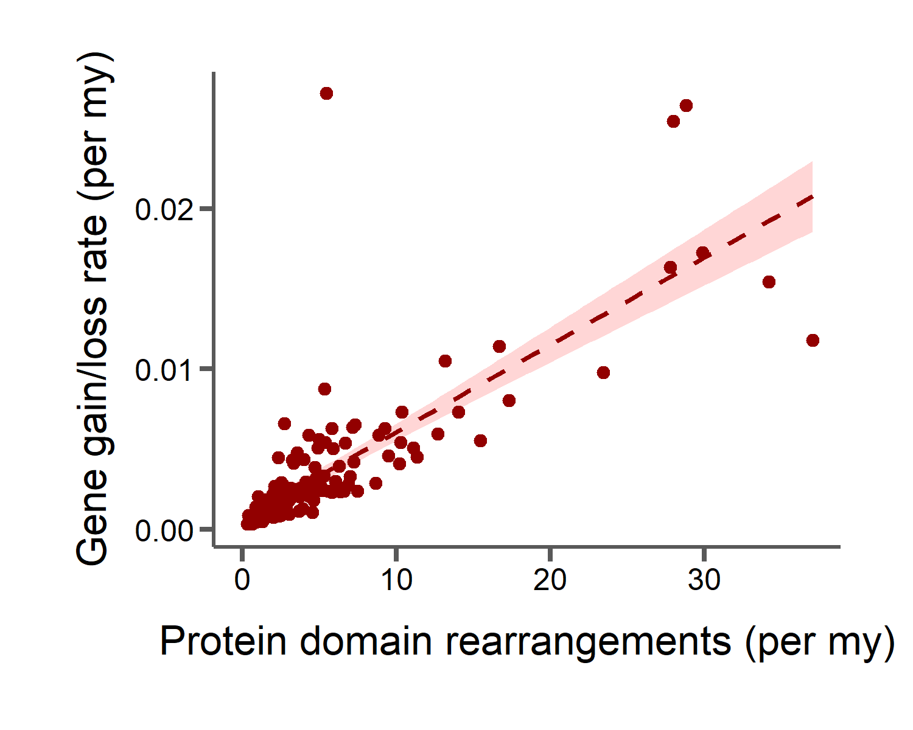
Strong correlation between rates of protein domain rearrangement and gene gain/loss
Products of different mutational mechanisms

Slide 35
Strong correlation between rates of protein domain rearrangement and gene gain/loss
Products of different mutational mechanisms
Duplications precede both types of change

Slide 36
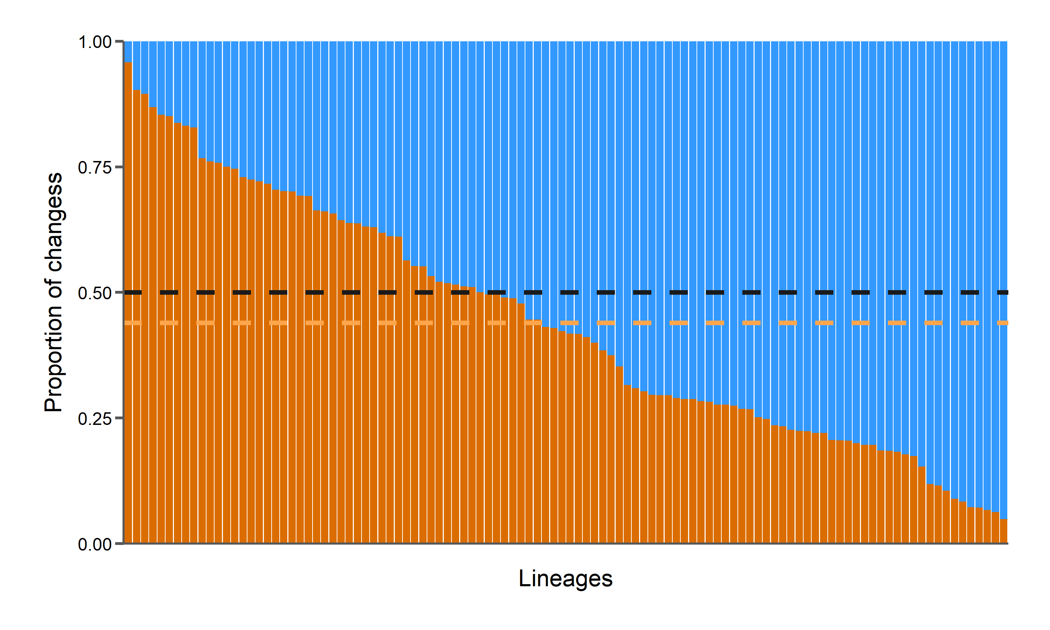

No large excess of gene gains or losses across arthropod orders
Equal proportion (baseline)
Average gain proportion: 0.44

Slide 37
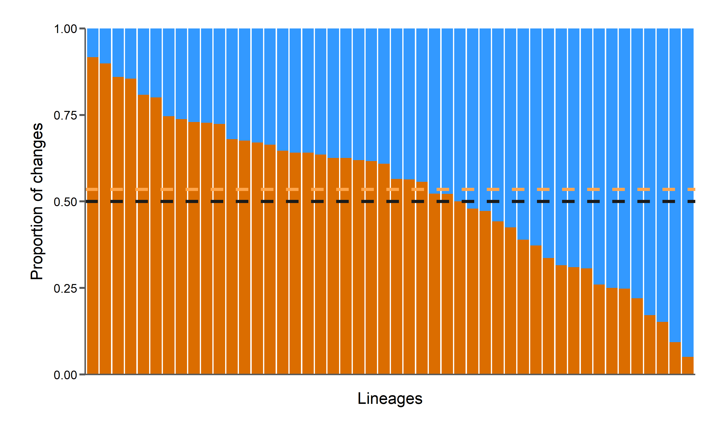
No large excess of gene gains or losses in Drosophila
i5K orders
25 Drosophila species
De Lage et al. 2019
Average proportion of gains = 0.44
Average proportion of gains = 0.54

Slide 38
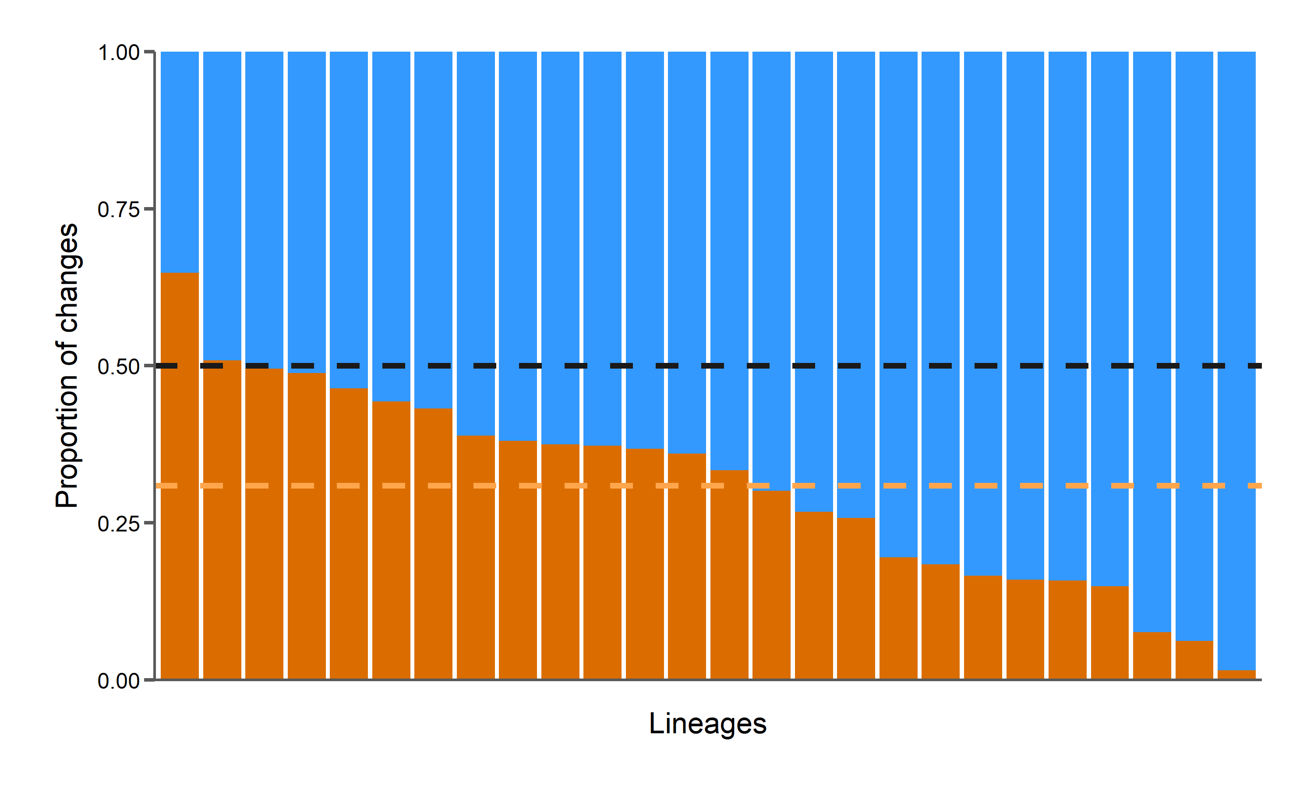
Larger excess of gene losses in Bombus
i5K orders
15 Bombus species
Sun et al. 2020
Average proportion of gains = 0.44
Average proportion of gains = 0.31

Slide 39
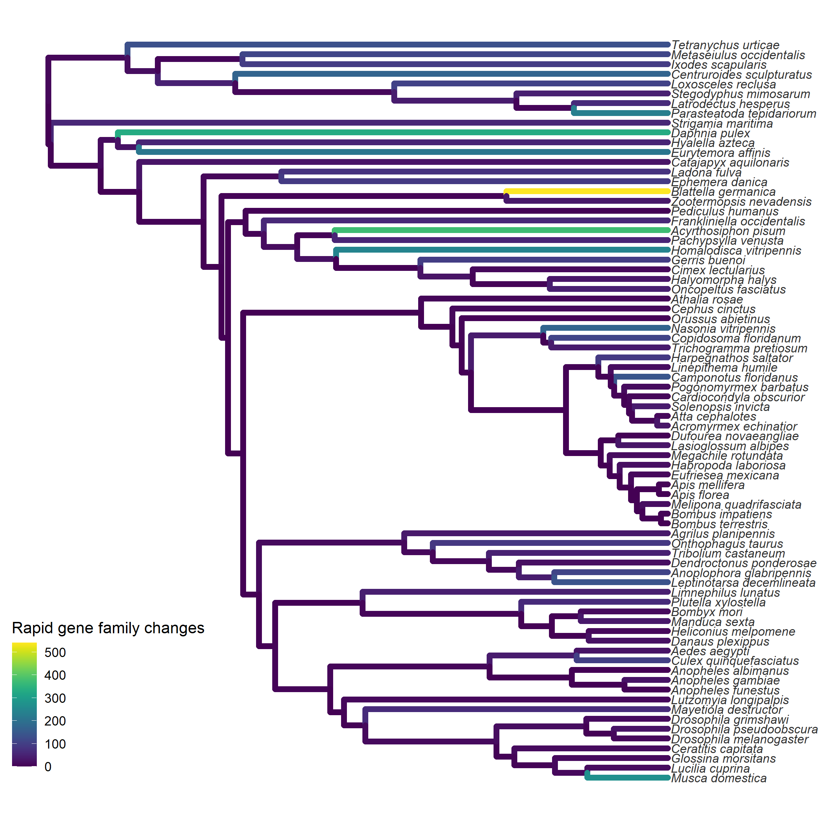
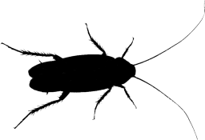
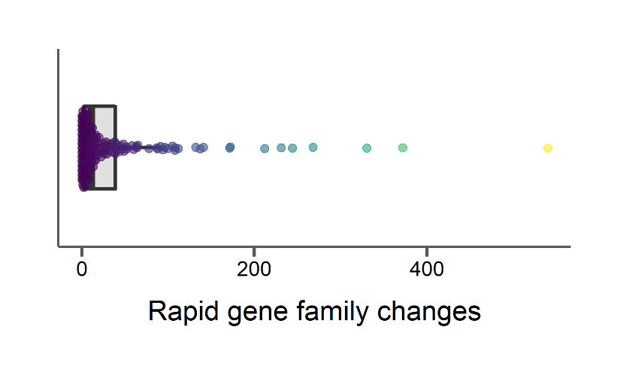
Cockroach has most rapidly evolving families

Slide 40
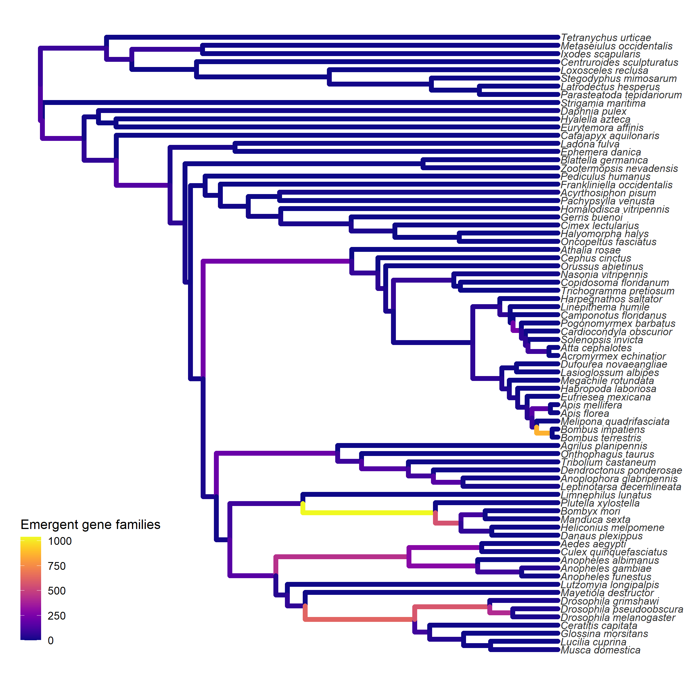

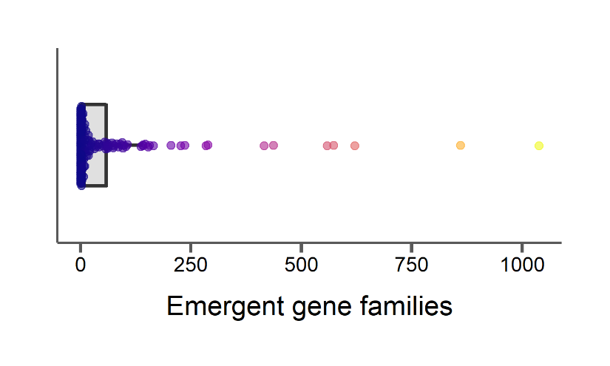
Lepidopterans gained many new gene families

Slide 41
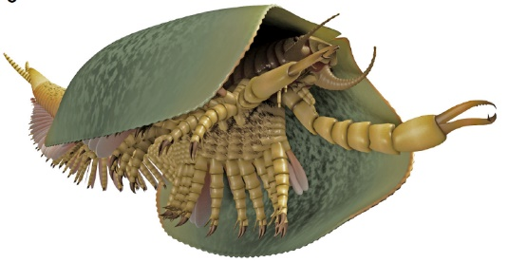
New gene families in Last Insect Common Ancestor (LICA) related to flight, larval development
Aria & Caron 2017

Slide 42
i5k pilot project – what have we learned?
Can’t rely on single-copy orthologs for broad, deep-time sampling
Rates of evolution vary little, but reflect their underlying mechanisms
Gene family evolution pinpoints interesting lineages
Image: Rob Waterhouse

Slide 43
i5k pilot project – what have we learned?
Can’t rely on single-copy orthologs for broad, deep-time sampling
Rates of evolution vary little, but reflect their underlying mechanisms
Gene family evolution pinpoints interesting lineages
Image: Rob Waterhouse

Slide 44
i5k pilot project – what have we learned?
Can’t rely on single-copy orthologs for broad, deep-time sampling
Rates of evolution vary little, but reflect their underlying mechanisms
Gene family evolution pinpoints interesting lineages
Image: Rob Waterhouse

Slide 45
Arthropods
Murine rodents
Deep time | Rapid speciation
76 whole genomes | 210 targeted exomes Skull shape measurements Sperm morphology
General patterns of molecular evolution | Molecular evolution of radiations Link genotype to phenotype

Slide 46
Arthropods
Murine rodents
Deep time | Rapid speciation
76 whole genomes | 210 targeted exomes Skull shape measurements Sperm morphology
General patterns of molecular evolution | Molecular evolution of radiations Link genotype to phenotype

Slide 47

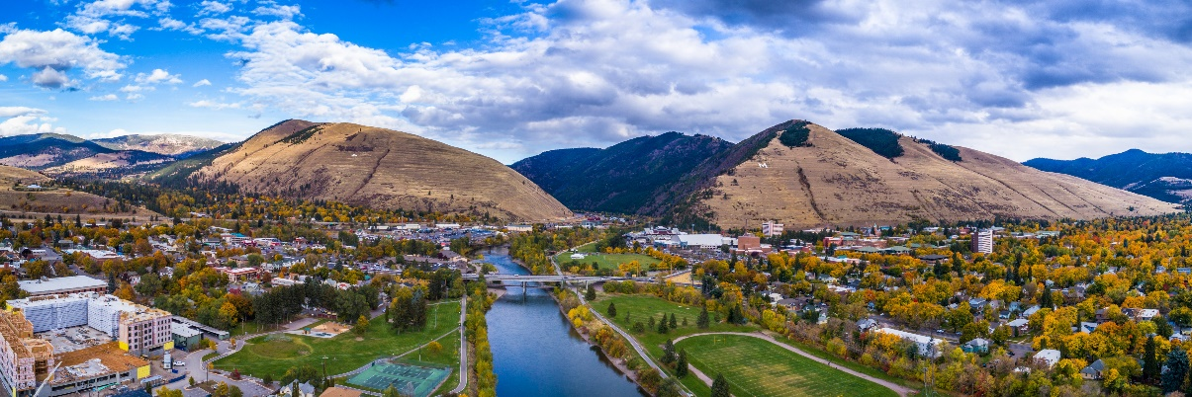
Murine rodents
Jeff Good
Emily Kopania
Sebastian Mortimer
Ana Paula Assis
Kevin Rowe (MV)
Carl Hutter (LSU)
Jake Esselstyn (LSU)
 | Rapid speciation
 | 210 targeted exomes Skull shape measurements Sperm morphology
 | Molecular evolution of radiations Link genotype to phenotype

Slide 48

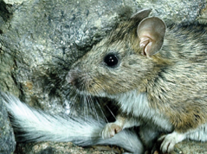
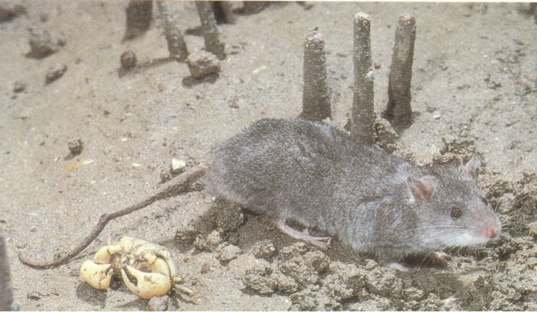
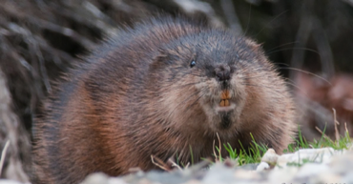
Murine Rodents
Photos: Kevin Rowe
>600 species in ~15 million years
12% of mammal species

Slide 49
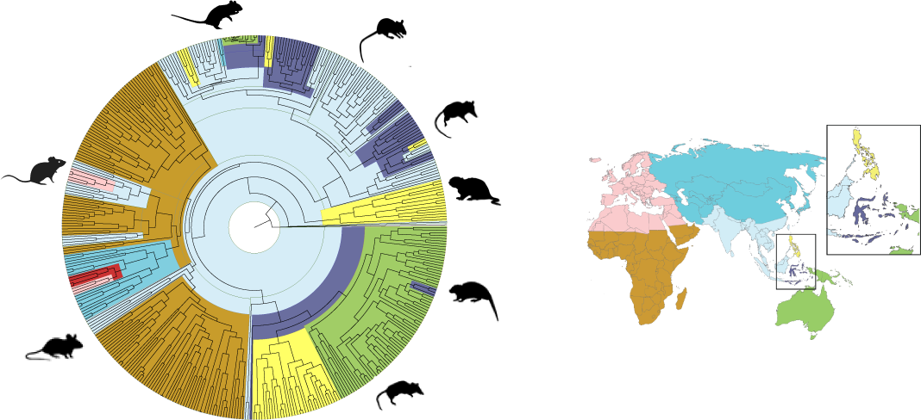
Island colonizations facilitate replicate radiations in murine rodents

Slide 50
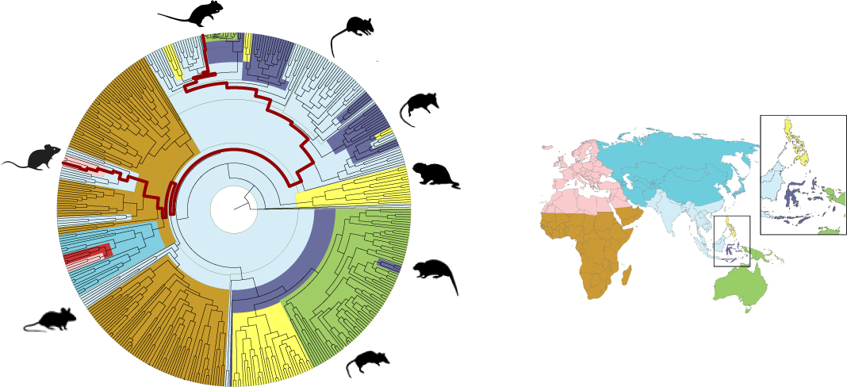
Much of murine diversity is unsampled

Slide 51
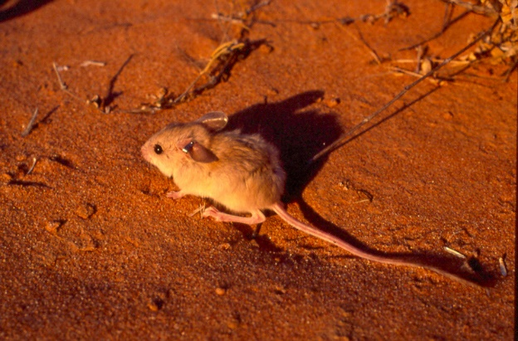
Are there correlations between rate of DNA substitution and … habitat transition?
Transition to arid habitat

Slide 52
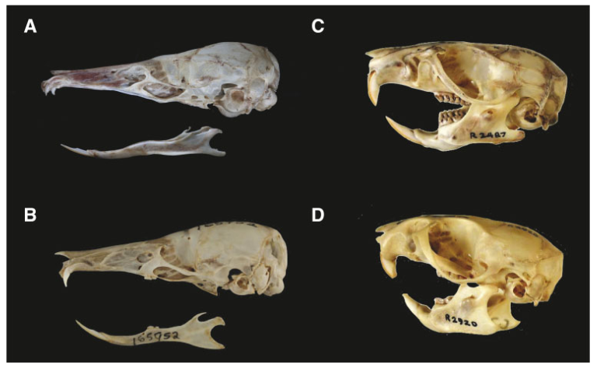
Are there correlations between rate of DNA substitution and … skull shape?
Transition to arid habitat
Skull shape

Slide 53
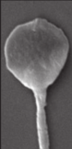



Are there correlations between rate of DNA substitution and … sperm morphology?
Transition to arid habitat
Sperm morphology
Skull shape

Slide 54




Initial results show higher proportion of positively selected sites in lineages with shifts in diet
Roycroft et al. 2021

Slide 55

Exome assembly of murine rodents
Targeted exome capture of 210 species
Step 1: Sequencing and assembly
+
de novo assembly of targeted regions
Sebastian Mortimer

Slide 56

Exome assembly of murine rodents
Targeted exome capture of 210 species
Step 1: Sequencing and assembly
+
de novo assembly of targeted regions
Sebastian Mortimer
Step 2: Annotation
and alignment
30 million assembled scaffolds
partitioned into 12,000 transcripts
Carl Hutter

Slide 57
Exome assembly of murine rodents
Targeted exome capture of 210 species
Step 1: Sequencing and assembly
+
de novo assembly of targeted regions
Sebastian Mortimer
Step 2: Annotation
and alignment
30 million assembled scaffolds
partitioned into 12,000 transcripts
Carl Hutter
Step 3: Phylogeny
Reconstruct the evolutionary history of murine rodents

Slide 58

Murine phylogeny from 188 species
12,000 gene trees used to infer species relationships

Slide 59


Murine phylogeny from 188 species recovers geographic groupings

Slide 60
How do substitution rates vary across lineages?
Do lineages descending from colonization experience faster rates?
Do genes relating to certain phenotypes experience faster rates?

Slide 61
How do substitution rates vary across lineages?
Do lineages descending from colonization experience faster rates?
Do genes relating to certain phenotypes experience faster rates?
Phylogenetic discordance poses a problem for inferring rates of molecular evolution

Slide 62


Phylogenies from the same set of organisms can disagree with each other
A phylogeny from a gene may be different from the species level phylogeny
A phylogeny from a gene may be different from the phylogeny of another gene
Species tree
Gene tree

Slide 63
Phylogenies from the same set of organisms can disagree with each other
A phylogeny from a gene may be different from the species level phylogeny
A phylogeny from a gene may be different from the phylogeny of another gene
Species tree
Gene tree
Gene tree 1
Gene tree 2

Slide 64
Phylogenies from the same set of organisms can disagree with each other
Gene tree error
Unsorted ancestral variation (ILS)
Hybridization and gene flow (Introgression)
Gene duplication and loss
Species tree
Gene tree
Gene tree 1
Gene tree 2

Slide 65


Mapping traits or variation onto a species tree from discordant loci can cause incorrect inferences
Species tree
Gene tree
Adapted from Mendes & Hahn 2016

Slide 66

Mapping traits or variation onto a species tree from discordant loci can cause incorrect inferences
Species tree
Gene tree
1 mutation on branch (B,C)
Adapted from Mendes & Hahn 2016

Slide 67

Mapping traits or variation onto a species tree from discordant loci can cause incorrect inferences
Species tree
Gene tree
1 mutation on branch (B,C)
Adapted from Mendes & Hahn 2016

Slide 68
Mapping traits or variation onto a species tree from discordant loci can cause incorrect inferences
Species tree
Gene tree
1 mutation on branch (A,B,C)
1 mutation on branch (A)
1 mutation on branch (B,C)
Adapted from Mendes & Hahn 2016

Slide 69

Discordance causes spurious inferences of selection
Thomas et al. in prep
16,000 genes from 7 rodent whole genomes
Species tree

Slide 70
Discordance causes spurious inferences of selection
Thomas et al. in prep
16,000 genes from 7 rodent whole genomes
Species tree
(false negatives when using species tree)
(false positives when using species tree)

Slide 71
Phylogenetic discordance in rodent exomes

Slide 72

Phylogenetic discordance in rodent exomes

Slide 73


Gene concordance factors (gCF) show extensive discordance among rodent exomes
$$gCF=\frac{Number of gene trees with branch}{Total number of gene trees}$$

Slide 74

Introgression is limited to only a few murine lineages

Slide 75


How to infer rates while accounting for discordance?
For gene-based inferences use gene trees
Species tree
Gene trees

Slide 76
How to infer rates while accounting for discordance?
For gene-based inferences use gene trees
For lineage-based inferences use only gene trees that match the species tree?
Species tree
Gene trees

Slide 77

How to infer rates while accounting for discordance?
For gene-based inferences use gene trees
For lineage-based inferences use only gene trees that match the species tree?
Species tree
Gene trees

Slide 78
How to infer rates while accounting for discordance?
For gene-based inferences use gene trees
For lineage-based inferences use only gene trees that match the species tree?
Species tree
Gene trees

Slide 79
How to infer rates while accounting for discordance?
For gene-based inferences use gene trees
For lineage-based inferences use only gene trees that match the species tree?
For lineage-based inferences, count substitutions by branch
Species tree
Gene trees

Slide 80

How to infer rates while accounting for discordance?
For gene-based inferences use gene trees
For lineage-based inferences use only gene trees that match the species tree?
For lineage-based inferences, count substitutions by branch
Species tree
Gene trees

Slide 81

How to infer rates while accounting for discordance?
For gene-based inferences use gene trees
For lineage-based inferences use only gene trees that match the species tree?
For lineage-based inferences, count substitutions by branch
Species tree
Gene trees

Slide 82

How to infer rates while accounting for discordance?
For gene-based inferences use gene trees
For lineage-based inferences use only gene trees that match the species tree?
For lineage-based inferences, count substitutions by branch
Species tree
Gene trees

Slide 83
How to infer rates while accounting for discordance?
For gene-based inferences use gene trees
For lineage-based inferences use only gene trees that match the species tree?
For lineage-based inferences, count substitutions by branch
Species tree
Gene trees

Slide 84

How to infer rates while accounting for discordance?
Lower rates with gene trees
Species tree
Gene trees

Slide 85
How do substitution rates vary across lineages?
Do lineages descending from colonization experience faster rates?
Do genes relating to certain phenotypes experience faster rates?

Slide 86




Little variation in average substitution rates across the rodent phylogeny

Slide 87
Do bursts of selection correspond to colonization?

Slide 88

Do bursts of selection correspond to colonization?

Slide 89

No difference in genome-wide rates of selection based on colonization

Slide 90
Are other traits correlated with molecular evolution?
Skull shape
Aridity

Slide 91
Are other traits correlated with molecular evolution?
1,073 genes with phenotypes related to facial anatomy
(http://www.informatics.jax.org/)
Skull shape
107 genes with phenotypes related to aridity
(Compiled in Giorello et al. 2018)
Aridity

Slide 92

About 40% of rodent genes show evidence of positive selection at some point in their history

Slide 93
A higher proportion of genes related to facial shape and aridity have evidence for selection
*

Slide 94

2D measurements of skulls to reconstruct ancestral skull shapes

Slide 95
2D measurements of skulls to reconstruct ancestral skull shapes

Slide 96

Significant convergent shifts in skull shape associated with worm-suckers

Slide 97
Significant convergent shifts in skull shape associated with worm-suckers

Slide 98
Carnivorous lineages are skewed on PC1 and experiences high rates of positive selection
Roycroft et al. 2021

Slide 99
Sperm evolution across Murinae
Sperm micrographs: Bill Breed

Slide 100


Sperm evolution across Murinae
Emily Kopania
Bill Breed
Sperm micrographs: Bill Breed

Slide 101

Rates of evolution in Mus are accelerated in certain tissues
Dean et al. 2009

Slide 102

Rates of evolution in Mus are accelerated in certain tissues and in late stages of spermatogenesis
Dean et al. 2009
Kopania et al. in press

Slide 103
Rates of evolution in Mus are accelerated in certain tissues and in late stages of spermatogenesis
Dean et al. 2009
Kopania et al. in press

Slide 104


Sperm evolution across Murinae
~100 species with
male reproductive phenotypes and
sequence data
Sperm micrographs: Bill Breed

Slide 105
Sperm evolution across Murinae
Are male reproductive genes that are rapidly evolving in Mus also evolving rapidly across the murine phylogeny?
~100 species with
male reproductive phenotypes and
sequence data
Sperm micrographs: Bill Breed

Slide 106

Genome-wide average: 0.18
* Indicates significant difference from genome-wide average
Wilcoxon rank-sum test FDR-corrected P < 0.05
Adapted from Dean et al. 2009

Slide 107
Genome-wide average: 0.18
Dean et al. 2009
* Indicates significant difference from genome-wide average
Wilcoxon rank-sum test FDR-corrected P < 0.05
Adapted from Dean et al. 2009

Slide 108
Genome-wide average: 0.18
* Indicates significant difference from genome-wide average
Wilcoxon rank-sum test FDR-corrected P < 0.05
Adapted from Dean et al. 2009

Slide 109

Adapted from Dean et al. 2009

Slide 110



Slide 111
More accurate rate estimates
No genome-wide bursts of molecular evolution coinciding with colonization events
Some evidence for increased positive selection on genes related to skull shape
Molecular evolution mirrors development of sperm across the rodent phylogeny

Slide 112

Comparative genomics of turtles!

Slide 113


Testudines
 | Order
 | 348 species
 | 220 million years

Slide 114

Testudines
 | Order
 | 348 species
 | 220 million years
 | No RNA-seq data

Slide 115





Jeff Good
Emily Kopania
Emily Moore
Sebastian Mortimer
Tim Thurman
Fernando Rodriguez
Kate Wilsterman
Cynthia Ulbing
Mafalda Ferreira
Nathanael Herrera
Stephen Richards
Matt Hahn
Elias Dohmen
Yiyuan Li
Erich Bornberg-Bauer
Rob Waterhouse
Ariel Chipman
Jessica Garb
Monica Poelchau
Kristen Panfilio
Acknowledgements
Carl Hutter
Jake Esselstyn
Kevin Rowe
Mia Levine
Michael Lampson
Jon Hughes
Jeremey Searle
Brad Shaffer
Pat Minx
Ladeana Hillier
Peter Scott
Andrew Shedlock
Tim Sackton
Nathan Weeks
Danielle Khost
Adam Freedman
Clara Boothby

Slide 116

Thanks
http://dailymammal.com/murines-five-ways/

